Slide 1
FIN 360: Corporate Finance
Topic 7: Risk and Rates of Return I (and Statistics Review)
Larry Schrenk, Instructor

Slide 2
Outline
Probability Measures
The Histogram
Linear Regression
What is Risk?
Three Stage Analysis of Risk
Two Classes of Risk

Slide 3
1. Probability Measures

Slide 4
Probability Measures
Measures of Central Tendency
  Mean, Median, Mode
Measures of Dispersion
  Standard Deviation, Variance
Higher Moments
  Skewness, Kurtosis
Measures of Dependence
  Covariance, Correlation

Slide 5
Measures of Central Tendency
What is a Measure of Central Tendency?

Slide 6
Mean (Average)
Equal Weighted Average (μ, )
Applications
Calculation:

Slide 7
Mean (Average)
Calculating the Equally Weighted Average

Slide 8
Mean (Average)
(Unequally) Weighted Average
Applications
Calculation:

Slide 9
Mean (Average)
Calculating the Unequally Weighted Average

Slide 10
Mode
The mode is the most frequent number.
  2, 3, 4, 2, 5, 7, 8, 2, 3
  The mode is 2

Slide 11
Median
The median is the ‘middle’ number.
  2, 3, 4, 2, 5, 7, 8, 2, 3
  Ordered: 2, 2, 2, 3, 3, 4, 5, 7, 8
  The median is 3.

Slide 12
Measures of Dispersion
What is a Measure of Dispersion?

Slide 13
Variance
Variance (σ²)
Applications
Calculation:
  Sample versus Population

Slide 14
Variance
Calculating Variance

Slide 15
Standard Deviation
Standard Deviation (σ)

Slide 16
Standard Deviation
Calculating Standard Deviation

Slide 17
Calculators
On the exams you may use the statistical functions on your calculator (or the formulae) to calculate these probability measures.

Slide 18
Higher Moments
What is a Higher Moment?

Slide 19
Skewness
Normal Distribution has a skewness of 0, i.e., it is symmetric

Slide 20
Kurtosis
Normal Distribution has a kurtosis of 3

Slide 21
Measures of Dependence
What is a Measure of Dependence?

Slide 22
Covariance
Covariance (σ_{X,Y})
Applications
Calculation:
  Variance versus Covariance

Slide 23
Covariance
Calculating Covariance
  Note: Unit Dependence

Slide 24
Correlation
Correlation (ρ_{X,Y})
Applications
Calculation:
  Range: -1 < ρ <1

Slide 25
Correlation
Calculating Correlation

Slide 26
T-P-S
What is the correlation?
  0
  0.5
  1
  None of the above

Slide 27
2. The Histogram

Slide 28
The Histogram
Ordered, column graph of data
25, 73, 59, 32, 65, 71, 13, 2, 93, 32, 74, 42, 95, 61, 33, 28, 28, 56, 22, 43, 48, 67, 69, 82, 13, 48, 46, 19, 70, 8, 27, 39, 71, 80, 32, 79, 77, 41, 99, 82, 57, 22, 84, 50, 93, 6, 26, 20, 86, 79
Histogram

Slide 29
The Histogram
Construction
  Order the numbers
  Groups into ranges (bins)
  Plot on a column graph
Excel Function Available

Slide 30
The Histogram
EXAMPLE
  Set:
    2, 4, 5, 2, 3, 4, 5, 6, 7, 8, 6, 8, 6, 7, 5, 3, 4, 5, 7, 8
  Order the numbers
    2, 2, 3, 3, 4, 4, 4, 5, 5, 5, 5, 6, 6, 6, 7, 7, 7, 8, 8, 8
  Groups into ranges (bins)

Slide 31
The Histogram
  Plot on a column graph

Slide 32
The Histogram
Histogram represents sample.
Estimate the population with closest, common continuous distribution.
‘Goodness-of-Fit’ software.

Slide 33
3. Linear Regression

Slide 34
The Method of Linear Regression
Best Linear Fit
  BLUE
  ‘Least Squares’ Criterion
  Dependent versus Independent Variable
Example: Education versus Income
Excel Function Available
  Covered in a later topic

Slide 35
The Method of Linear Regression
Data

Slide 36
The Method of Linear Regression
Scatter Plot of Data

Slide 37
The Method of Linear Regression
Fitting the Best Line

Slide 38
Optimization
Minimize the sum of squared differences from the mean

Slide 39
The Method of Linear Regression
Results
  Intercept = 3.3
  Slope = 0.98
  R² = 0.32
  Standard Error = 3.5
Interpretation

Slide 40
Two Applications of Statistical Techniques to Financial Data
Are Assets Normally Distributed?
  Skewness
  Leptokurtic Tails
  Value-at-Risk
Regression and β
  Getting β from a Linear Regression
  Capital Asset Pricing Model (CAPM)

Slide 41
Anscombe’s Quartet

Slide 42
Anscombe’s Quartet

Slide 43
Anscombe’s Quartet

Slide 44
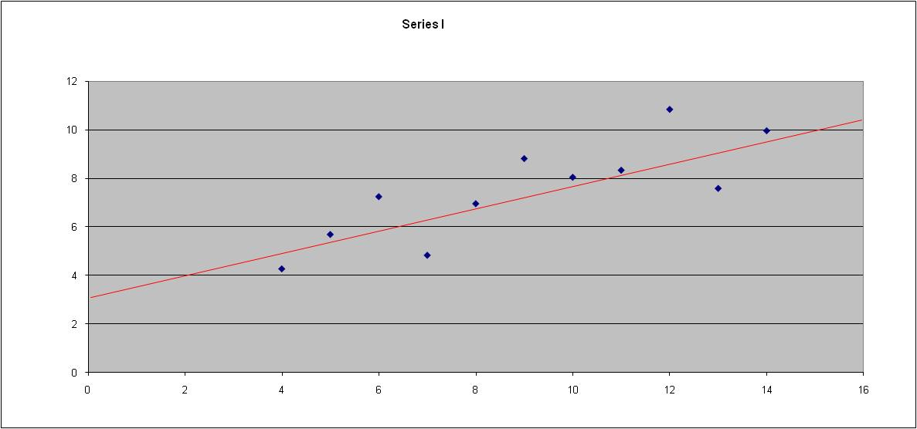
Anscombe’s Quartet I

Slide 45
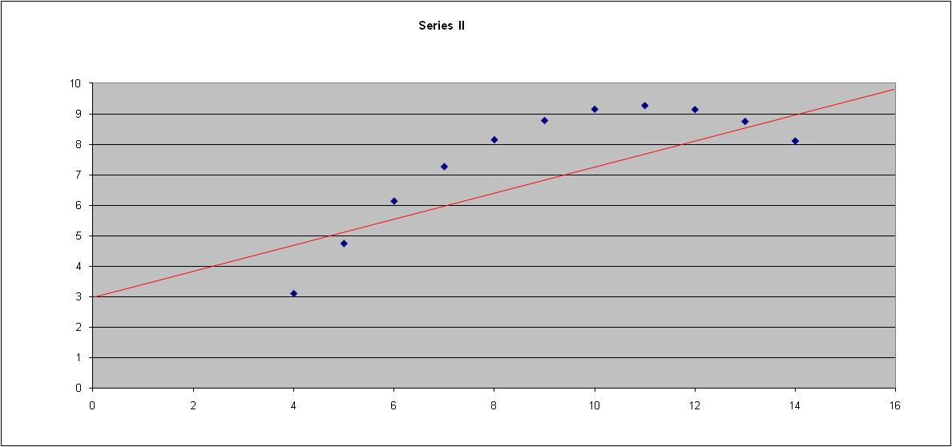
Anscombe’s Quartet II

Slide 46
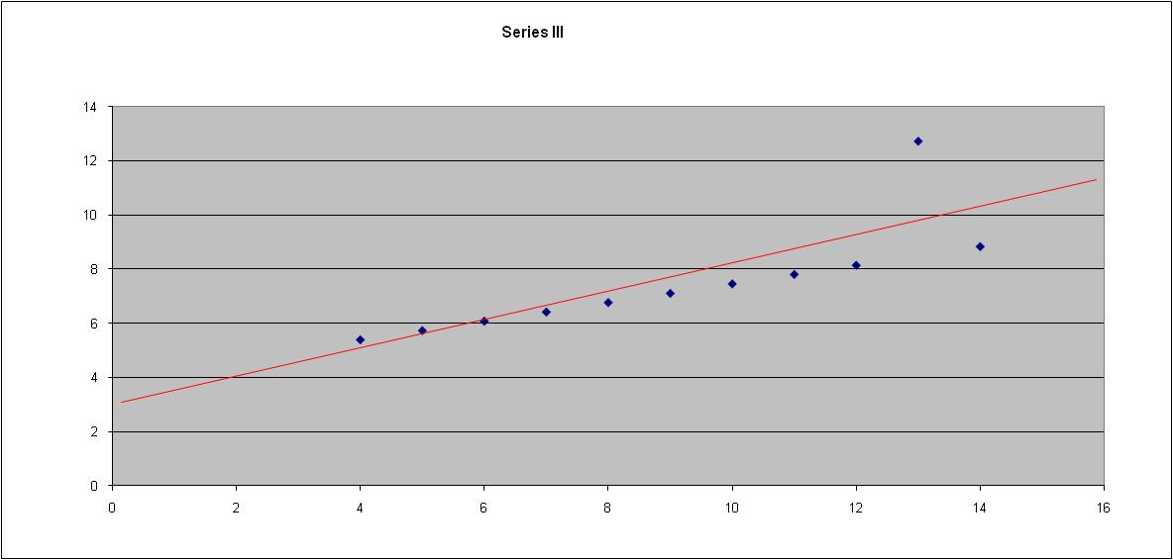
Anscombe’s Quartet III

Slide 47
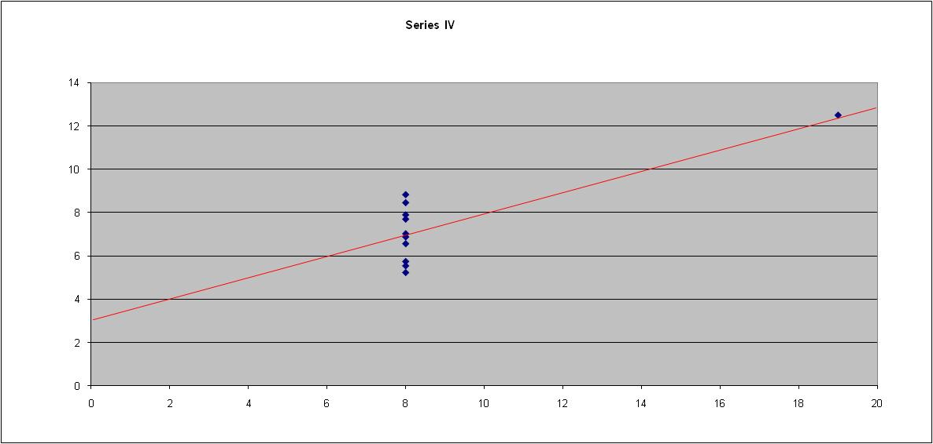
Anscombe’s Quartet IV

Slide 48
Moral of the Story
Always Plot Your
Data First

Slide 49
4. What is Risk?

Slide 50
Risk and Uncertainty
In every facet of our lives we face something unknown.
Complete lack of knowledge is ‘ignorance’.
Some idea of its probability is ‘risk’.

Slide 51
Risk and Ignorance
Ignorance
  If you ask me to put my hand in a box and pull out a mystery object, this is Ignorance, since I have no idea what the box may contain.
Risk
  If you ask me to put my hand in a box containing an equal number of red and blue balls and ask me to pull out a ball, this is risk
  I may not know which color I will get, but I know that the probability is 50-50 for each color.
  Risk ⇒ Rational Expectation

Slide 52
The Quantification of Risk
Past Data
  Historical prices
  Forward-looking data
  Assumption: Future behaves like past
Statistical Distribution
  Distribution,
  Mean,
  Variance, etc.

Slide 53
Quantification Example
Historical Data:
  Normally distributed, μ = 10%, σ = 20%
Forecast
  E[r] = 10%
  Confidence intervals, standard error, etc.

Slide 54
‘Expected’ versus ‘Realized’
Forecast is only expectation
  E[ ] = Expectations Operator
Contrast: realized/actual value
Quantify the forecast error
  confidence intervals
  Note: In cases of ignorance, I could not even form such an expectation.

Slide 55
What is Risk
Risk: The possibility the realized value will differ from the expected value.
  Risk free asset ⇒ realized = expected
Greater risk ⇒ greater likelihood that the realized value will differ from the expected value.

Slide 56
Downside versus Upside Risk
Realized value higher or lower than expected
Upside Risk: Better possibility
  Actual stock return higher than expected
Downside Risk: Worse possibility
  Actual stock return lower than expected
  NOTE: Alternate definition–risk as only downside risk

Slide 57
5. Three Step Analysis of Risk

Slide 58
Three Step Analysis of Risk
  Identify Risk
  Measure Risk
  Price Risk

Slide 59
Step 1–Identify Risk
Identify risk exposure
  Profit of a firm
    Input price changes
    Labor problems
    Shifts in consumer tastes
  Bond
    Interest rate risk
    Default risk
  Foreign investment
    Exchange rate risk
Result: Asset exposed to risks X, Y, etc.

Slide 60
Step 2–Measure Risk
Measure/quantify the risk
  ‘Cardinal Ordering’
  Use of statistics
  Historical volatility/standard deviation
  Correct measure of specific risks
Result: Asset exposure to risk X is 8 units.

Slide 61
Step 3–Price Risk
Price the Risk
  Compensation for specific level of risk.
  Return, not dollar, compensation
  Higher risk ⇒ higher return
Result: Asset exposure to 8 units of X risk yields a risk premium of 10%.
  Recall: Risk premium = E[r] – r_{f}

Slide 62
Over-Simplified Example
Risk Exposure: Return Volatility
Risk Measure: Standard Deviation
Risk Price: 1% risk premium per 2% Standard Deviation

Slide 63
Which is Riskier?

Slide 64
Which is Riskier? (cont’d)
Expected Return
  Investment A = 10%
  Investment B = 10%
Which is riskier?
  Which is more likely to differ from the expected value?
  Which is more likely to actually have a return of about 10%?

Slide 65
Selecting Stocks
Which stock would you choose from each pair?▪
 | R | σ
A | 10% | 20%
B | 12% | 15%
 | R | σ
E | 10% | 15%
F | 12% | 15%
 | R | σ
C | 11% | 12%
D | 10% | 15%
 | R | σ
G | 10% | 12%
H | 12% | 15%
?

Slide 66
Dominance
Basic Assumptions–Risk-Return Trade-Off
  Like Return
  Dislike Risk
Dominance ⇒ Universal Choice
  B dominates A
  C dominates D
  F dominates E
  No dominance between G and H
Dominance versus Taste Preference

Slide 67
Dominance Graph
Which stocks are dominated?▪
A
Return
B
C
D
E
F
σ

Slide 68
Risk Analysis: Recap
Risk Exposure: Return Volatility
Risk Measure: Standard Deviation
Risk Price: ???

Slide 69
6. Two Classes of Risk

Slide 70
Two Classes of Risk
Thousands of possible risks
Two basic classes:
  Non-Market Risk
  Market Risk
  Note: We will discuss the appropriateness of these names shortly.

Slide 71
Non-Market Risk
Has an effect on…
  One firm,
  Selection of firms, or
  Maybe even an industry, but
  Not the market as a whole.
Examples:
  A Labor Problem
  Change in an Input Price
  Litigation
  Etc.

Slide 72
Market Risk
Has an effect on…
  Market as a whole
  Economy-wide
Examples:
  Interest Rate Changes
  A Change in the Corporate Tax Rate
  Inflation
  Etc.

Slide 73
Alternate Names
Non-Market risk is also called:
  Microeconomic Risk
  Idiosyncratic Risk
  Firm/Company Specific Risk
  Diversifiable Risk
  Non-Systematic Risk
Market risk is also called:
  Macroeconomic Risk
  Non-Diversifiable Risk
  Systematic Risk

Slide 74
Market–Non-Market Continuum
Where do the following risks fall?▪
  Warehouse fire
  Change in Social Security tax
  Strike in auto industry
  Bug found in Windows
  Change in foreign exchange rate
  Inflation expectations
  Swine flu ▪

Slide 75
T-P-S
Inflation, recession, and high interest rates are economic events that are best characterized as being
systematic risk factors that can be diversified away.
company-specific risk factors that can be diversified away.
among the factors that are responsible for market risk.
risks that are beyond the control of investors and thus should not be considered by security analysts or portfolio managers.
irrelevant except to governmental authorities like the Federal Reserve.

