Slide 1
FIN 377: Investments
Week 4: Organization and Functioning of Securities Markets
Larry Schrenk, Instructor

Slide 2
Overview
Review and Questions
Current Events
Practice Problems
Excel Skills: Random Numbers

Slide 3
1. Review and Questions

Slide 4
Key Ideas (Slides 2.1-46)
What is a Market
Market Efficiency
Types of Markets
Money vs. Capital
Primary vs. Secondary
Markets for Different Securities
Market Orders

Slide 5
3.1.1 Characteristics of a Good Market
Timely and accurate information
Liquidity
Marketability
Price continuity
Depth
Low transaction costs
Cost of reaching the market
Brokerage costs
Cost of transferring the asset
Prices rapidly adjust to new information

Slide 6
Informationally Efficient Market
Large number of competing profit-maximizing participants
New information comes in a random fashion
Profit-maximizing investors cause security prices to adjust rapidly to reflect the effect of new information

Slide 7
Weak-Form EMH
Current prices reflect all security-market historical information
Including the historical sequence of prices, rates of return, trading volume data, and other market-generated information
Past rates of return and other market data should have no relationship with future rates of return
In short, prices reflect all market information

Slide 8
Semistrong-Form EMH
Current security prices reflect all public information
Market and non-market information
Public information after it is should not lead to above-average, risk-adjusted profits
In short, prices reflect all public information

Slide 9
Strong-Form EMH
Stock prices reflect all public and private information
No investors consistently derive above-average, risk-adjusted rates of return
In short, prices reflect all public and private information

Slide 10
Overview
Money markets vs. capital markets
Types of money market instruments
Capital market securities:
Bonds
Equity
Derivatives

Slide 11
The Bond Market
Government Bonds
Treasury Notes and Bonds, TIPS
Federal Agency Debt
Municipal Bonds (Muni’s)
Corporate Bonds
International Bonds
Mortgages

Slide 12
Equity Securities
Common stock: Ownership
Residual claim
Limited liability
Preferred stock: Perpetuity
Fixed dividends
Priority over common
Tax treatment

Slide 13
Derivatives Markets
Futures Contracts
An agreement made today regarding the delivery of an asset (or in some cases, its cash value) at a specified delivery or maturity date for an agreed-upon price, called the futures price, to be paid at contract maturity
Long position: Take delivery at maturity
Short position: Make delivery at maturity

Slide 14
Derivatives Markets
Options
Call: Right to buy underlying asset at the strike or exercise price
Value of calls decreases as strike price increases
Put: Right to sell underlying asset at the strike or exercise price
Value of puts increase with strike price
Value of both calls and puts increases with time until expiration

Slide 15
3.5.4 Margin Transactions
Buying on margin
Borrow part of the cost, leveraging transaction
Stock is collateral
Maximum that can be borrowed
Margin requirement
Proportion of transaction value paid in cash
Varied over time from 40% to 100%

Slide 16
3.5.5 Short Sales
Profit on price decline
Sale of stock not owed
Stock is borrowed through the broker
Later replaced by buying shares
Technical points affecting short sales:
Short seller must pay any dividends due
Short sellers must post same margin

Slide 17
2. Current Events Secular Stagnation

Slide 18
Definition
Macro Theory
Secular Stagnation = Negligible or no economic growth in a market-based economy
Secular = long-term (vs. cyclical or short-term)

Slide 19
Basics
Fundamental economic change
Private-sector investment demand falls far short of private-sector saving
Interest rates don’t fall far enough to bring them into balance
Alvin Hansen, 1930s
Larry Summers

Slide 20
Great Depression and WWII
Secular stagnation in Great Depression
World War II and the postwar spending boom lifted the U.S. economy from the stagnation of the 1930

Slide 21
Now: Private-Sector Investment ↓
Economy’s structure changed
Computing power cheaper
Google and Facebook need less capital
Malls replaced by e-commerce
Small urban apartments vs. suburban houses
Cars and appliances replaced less often

Slide 22
Now: Private-Sector Savings ↑
Fewer children/workers
More inequality
Longer retirement periods
Increased uncertainty

Slide 23
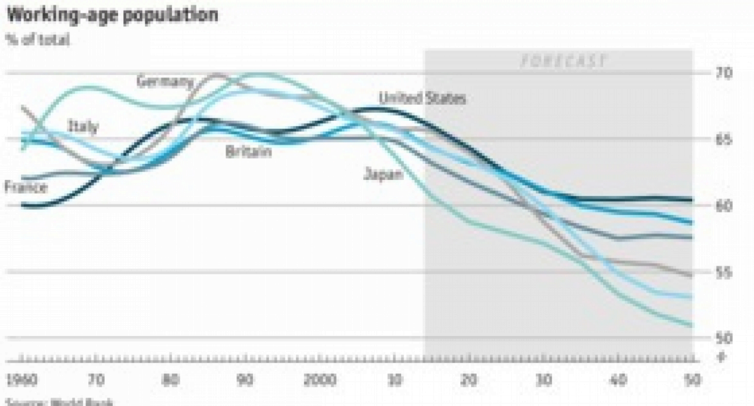
Demographics

Slide 24
Implications
Extremely low interest rates
Weak demand
Low growth
Inflation down (or deflation)
Bidding price of existing capital assets
Central banks can’t stimulate economy

Slide 25
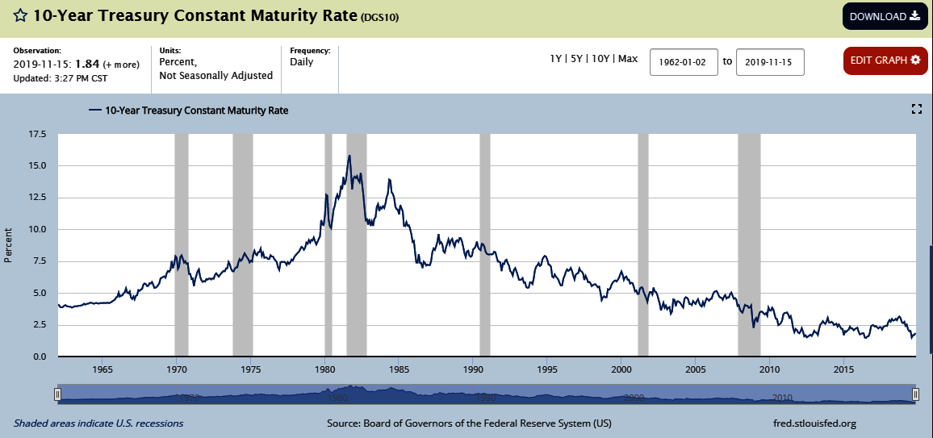
Interest Rates

Slide 26
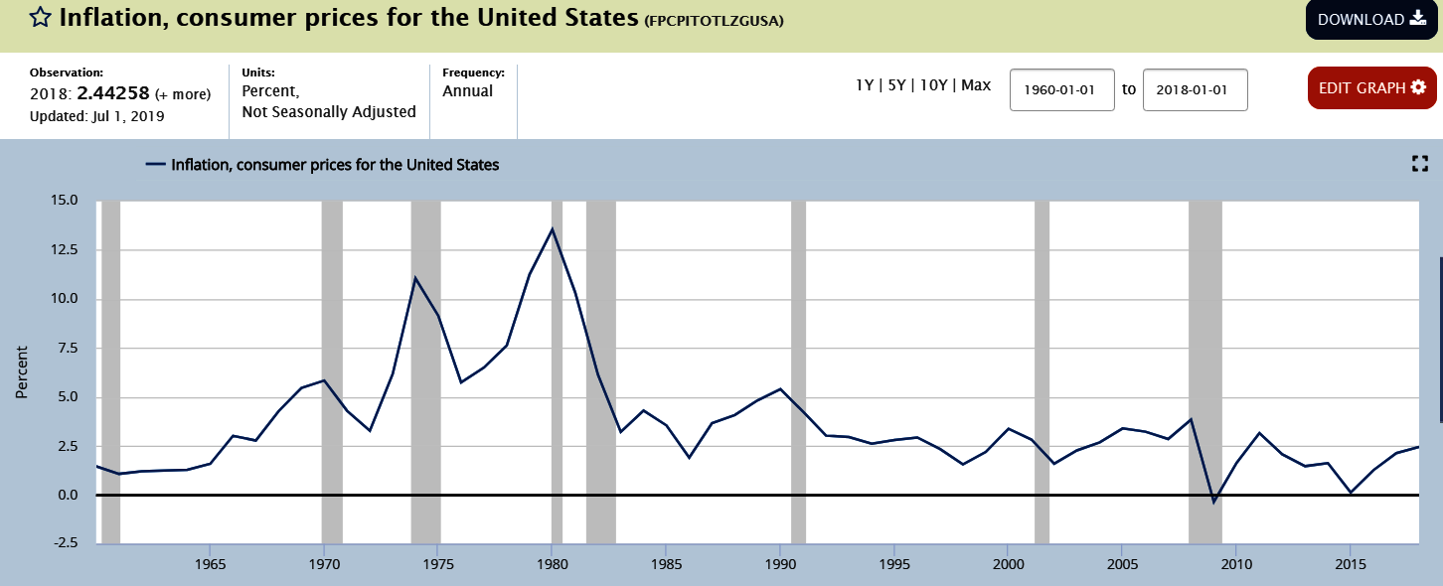
Inflation

Slide 27
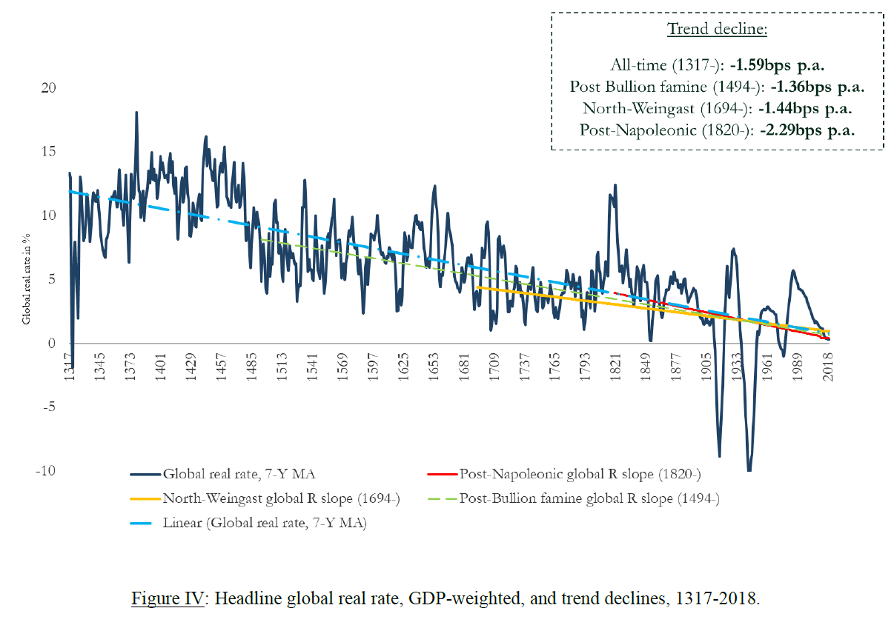
Trend 1317-2018

Slide 28
Bibliography
Larry Summers. “The Age of Secular Stagnation: What It Is and What to Do about It.” Foreign Affairs (February 15, 2016)
“What it Means to Suffer from Secular Stagnation.” The Economist (March 8, 2015)
Coen Teulings and Richard Baldwin, eds. Secular Stagnation: Facts, Causes and Cures. VOX, 2014 (link)
Schmelzing, Paul. “Eight Centuries of Global Real Interest Rates, R-G, and the ‘Suprasecular’ Decline, 1311-2018." Working Paper, 2020.

Slide 29
3. Practice Problems

Slide 30
Practice Problem 1
You invest $20,000 in a stock selling for $50 with maximum leverage and a 50% initial margin. What is your return if the stock increases to $60? (Ignore interest and commissions.)

Slide 31
Practice Problem 2
You buy 100 shares on 60% margin when the stock is selling at $30. The interest rate is 8% annual, and commissions on the purchase and sale are 2%. What is the return a year later, if you receive a $0.40 dividend and sell the stock for $35?

Slide 32
Practice Problem 3
You short 100 shares selling at $70. Your margin requirement is 65% (6% interest) and the commission $160. There is a $3.00 dividend. You buy 100 shares at $60 to close out your position and there is a $150 commission. What is your return?

Slide 33
Practice Problem 4
The stock of the Wolf Co. is selling for $45 a share. You put in a limit buy order at $40 for one month. During the month the stock price declines to $38, then jumps to $50. Ignoring commissions, what would have been your rate of return on this investment? What would be your rate of return if you had put in a market order? What if your limit buy order was at $35?

Slide 34
4. Excel Skills

Slide 35
Random Numbers
RAND
NORMDIST
NORMSDIST

