Slide 1
FIN 377: Investments
Week 7: Introduction to Portfolio Management II
Larry Schrenk, Instructor

Slide 2
Overview
Review and Questions
Current Events: Common Biases
Practice Problems
Excel Skills: Averages

Slide 3
1. Review and Questions

Slide 4
Steps to CAPM: 1. Assumptions
Greedy
Mean
Risk Averse
Variance/Standard Deviation

Slide 5
Steps to CAPM: 2. Individual Securities
Only one security
Risk vs. return
Means/variance efficiency
Dominance vs risk preference

Slide 6
Steps to CAPM: 3. Risky Assets
Portfolios
Investment opportunity set
Efficient Frontier
Beta

Slide 7
Steps to CAPM: 4. Risk-Free Asset
Portfolios
Investment opportunity set
Capital market line (CML)

Slide 8
2. Current Events: Common Biases Test

Slide 9
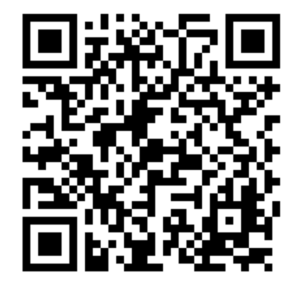
Location
https://winona.az1.qualtrics.com/jfe/form/SV_cuomPAqXwyXQc61

Slide 10
Problem 1
Write down your estimate of the percentage of words in the English language that begin with the letter ‘‘a.’’

Slide 11
Problem 2
Write down your estimate of the percentage of words in the English language that have the letter ‘‘a’’ as their third letter.

Slide 12
Problem 3
Linda is thirty-one years old, single, outspoken, and very smart. She majored in philosophy. As a student, she was deeply concerned with issues of discrimination and social justice, and she participated in antinuclear demonstrations.
List the letters of following descriptions in order from greater to lesser likelihood:
A. Linda is a bank teller and member of the League of Women Voters.
B. Linda is a bank teller.
C. Linda is a bank teller who is active in the feminist movement and member of the League of Women Voters.
D. Linda is a bank teller who is active in the feminist movement.

Slide 13
Problem 4
Part 1: Take the last three digits of your phone number. Add the number one to the front of the string and write it down.
Part 2: On the next line, write down your best estimate of the actual year in which the Taj Mahal was completed (do this even if you can only make a wild guess).

Slide 14
3. Practice Problems

Slide 15
4. Excel Skills

Slide 16
Averages
AVERAGE
MEDIAN
MODE
GEOMEAN

