Slide 1
FIN 377: Investments
Week 8: Asset Pricing Models I
Larry Schrenk, Instructor

Slide 2
Overview
Review and Questions
Current Events: Behavioral Finance
Practice Problems
Excel Skills: Probability Functions

Slide 3
1. Review and Questions

Slide 4
Key Ideas (Slides 5.1-43)
Capital Asset Pricing Model (CAPM)
Security Market Line (SML)
CAPM Equation
Empirical Tests of the CAPM
Market Portfolio: Theory vs. Practice

Slide 5
7.1 The Capital Asset Pricing Model
CAPM evaluates risk-return trade-off for both diversified portfolios and individual securities
Redefines risk from total volatility to just market risk
Beta calculates level of market risk

Slide 6
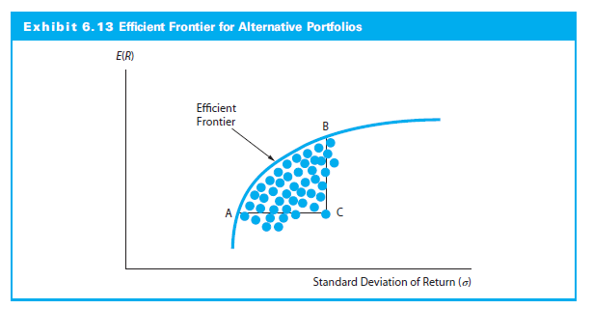
7.1 The Capital Market Line (CML)
CML
RFR

Slide 7
7.1.1 A Conceptual Development of the CAPM
Risk-free asset makes capital market line (CML) the relevant frontier
CML doesn’t measure expected return on individual assets
For individual asset (or any portfolio), the relevant risk measure is the asset’s covariance with the market portfolio
σ_{i} ρ_{iM}, where ρ_{iM} is the correlation coefficient between the asset and the market

Slide 8
7.1.1 A Conceptual Development of the CAPM
Inserting σ_{i} ρ_{iM} into the CML:
If β_{i}=(σ_{i} ρ_{iM}) / σ_{M} is the asset beta, CAPM equation:

Slide 9
CAPM Equation
CAPM equation:

Slide 10
CAPM Equation (Reformulation)

Slide 11
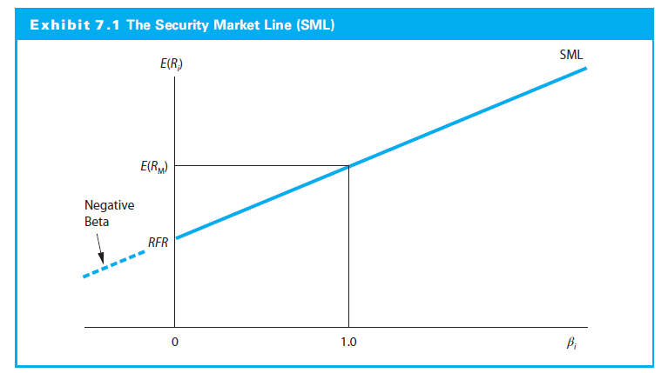
7.1.2 The Security Market Line

Slide 12
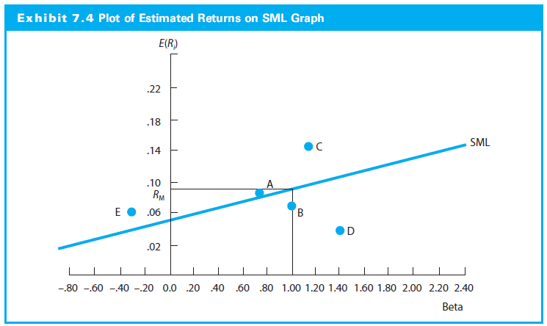
7.1.2 The Security Market Line

Slide 13
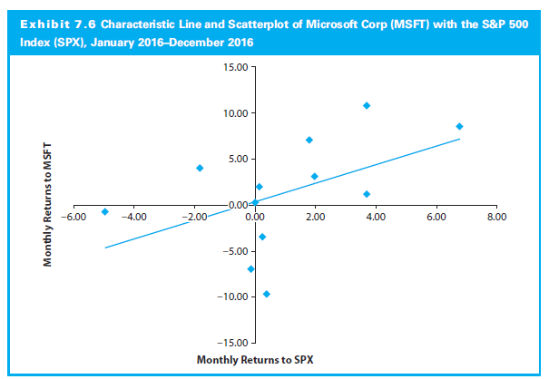
7.1.2 The Security Market Line

Slide 14
7.2.1 Stability of Beta
Numerous studies concluded beta not stable for individual stocks but stable for portfolios
Larger the portfolio and the longer the period, the more stable the beta
Betas regress toward the mean
High and low beta portfolios tended to converge over time toward 1.00

Slide 15
7.2.4 Summary of Empirical Results for the CAPM
Early evidence supported the CAPM
Evidence that the intercepts higher than RFR
Consistent with a zero-beta model or
Higher borrowing rates
Beyond beta, size, P/E ratio, financial leverage, and book-to-market value ratio have explanatory power

Slide 16
7.3 The Market Portfolio: Theory versus Practice
True market portfolio should
Include all the risky assets in the world
In proportion to their market value
U.S. Index as a market proxy
Most studies use an U.S. index
U.S. stocks constitutes less than 15% of the global risky asset portfolio

Slide 17
2. Current Events Behavioral Finance

Slide 18
Behavioral Finance
Acknowledges that investors are not perfectly rational
Allows for psychological factors of behavior
Applies results from experiments on risk taking
Laboratory experiments indicate that investors are systematically biased

Slide 19
Bounded Rationality
Herbert Simon: “satisficing” versus “optimizing”
Theory of Bounded Rationality
Cognitive constraints
Information availability

Slide 20
Two Modes of Thought (Kahneman)
System 1
Fast
Instinctive
Emotional
System 2
Slower
More deliberative
More logical

Slide 21
Two Cognitive Tests
Monkey Business Illusion
Stroop Effect

Slide 22
Selected Examples
A. Framing
B. Retrievability/Availability
C. Anchoring
D. Representativeness

Slide 23
A. Framing
Choices are inconsistent across different presentations
People reach conclusions based on the 'framework' within which a situation is presented

Slide 24
Framing Example
Choice 1:
Program A: "200 people will be saved"
Program B: “There is a 1/3 probability that 600 people will be saved, and a 2/3 probability that no people will be saved“
Choice 2:
Program C: "400 people will die"
Program D: “There is a 1/3 probability that nobody will die, and a 2/3 probability that 600 people will die“
Choice 1: 72% A Choice 2: 78% D

Slide 25
B. Retrievability/Availability
Ease with which information can be found or retrieved
People assess the importance of issues by the ease with which they can be recalled
People tend to heavily weigh their judgments toward more recent information

Slide 26
Problems 2 and 3
Write down your estimate of the percentage of words in the English language that begin with the letter ‘‘a.’’
Write down your estimate of the percentage of words in the English language that have the letter ‘‘a’’ as their third letter.

Slide 27
Problems 2 and 3: Solutions
Most people estimate that there are more words beginning with ‘‘a’’ than words with ‘‘a’’ as the third letter.
In fact, 6% begin with “a”, but
9% have ‘‘a’’ as their third letter

Slide 28
Problems 2 and 3: Your Answers
Write down your estimate of the percentage of words in the English language that begin with the letter ‘‘a.’’
Average: 17.00%
Write down your estimate of the percentage of words in the English language that have the letter ‘‘a’’ as their third letter.
Average: 19.77%

Slide 29
C. Anchoring
Arbitrary value that impacts decision
Information shortcut
Quantitative anchor
Current stock price, or recent performance
Price of other stocks
Loss aversion

Slide 30
Problem 4
Part 1: Take the last three digits of your phone number. Add the number one to the front of the string and write it down.
Part 2: Write down your best estimate of the actual year in which the Taj Mahal was completed (do this even if you can only make a wild guess).

Slide 31
Problem 4: Solution
What is the relationship between the questions in Part 1 and Part 2?
What should be the correlation between the numbers given as answers?
NOTE: The Taj Mahal was completed in 1648.

Slide 32
Problem 4: Your Answers
The correlation between your answers was 0.19.
The average correlation between answers is often as high as 0.6.

Slide 33
D. Representativeness
When the similarity of objects or events confuses people's thinking regarding the probability of an outcome

Slide 34
Problem 5
Linda is thirty-one years old, single, outspoken, and very smart. She majored in philosophy. As a student, she was deeply concerned with issues of discrimination and social justice, and she participated in antinuclear demonstrations.
List the letters of following descriptions in order from greater to lesser likelihood:
A. Linda is a bank teller and member of the League of Women Voters.
B. Linda is a bank teller.
C. Linda is a bank teller who is active in the feminist movement and member of the League of Women Voters.
D. Linda is a bank teller who is active in the feminist movement.

Slide 35
Problem 5: Solution
Solution: B > A/D > C
B. Bank Teller
A. Bank Teller + Member of League
D. Bank Teller + Active Feminist
C. Bank Teller + Active Feminist + Member of League
B
A
C
D

Slide 36
Problem 5: Your Answers
Solution: B > A/D > C
B. Bank Teller
A. Bank Teller + Member of League
D. Bank Teller + Active Feminist
C. Bank Teller + Active Feminist + Member of League
Only 31.82% of you said:
B > ... > C

Slide 37
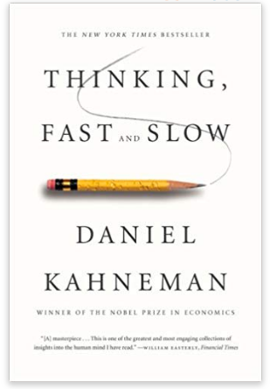
Book Recommendation I
Daniel Kahneman. Thinking, Fast and Slow. Farrar, Straus and Giroux, 2011. BF441 .K238 2011

Slide 38
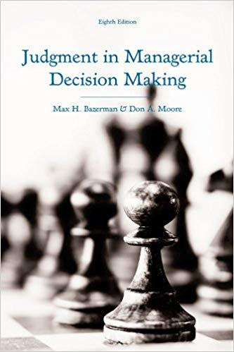
Book Recommendation II
Max H. Bazerman and Don A. Moore. Judgment in Managerial Decision Making. 8th ed. Wiley, 2012. HD30.23 .B38 2013

Slide 39
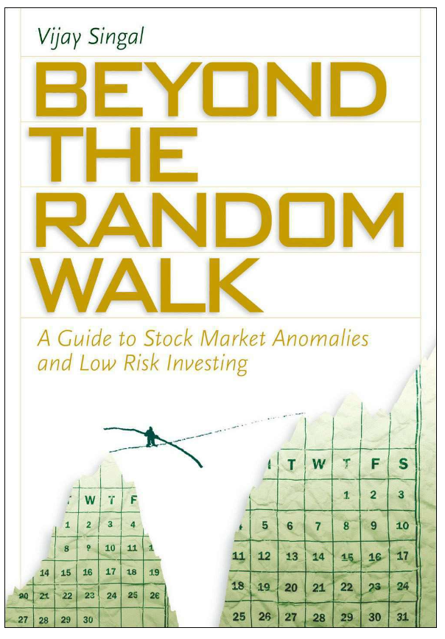
Book Recommendation III
Vijay Singal. Beyond the Random Walk : A Guide to Stock Market Anomalies and Low-Risk Investing. Oxford University Press, 2004. HG4521 .S576 2004

Slide 40
3. Practice Problems

Slide 41
Practice Problem 1
The RFR is 5% and the market return is 14% percent. What is the expected return for a stock with a beta of 1.31? 0.75?

Slide 42
Practice Problem 2
The RFR is 3% and the market risk premium is 8% percent. What is the expected return for a stock with a beta of 0.8?

Slide 43
Practice Problem 3
The RFR is 5% and the market return is 14% percent. What is the beta of a stock with an expected return of 15%?

Slide 44
Practice Problem 4
What is the alpha of a portfolio that returns 11.00%, if its beta is 1.1, while the market risk premium is 9% and the risk-free rate 3.1%?

Slide 45
Practice Problem 5
What is the beta of Stock A?
Asset | σ_{i} | ρ_{i,m}
Stock A | 20% | 0.6
S&P 500 | 30% | 1.0

Slide 46
4. Excel Skills

Slide 47
Probability Functions
STDEV, STDEV.P
VAR, VAR.P
SKEW
KURT
COVAR
CORREL

