Slide 1
FIN 377: Investments
Week 11: Bond Fundamentals and Valuation II
Larry Schrenk, Instructor

Slide 2
Overview
Review and Questions
Current Events: Saudi Oil Refinery Attack
Practice Problems
Excel Skills: Goal Seek/Solver

Slide 3
1. Review and Questions

Slide 4
Key Ideas (Slides 6.53-88)
Bond Valuation and Yields
Price
Yield to Maturity (YTM)
Yield to Call (YTC)
Price Sensitivities
Bond Analysis Tools
Duration
Convexity

Slide 5
12.5 Bond Valuation and Yields with Coupons
Bond value:
Where:
CF = period cash flow
i = discount rate
n = maturity date

Slide 6
12.5 Bond Valuation and Yields with Coupons
Bond value:
Where:
C = period coupon
i = yield to maturity, stated on a period basis
n = maturity date of the bond, stated in periods

Slide 7
Bond Pricing Example
Price of a semi-annual 30 year, 8% coupon bond. Market rate of interest is 10%.
P/Y = 2; N = 60; I = 10; PV = $810.71;
PMT = -40; FV = -1000

Slide 8
12.5 Bond Valuation and Yields with Semiannual Coupons
The Yield to Maturity (YTM) Model
Price bonds in terms of their yields−expected rates of return
Use the observed current market price (MP0) and the expected cash flows to compute the expected yield on the bond
Equivalent to IRR

Slide 9
Yield to Maturity Example I
Suppose an 8% coupon, semi-annual 30 year bond is selling for $1276.76. What is its average rate of return?
r = 3% per half year
YTM = 6%
P/Y = 2; N = 60; I = 6.00%; PV = 1276.76; PMT = -40; FV = -1000

Slide 10
12.5 Computing Other Bond Yield Measures
Yield to Call (YTC)
Expected return is bond called at first opportunity
Adjust present value equation:
Where:
n_{call} = number of periods to first call date
P_{call} = call price of the bond

Slide 11
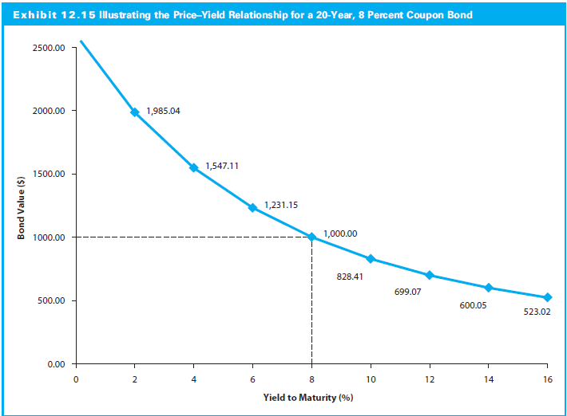
12.5 Relationship between Bond Yields, Coupon Rates, and Prices

Slide 12
Bond Duration and Convexity
Convexity
Duration

Slide 13
13.1.2 Bond Duration
Calculating Bond Duration
Bond duration can be interpreted as a measure of the bond’s price volatility (interest rate sensitivity)
Duration is bond’s price elasticity coefficient with respect to yield changes

Slide 14
13.1.2 Bond Duration
Macaulay versus Modified Duration
Macaulay duration: How many years to be repaid bond’s price by the its total cash flows
Modified duration: Price change in a bond given a 1% change in interest rates

Slide 15
13.1.2 Bond Duration
Calculating Bond Duration
Bond duration can be interpreted as a measure of the bond’s price volatility (interest rate sensitivity)
Duration is bond’s price elasticity coefficient with respect to yield changes

Slide 16
13.1.2 Bond Duration
Macaulay versus Modified Duration
Macaulay duration: How many years to be repaid bond’s price by the its total cash flows
Modified duration: Price change in a bond given a 1% change in interest rates

Slide 17
13.1.2 Bond Duration
Duration is measured in units of time, not dollars
Weights are the PV of cash flow scaled by the PV (P₀) of the bond
Higher coupon → lower duration
More of the total cash flow is paid sooner
Zero-coupon bond → duration = maturity

Slide 18
13.1.3 Bond Convexity
Trade-off between price and YTM is curved (convex) function
Mod D misses convexity property
Mod D estimates a curved line with a straight (tangent) line

Slide 19
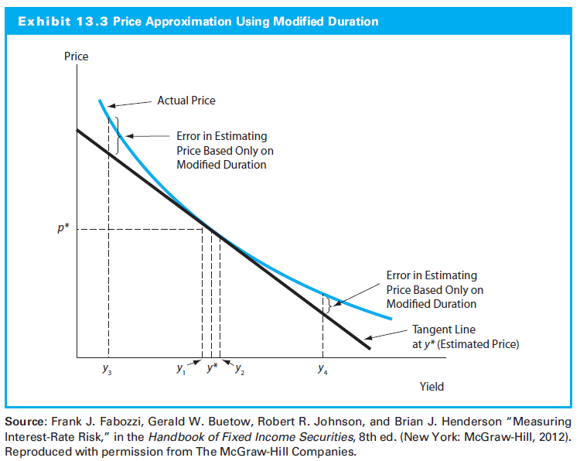
13.1.3 Bond Convexity

Slide 20
2. Current Events: Saudi Oil Refinery Attack

Slide 21
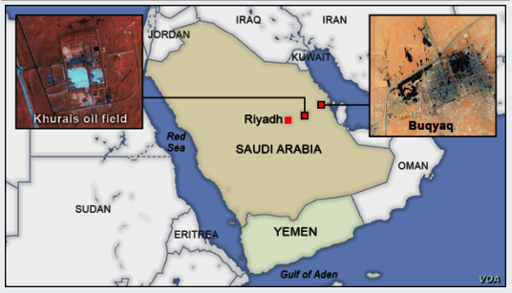
2019 Abqaiq–Khurais attack
At 04:00 a.m. (SAST, UTC+3) on 14 September 2019, drones attacked Saudi oil facilities at Abqaiq and Khurais

Slide 22
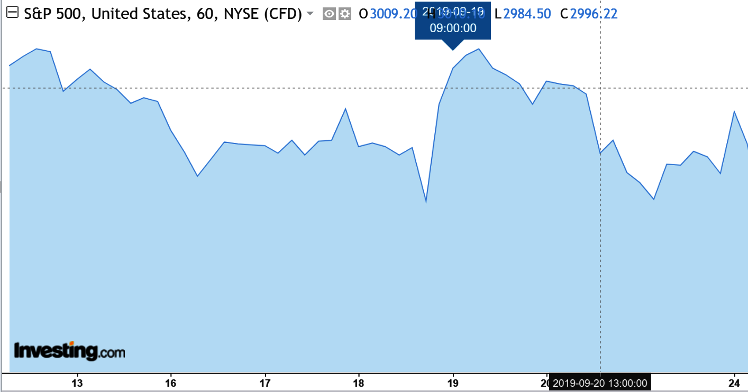
S&P 500

Slide 23
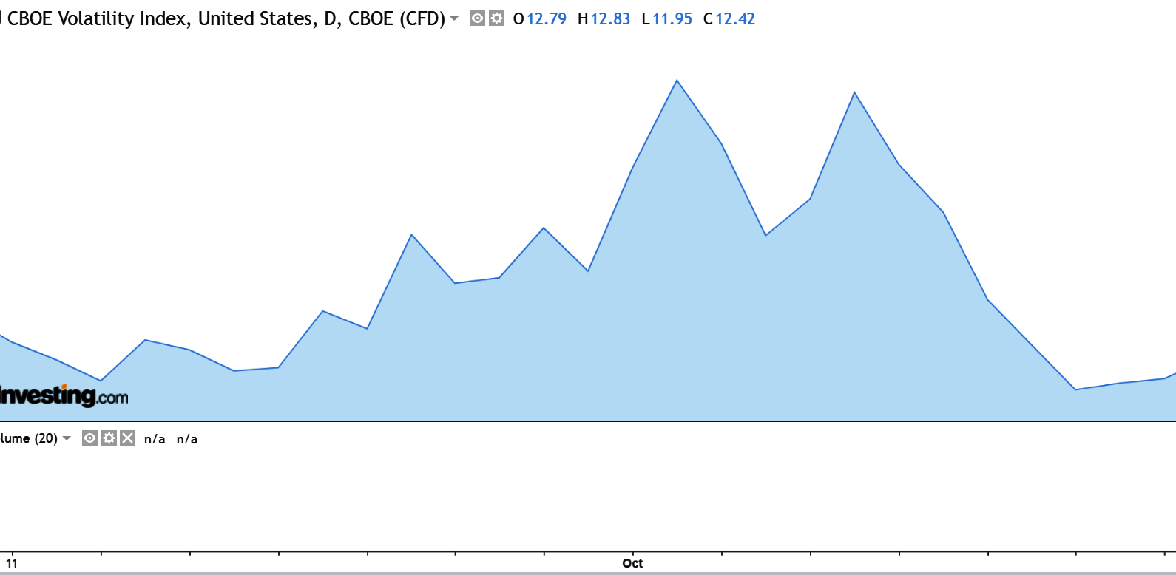
CBOE VIX

Slide 24
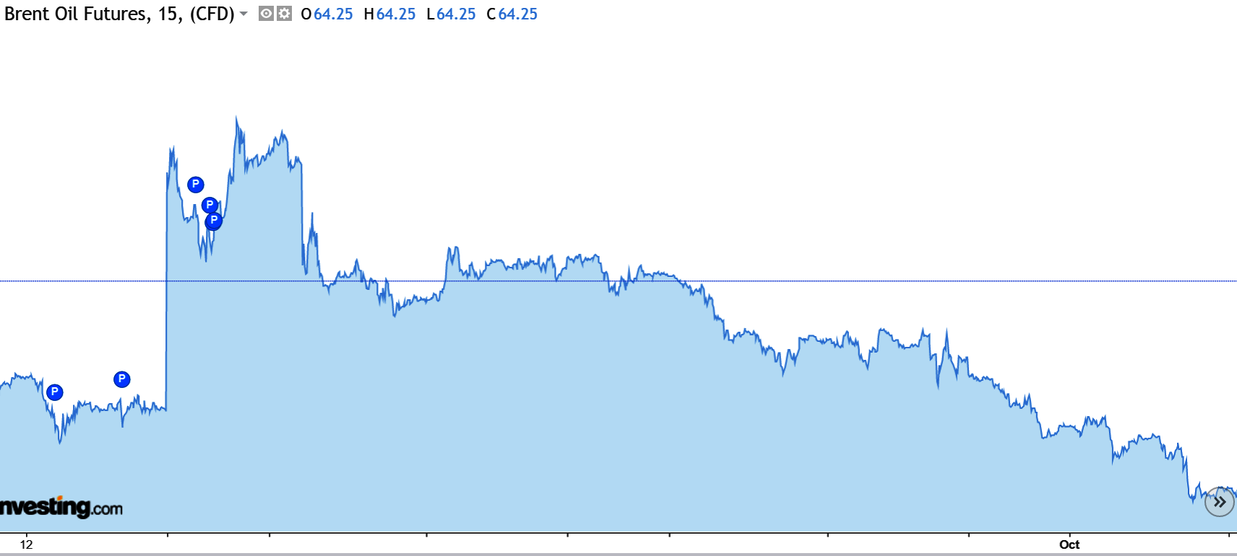
Brent Oil Futures

Slide 25
3. Practice Problems

Slide 26
Practice Problem 1
What is the duration of a 3-year annual bond with a coupon rate of 10% (r = 8%)? (NOTE: P₀ = 1,051.54)

Slide 27
Practice Problem 2
What is the modified duration of a 3-year annual bond with a coupon rate of 10% (r = 8%)? (NOTE: D = 2.74 from previous problem)

Slide 28
Practice Problem 3
What is the approximate price change of a 3-year annual bond with a coupon rate of 10% (r = 8%), if interest rates increase by 2 basis points? (NOTE: Mod D = 2.54 from previous problem and P₀ = 1,051.54)

Slide 29
Practice Problem 4
Find the duration of the following portfolio.
Asset | Weight | D
A | 20% | 5,67
B | 80% | 3.45

Slide 30
4. Excel Skills

Slide 31
Goal Seek and Solver
Goal Seek
Solver

