Slide 1
FIN 377: Investments
Topic 1: The Investment Setting
Larry Schrenk, Instructor

Slide 2
Overview
1.1 What Is an Investment?
1.2 Measures of Return and Risk
1.3 Determinants of Required Rates of Return
1.4 Relationship between Risk and Return
1.5 Financial Ethics

Slide 3
Learning Objectives
After you read this chapter, you should be able to answer the following questions:
Why do individuals invest?
What is an investment?
How do investors measure the rate of return on an investment?
How do investors measure the risk related to alternative investments?
What factors contribute to the rates of return that investors require on alternative investments?
What macroeconomic and microeconomic factors contribute to changes in the required rates of return for investments?

Slide 4
Readings
Reilley, et al., Investment Analysis and Portfolio Management, Chap. 1

Slide 5
1.1 What Is an Investment?

Slide 6
1.1 What Is An Investment?
Investment
  What you do with savings to make them increase over time
Reason for Saving
  Trade-off of present consumption for a higher level of future consumption

Slide 7
1.1 What Is An Investment?
Pure Rate of Interest
  Rate of exchange between future and current consumption
Pure Time Value of Money
  Difference between borrowed funds and surplus on their savings
  Interest rate, the pure time value of money

Slide 8
1.1 What Is An Investment?
Inflation
  If investors expect a change in prices, they will require a higher rate of return
Uncertainty
  If future payment is not certain, the investor demands interest rate exceeding nominal risk-free interest rate
    Investment risk
    Risk premium

Slide 9
1.1.1 Investment Defined
Investment
  Commitment of dollars for a period of time to obtain future payments compensate the investor for:
    Time funds are committed (opportunity cost)
    Expected rate of inflation over period (inflation)
    Uncertainty of the future payments (risk)

Slide 10
1.1.1 Investment Defined
  Investor trades known dollar amount today for expected future stream of payments greater than amount today
  The ‘investor’:
    Individual
    Government
    Pension fund
    Corporation etc.
  Investment examples:
    Corporations in plant and equipment
    Individuals in stocks, bonds, commodities, or real estate etc.

Slide 11
1.2 Measures of Return and Risk

Slide 12
Probability Measures
Measures of Central Tendency
  Mean, Median, Mode
Measures of Dispersion
  Standard Deviation, Variance
Higher Moments
  Skewness, Kurtosis
Measures of Dependence
  Covariance, Correlation

Slide 13
Measures of Central Tendency
What is a Measure of Central Tendency?

Slide 14
Mean (Average)
Equal Weighted Average (m, )
Applications
Calculation:

Slide 15
Mean (Average)
Calculating the Equally Weighted Average

Slide 16
Mean (Average)
(Unequally) Weighted Average
Applications
Calculation:

Slide 17
Mean (Average)
Calculating the Unequally Weighted Average

Slide 18
Mode
The mode is the most frequent number.
  2, 3, 4, 2, 5, 7, 8, 2, 3
  The mode is 2

Slide 19
Median
The median is the ‘middle’ number.
  2, 3, 4, 2, 5, 7, 8, 2, 3
  Ordered: 2, 2, 2, 3, 3, 4, 5, 7, 8
  The median is 3.

Slide 20
Measures of Dispersion
What is a Measure of Dispersion?

Slide 21
Variance
Variance (σ²)
Applications
Calculation:
  Sample versus Population

Slide 22
Variance
Calculating Variance

Slide 23
Standard Deviation
Standard Deviation (σ)

Slide 24
Standard Deviation
Calculating Standard Deviation

Slide 25
1.2.4 Measuring the Risk of Expected Rates of Return
Sharpe Ratio

Slide 26
Statistical Calculations
On the exams you must be able to calculate the probability measures using formulae.
Using the calculator functions is not an acceptable substitute.

Slide 27
Higher Moments
What is a Higher Moment?

Slide 28
Skewness
Normal Distribution has a skewness of 0, i.e., it is symmetric

Slide 29
Kurtosis
Normal Distribution has a kurtosis of 3

Slide 30
Measures of Dependence
What is a Measure of Dependence?

Slide 31
Covariance
Covariance (σ_{X,Y})
Applications
Calculation:
  Variance versus Covariance

Slide 32
Covariance
Calculating Covariance
  Note: Unit Dependence

Slide 33
Correlation
Correlation (ρ_{X,Y})
Applications
Calculation:
  Range: -1 < ρ <1

Slide 34
Correlation
Calculating Correlation

Slide 35
Question:
What is the correlation?
  0
  0.5
  1
  None of the above

Slide 36
1.2.1 Measures of Historical Rates of Return
Holding Period Return (HPR)
  NOTE: What I call HPR, the textbook calls Holding Period Yield (HPY). I will not use the formula that the book introduces as HPR.

Slide 37
1.2.1 Measures of Historical Rates of Return
I invested $95 five years ago, and my portfolio is now worth $150

Slide 38
Holding Period Return
Problem: Comparing assets with different holding periods.
Which is better?
  7.8% over 7 years
  10.5% over 10 year
Need a common time period
  Convert all rates to an annual basis
  ‘Annualize’ them (as with ratios)

Slide 39
1.2.2 Computing Mean Historical Returns
Arithmetic Mean Return (AM)
Geometric Mean Return (GM)

Slide 40
1.2.2 Computing Mean Historical Returns
Return on IBM: 5%, 17%, 4%
Arithmetic Mean Return (AM)
Geometric Mean Return (GM)

Slide 41
Simple Rates (Interest)
Returns
  Return on your principal, but
  No return on the accumulated interest
$100 in an account for three year at 12% simple interest
  100 + 12 + 12 + 12 = $136.

Slide 42
Compound Rates (Interest)
Returns
  Return on your principal, and
  Return on the accumulated interest
$100 in an account for three year at 12% compound interest
  A gain of $4.49 over simple interest!
0 | 100.00 | 100.00
1 | 100.00*1.12 | 112.00
2 | 112.00*1.12 | 125.44
3 | 125.44*1.12 | 140.49

Slide 43
Non-Annual Rates
For example, monthly data for stock returns.
If a stock was at $110 at the end of last month and $108 at the end of this month:
  Need to annualize the return.

Slide 44
Rate Conversions
Most often we will be converting a non-annual rate to an annual rate.
Unfortunately, there are several ‘versions’ of annual rates.

Slide 45
Conversions
HPR
EAR
APR

Slide 46
Annual Percentage Rate (APR)
Annual Percentage Rate (APR)
  This is an application of simple (not compound) interest.
  AKA: Nominal, Stated, Quoted Rate

Slide 47
APR Example
If you have a monthly HPR of 2%
But if I put $100 in an account at 2% per month and left it there for 12 months, I would have:
So the APR understates my return by 2.82%!

Slide 48
Effective Annual Return (EAR)
The correct annual rate to use is the Effective Annual Return (EAR).
  This form of the annual rate recognizes compound interest.
  AKA:
    Equivalent Annual Return (EAR)

Slide 49
Effective Annual Return (EAR)
If you have an APR and want to convert it to EAR:
In our example, we had an APR of 24%.

Slide 50
Effective Annual Return (EAR)
If you have an HPR and want to convert it to EAR:
In our example, we had a monthly rate of 2%.

Slide 51
IMPORTANT DISTINCTION
Formula: APR ⇒ EAR
Formula: HPR ⇒ EAR

Slide 52
Effective Annual Return (EAR)
We can also start with the EAR and find any equivalent HPR.
If my EAR is 31%, then the equivalent weekly HPR is:

Slide 53
Calculator Functions
Nom = Nominal Rate (APR)
Eff = Effective Rate (EAR)

Slide 54
Rate Practice
HPR_{weekly} = 0.2%. Find EAR and APR.
APR_{weekly} = 20%. Find EAR
EAR = 10%. Find HPR_{quarterly}. ▪

Slide 55
Risk and Ignorance
In every facet of our lives we face something unknown.
Complete lack of knowledge is ‘ignorance’.
Some idea of its probability is ‘risk’.

Slide 56
Risk and Ignorance
Ignorance
  If you ask me to put my hand in a box and pull out a mystery object, this is Ignorance, since I have no idea what the box may contain.
Risk
  If you ask me to put my hand in a box containing an equal number of red and blue balls and ask me to pull out a ball, this is risk
  I may not know which color I will get, but I know that the probability is 50-50 for each color.
  Risk ⇒ Rational Expectation

Slide 57
The Quantification of Risk
Past Data
  Historical prices
  Forward-looking data
  Assumption: Future behaves like past
Statistical Distribution
  Distribution,
  Mean,
  Variance, etc.

Slide 58
‘Expected’ versus ‘Realized’
Forecast is only expectation
  E[ ] = Expectations Operator
Contrast: realized/actual value
Quantify the forecast error
  confidence intervals
  Note: In cases of ignorance, I could not even form such an expectation.

Slide 59
What is Risk
Risk: The possibility realized value will differ from expected value.
  Risk free asset ⇒ realized = expected
Greater risk ⇒ greater likelihood realized value will differ from expected value.

Slide 60
Downside versus Upside Risk
Realized value higher or lower than expected
Upside Risk: Better possibility
  Actual stock return higher than expected
Downside Risk: Worse possibility
  Actual stock return lower than expected
  NOTE: Alternate definition–risk as only downside risk

Slide 61
Three Step Analysis of Risk
  Identify Risk
  Measure Risk
  Price Risk

Slide 62
Step 1–Identify Risk
Identify risk exposure
  Profit of a firm
    Input price changes
    Labor problems
    Shifts in consumer tastes
  Bond
    Interest rate risk
    Default risk
  Foreign investment
    Exchange rate risk
Result: Asset exposed to risks X, Y, etc.

Slide 63
Step 2–Measure Risk
Measure/quantify the risk
  ‘Cardinal Ordering’
  Use of statistics
  Historical volatility/standard deviation
  Correct measure of specific risks
Result: Asset exposure to risk X is 8 units.

Slide 64
Step 3–Price Risk
Price the Risk
  Compensation for specific level of risk.
  Return, not dollar, compensation
  Higher risk ⇒ higher return
Result: Asset exposure to 8 units of X risk yields a risk premium of 10%.
  Recall: Risk premium = E[r] – r_{f}

Slide 65
Over-Simplified Example
Risk Exposure: Return Volatility
Risk Measure: Standard Deviation
Risk Price: 1% risk premium per 2% Standard Deviation

Slide 66
Which is Riskier?

Slide 67
Which is Riskier? (cont’d)
Expected Return
  Investment A = 10%
  Investment B = 10%
Which is riskier?
  Which is more likely to differ from the expected value?
  Which is more likely to actually have a return of about 10%?

Slide 68
Selecting Stocks
Which stock would you choose from each pair?▪
 | R | σ
A | 10% | 20%
B | 12% | 15%
 | R | σ
E | 10% | 15%
F | 12% | 15%
 | R | σ
C | 11% | 12%
D | 10% | 15%
 | R | σ
G | 10% | 12%
H | 12% | 15%
?

Slide 69
Dominance
Basic Assumptions–Risk-Return Trade-Off
  Like Return
  Dislike Risk
Dominance ⇒ Universal Choice
  B dominates A
  C dominates D
  F dominates E
  No dominance between G and H
Dominance versus Taste Preference

Slide 70
Dominance Graph
Which stocks are dominated?▪
A
Return
B
C
D
E
F
s

Slide 71
1.3 Determinants of Required Rates of Return

Slide 72
1.3 Determinants of Required Rates of Return
Three Components of Required Return:
  Opportunity cost
  Inflation
  Risk
Complications of Estimating Required Return
  A wide range of rates is available for alternative investments at any time.
  The rates of return on specific assets change dramatically over time.
  The difference between the rates available on different assets change over time.

Slide 73
Inflation Basics
Rise in the general level of prices
Unit of currency buys less
Erosion in purchasing power
Measure–Annualized percentage change in a general price index (CPI)

Slide 74
Real versus Nominal
Nominal Values
  ‘Money of the Day’
  Not Adjusted for Inflation
  The Dollar Value You Actually Pay
Real Values
  Adjusted for Inflation
  ‘Current’ Dollars/Today’s Dollars
  Constant Consumption Value

Slide 75
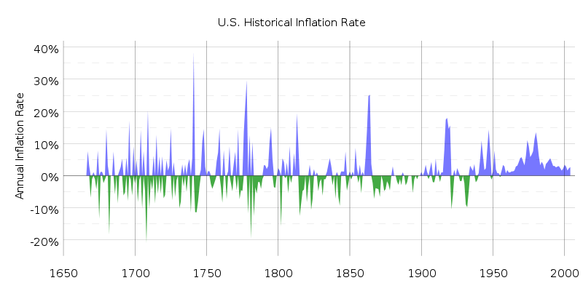
Inflation History

Slide 76
Inflation Example
You want to be a millionaire by age 50.
You save $546.23/month at 9%, so that you have $1,000,000 at the end of 30 years.
You are technically a millionaire since you do have $1,000,000 in your investment account.
But, in today’s dollars, that million is only worth $301,795.87 if the inflation rate is 4%.
  ‘In Today’s Dollars’–$1,000,000 in 30 years will allow you to buy the same goods that $301,795.87 buys today.

Slide 77
Simple Example
A can of soda costs $1.00 today and $1.05 next year. What is the inflation rate?
At this rate of inflation, what will a can of soda cost in 5 years?

Slide 78
Simple Example with Calculator
At 5% inflation, what will a $1.00 can of soda cost in 5 years?
  Input 5, Press N (This is annual so N = 5)
  Input 5, Press I/Y
  Input 1, press +/-, press PV
  Press CPT, FV to get $1.28
Do you recognize this pattern?
The following three questions are identical:
  At 5% inflation, what will a $1.00 can of soda cost in 5 years? $1.28
  At 5% growth, how tall will a 1 foot tree be in 5 years? 1.28 feet
  At a 5% interest rate, what will be the future value of $1.00 5 years? $1.28

Slide 79
Real and Nominal Rates of Interest
Nominal interest rate (NRFR):
  Growth rate of your money
Real interest rate (RRFR):
  Growth rate of your purchasing power

Slide 80
1.3.1 The Real Risk-Free Rate
The real risk-free rate (RRFR)
  No uncertainty about future cash flows
  Influenced by investment opportunities in economy
  Investment opportunities determined by the long-run real growth rate of the economy
  Thus, positive relationship between the real growth rate in the economy and the RRFR

Slide 81
1.3.2 Factors Influencing the Nominal Risk-Free Rate (NRFR)
Nominal risk-free rate of interest is not stable because two other factors:
  Relative ease or tightness in capital markets, and
  The expected rate of inflation

Slide 82
1.3.2 Factors Influencing the Nominal Risk-Free Rate (NRFR)
Conditions in the Capital Market
  Cost of funds/interest rate is the price that equates the current supply and demand for capital
  Short-run changes in the relative ease or tightness in the capital market caused by temporary disequilibrium in the supply and demand of capital

Slide 83
1.3.2 Factors Influencing the Nominal Risk-Free Rate (NRFR)
Expected Rate of Inflation
    Fisher equation

Slide 84
1.3.2 Factors Influencing the Nominal Risk-Free Rate (NRFR)
The Common Effect
  All factors regarding the required rate of return affect all investments equally
    For example, if a decline in the expected real growth rate of the economy causes a decline in the RRFR of 1 percent, then the required return on all investments should decline by 1 percent

Slide 85
Real versus Nominal CFs
Nominal Values
  On price tags or in contracts
  Amount that we actually pay
Real Values
  Remove the effects of inflation

Slide 86
Real versus Nominal CFs
If inflation is 5% per year and the nominal cash flow in year two is $150.00, then the corresponding real cash flow is:
P/Y = 1; N = 2; I/Y = 5; PV = $136.05; PMT = 0; FV = -150

Slide 87
Real versus Nominal Rates
Real (r_{r}) and nominal (r_{n}) interest rates:
  Note: There is an approximation formula, r_{n} = r_{r} + i , that should never be used.

Slide 88
Real versus Nominal Values
Discount the annual, nominal cash flows (r_{r} = 6%; i = 4%): 150.00 220.00 -120.00
  1) Convert the rate and discount, or

Slide 89
Real versus Nominal Values
  2) Discount the converted the cash flow.
  You are mathematically certain to get the same answer for both procedures!
Simple Rule–Be Consistent. Discount…
  Real Amounts with Real Rate
  Nominal Amounts with Nominal Rate

Slide 90
1.3.3 Risk Premium
Business Risk
  Uncertainty of earnings caused by the nature of a firm’s business
Operating Risk
  Uncertainty of earnings caused by the nature of a firm’s production
    Sales volatility and operating leverage determine the level of operating risk
Financial Risk
  Uncertainty of earnings caused by the use of debt financing
    Borrowing requires fixed payments which must be paid ahead of payments to stockholders
    The use of debt increases uncertainty of stockholder income and causes an increase in the stock’s risk premium

Slide 91
1.3.3 Risk Premium
Liquidity Risk
  How long to convert an investment into cash?
  How certain is the price that will be received?
Exchange Rate Risk
  Uncertainty introduced by acquiring securities denominated in a different currency
  Uncertainty in return when converting an investment back into the “home” currency

Slide 92
1.3.3 Risk Premium
Country Risk
  Uncertainty caused by the possibility of a major change in the political or economic environment in a country
  Investments in countries that have unstable political-economic systems must include a country risk-premium when determining their required rate of return

Slide 93
1.3.4 Risk Premium and Portfolio Theory
From portfolio theory, relevant risk measure for an asset is its co-movement with the market portfolio
  Systematic risk relates the variance of the investment to the variance of the market
  Unsystematic risk is due to the asset’s unique features

Slide 94
Two Classes of Risk
Thousands of possible risks
Two basic classes:
  Non-Market Risk
  Market Risk
  .

Slide 95
Non-Market Risk
Has an effect on…
  One firm,
  Selection of firms, or
  Maybe even an industry, but
  Not the market as a whole.
Examples:
  A Labor Problem
  Change in an Input Price
  Litigation
  Etc.

Slide 96
Market Risk
Has an effect on…
  Market as a whole
  Economy-wide
Examples:
  Interest Rate Changes
  A Change in the Corporate Tax Rate
  Inflation
  Etc.

Slide 97
Market–Non-Market Continuum
Where do the following risks fall?
  Warehouse fire
  Change in Social Security tax
  Strike in auto industry
  Bug found in Windows
  Change in foreign exchange rate
  Inflation expectations

Slide 98
1.3.4 Risk Premium and Portfolio Theory
Risk premium for an individual asset is a function of the asset’s systematic risk
The measure of an asset’s systematic risk is its beta (β).

Slide 99
1.4 Relationship between Risk and Return

Slide 100
1.4 Relationship Between Risk and Return
The Security Market Line (SML)
  Combination of risk and return trade-offs
  Investors select investments consistent with risk preferences

Slide 101
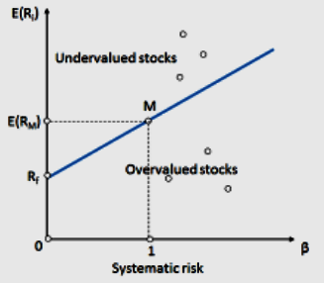
Security Market Line (SML)

Slide 102
1.4 Changes in the SML
Individual investments can change position
  Due to changes in perceived risk
Slope of the SML can change
  Due to a change in the risk attitudes of investors
SML can have parallel shift
  Due to a change in the RRFR or the expected rate of inflation

Slide 103
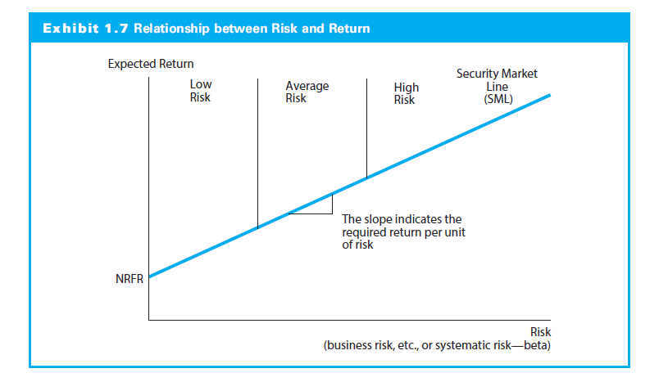
1.4.1 Movements Along the SML

Slide 104
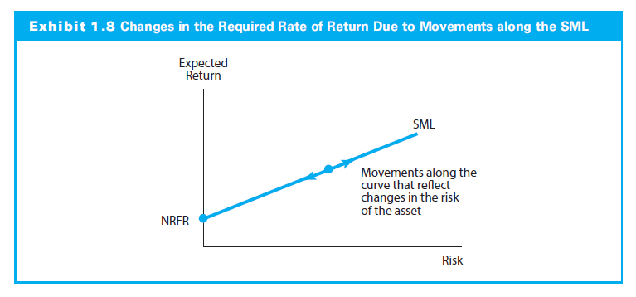
1.4.1 Movements Along the SML

Slide 105
1.4.2 Changes in the Slope of the SML
Select any point on the SML and compute a risk premium (RP) for an asset through the equation:

Slide 106
1.4.2 Changes in the Slope of the SML
If there is a portfolio (M) containing all the risky assets in the market (market portfolio), compute the market RP as follows:
  Where:
    RP_{m} = risk premium on the market portfolio
    E(r_{m}) = expected return on the market portfolio
    NRFR = nominal return on a risk-free asset

Slide 107
1.4.2 Changes in the Slope of the SML
Market RP not constant because slope of the SML changes
Yield spreads (differences in yields) change over time
Change in the RP implies a change in the slope of the SML

Slide 108
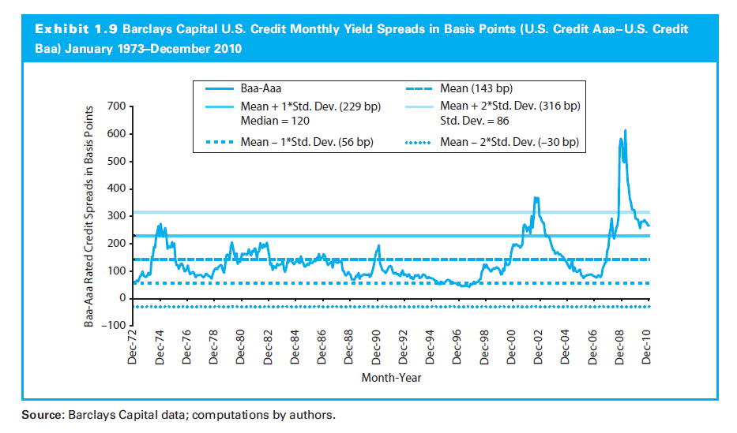
1.4.2 Changes in the Slope of the SML

Slide 109
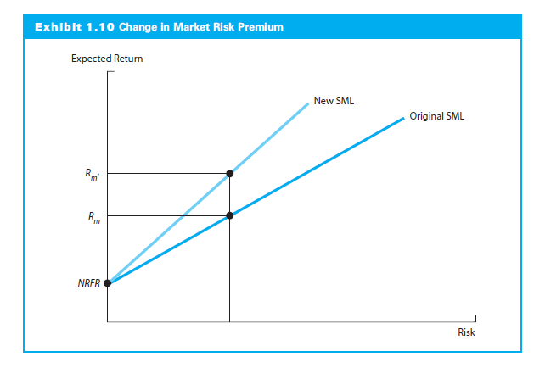
1.4.2 Changes in the Slope of the SML

Slide 110
1.4.3 Changes in Capital Market Conditions or Expected Inflation
Changes in Market Condition or Inflation
  A change in the RRFR or expected inflation causes parallel shift in SML
  When nominal risk-free rate increases, the SML will shift up
    Higher return with the same risk premium

Slide 111
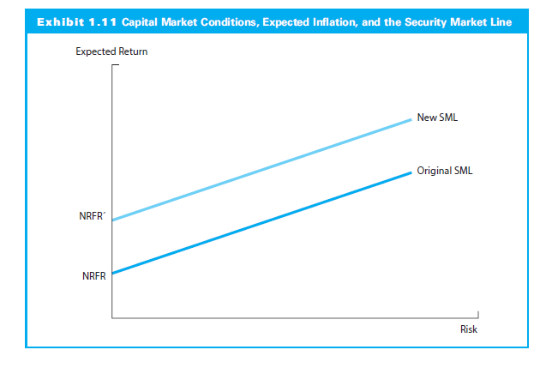
1.4.3 Changes in Capital Market Conditions or Expected Inflation

Slide 112
1.5 Financial Ethics

Slide 113
Readings (Course Web Pages)
Reading 1: Ethics and Trust in the Investment Profession by Parmar, Kelly, and Stevens
Reading 2: Code of Ethics and Standards of Professional Conduct Standards of Practice Handbook, Eleventh Edition
Reading 3: Guidance for Standards I–VII Standards of Practice Handbook, Eleventh Edition
Reading 4: Introduction to the Global Investment Performance Standards (GIPS)
Reading 5: Global Investment Performance Standards (GIPS)

Slide 114
Ethics and Trust in the Investment Profession
Moral/ethical principles are beliefs regarding what is good, acceptable,or obligatory behavior
Standards of conduct are benchmarks for the minimally acceptable behavior

Slide 115
Challenges to Ethical Conduct
Ethical infrastructure
Situational influences shape our thinking, decision making, and behavior
Behavioral finance/ethics

Slide 116
Ethical Conduct in the
Investment Industry
Trust in client relationship
Specialized/superior knowledge
  Information asymmetry
Intangible products
‘Fiduciary’ duty

Slide 117
Ethical vs. Legal
Legal and ethical conduct not always the same
Unethical practices may not be illegal
Vice versa

Slide 118
CFA Institute Guidelines
Standards of Practice Handbook
Code and Standards

Slide 119
The Code of Ethics
■ Act with integrity…
■ Place the integrity of the investment profession and the interests of clients above their own personal interests.
■ Use reasonable care and exercise independent professional judgment…
■ Practice and encourage others to practice in a professional and ethical manner…
■ Promote the integrity and viability of the global capital markets…
■ Maintain and improve their professional competence…

Slide 120
Standards of Professional Conduct
I. PROFESSIONALISM
  A Knowledge of the Law
  B Independence and Objectivity
  C Misrepresentation
  D Misconduct

Slide 121
Standards of Professional Conduct
II. INTEGRITY OF CAPITAL MARKETS
  A Material Nonpublic Information
  B Market Manipulation

Slide 122
Standards of Professional Conduct
III. DUTIES TO CLIENTS
  A Loyalty, Prudence, and Care
  B Fair Dealing
  C Suitability
  D Performance Presentation
  E Preservation of Confidentiality

Slide 123
Standards of Professional Conduct
IV. DUTIES TO EMPLOYERS
  A Loyalty
  B Additional Compensation Arrangements
  C Responsibilities of Supervisors

Slide 124
Standards of Professional Conduct III
V. INVESTMENT ANALYSIS, RECOMMENDATIONS, AND ACTIONS
  A Diligence and Reasonable Basis
  B Communication with Clients and Prospective Clients
  C Record Retention

Slide 125
Standards of Professional Conduct III
VI. CONFLICTS OF INTEREST
  A Disclosure of Conflicts
  B Priority of Transactions
  C Referral Fees

Slide 126
Standards of Professional Conduct III
VII. RESPONSIBILITIES AS A CFA INSTITUTE MEMBER OR CFA CANDIDATE
  A Conduct as Participants in CFA Institute Programs
  B Reference to CFA Institute, the CFA Designation, and the CFA Program

Slide 127
Global Investment
Performance Standards (GIPS)
0 Fundamentals of Compliance
1 Input Data
2 Calculation Methodology
3 Composite Construction
4 Disclosure
5 Presentation and Reporting
6 Real Estate
7 Private Equity
8 Wrap Fee/Separately Managed Account (SMA) Portfolios (Info)

