Slide 1
FIN 377: Investments
Topic 4: An Introduction to Portfolio Management
Larry Schrenk, Instructor

Slide 2
Overview
6.1 Some Background Assumptions
6.2 Markowitz Portfolio Theory
6.3 The Efficient Frontier
6.4 Capital Market Theory

Slide 3
Learning Objectives
What do we mean by risk aversion, and what evidence indicates that investors are generally risk averse?
What are the basic assumptions behind the Markowitz portfolio theory?
What do we mean by risk, and what are some measures of risk used in investments?
How do we compute the expected rate of return for a portfolio of assets?
How do we compute the standard deviation of rates of return for an individual risky asset?
What are the covariance and correlation statistics and what is the relationship between them?
What is the formula for the standard deviation for a portfolio of risky assets, and how does it differ from the standard deviation of an individual risky asset?
Given the formula for the standard deviation of a portfolio, how do we diversify a portfolio?
What happens to the portfolio standard deviation when the correlation between the assets changes?
What is the mean-variance efficient frontier of risky assets?
What determines which portfolio an investor selects on the efficient frontier?
How does capital market theory extend Markowitz portfolio theory with the addition of a risk-free asset?
What is the capital market line (CML), and how does it enhance our understanding of the relationship between risk and expected return?
What is the market portfolio, and what role does it play in the investment process implied by the CML?
What is the difference between systematic and unsystematic risk, and how does that relate to the concept of diversification?
Under what conditions does the CML recommend the use of leverage in forming an investor’s preferred strategy.

Slide 4
Readings
Reilley, et al., Investment Analysis and Portfolio Management, Chap. 6

Slide 5
6.1 Some Background Assumptions

Slide 6
6.1 Some Background Assumptions
Investors maximize return for a given level of risk
Portfolio includes all assets and liabilities
Relationship between the returns important
A good portfolio more than collection of individually good investments

Slide 7
6.1.1 Risk Aversion
With equal return, risk-averse investors select asset with lower risk
Evidence
  Insurance purchases: life insurance, car insurance, and health insurance
  Bond yield increases with risk classifications,
Not all investors are risk averse
  May depend on the amount of money
  Risk small amounts; insure large losses

Slide 8
6.1.2 Definition of Risk
For most, risk means the uncertainty of future outcomes
An alternative, the probability of an adverse outcome

Slide 9
Diversification: An Example
We bounce a rubber ball and record the height of each bounce.
  The average bounce height is very volatile
As we add more balls…
  Average bounce height less volatile.
  Greater heights ‘cancels’ smaller heights

Slide 10
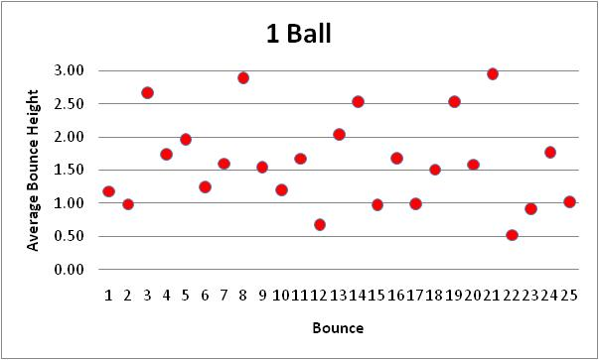
Average Bounce

Slide 11
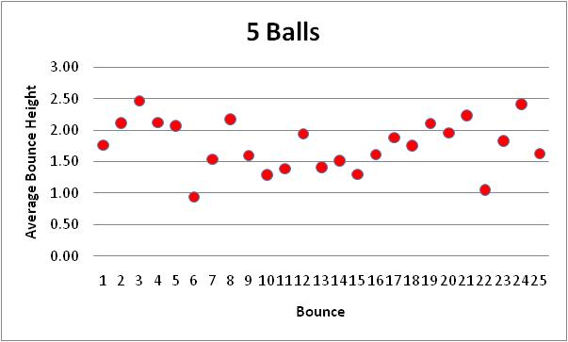
Average Bounce

Slide 12
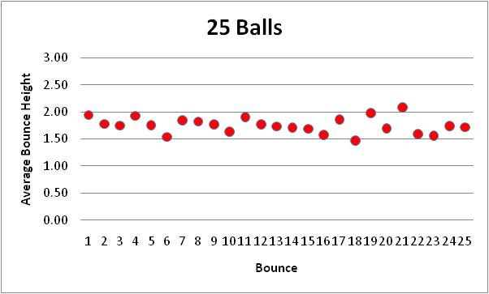
Average Bounce

Slide 13
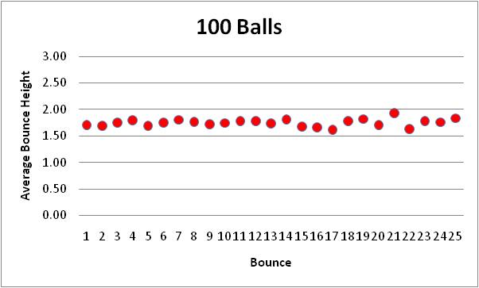
Average Bounce

Slide 14
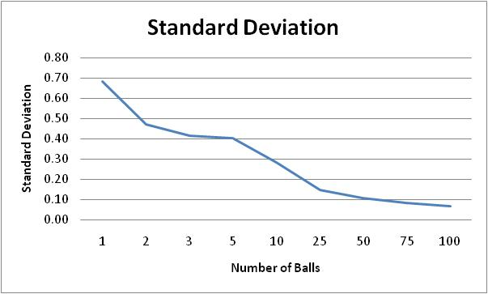
Bouncing Ball Standard Deviation

Slide 15
Diversification: An Analogy
‘Cancellation’ effect = diversification
Hold one stock and record daily return
  The return is very volatile.
As we add more stock…
  Average return less volatile
  Larger returns ‘cancels’ smaller returns

Slide 16
Diversification: The Dis-Analogy
Stocks are not identical to balls.
Drop more balls, volatility will
  Eventually go to zero.
Add more stocks, volatility will
  Decrease, but
  Level out at a point well above zero.

Slide 17
Stock Diversification
Key Idea: No matter how many stocks in my portfolio, the volatility will not get to zero!

Slide 18
What Different about Stocks?
As I start adding stocks
The non-market risks of some stocks cancel the non-market risks of other stocks.
The volatility begins to go down.

Slide 19
What Different about Stocks?
At some point, all non-market risks cancel each other.
But there is still market risk!
But volatility can never reach zero.
Diversification cannot reduce market risk.

Slide 20
Diversification and Market Risk
Market risk
  Impact on all firms in the market
  No cancellation effect
Example:
  Government doubles the corporate tax
  All firms worse off
  Holding many different stocks would not help.
Diversification can eliminate my portfolio’s exposure to non-markets risks, but not the exposure to market risk.

Slide 21
What Happens in Stock Diversification?▪
Non-Market Risk
Volatility of Portfolio
Market Risk
Number of Stocks

Slide 22
Empirical Diversification Example
Five Companies
  Ford (F)
  Walt Disney (DIS)
  IBM
  Marriott International (MAR)
  Wal-Mart (WMT)

Slide 23
Diversification Example (cont’d)
Five Equally Weighted Portfolios
Portfolio Equal Value in…
F Ford
F,D Ford, Disney
F,D,I, Ford, Disney, IBM
F,D,I,M Ford, Disney, IBM, Marriott
F,D,I,M,W Ford, Disney, IBM, Marriott, Wal-Mart
Minimum Variance Portfolio (MVP)

Slide 24
Individual Returns

Slide 25
F Portfolio

Slide 26
F,D Portfolio

Slide 27
F,D,I Portfolio

Slide 28
F,D,I,M Portfolio

Slide 29
F,D,I,M,W Portfolio

Slide 30
F,D,I,M,W versus F Portfolio

Slide 31
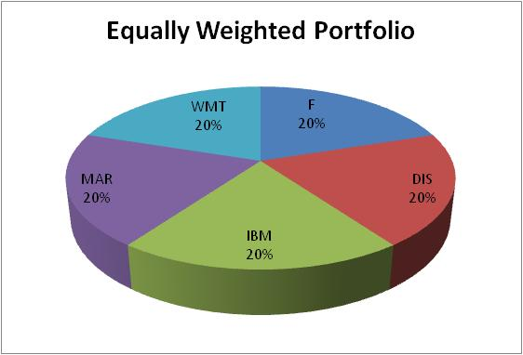
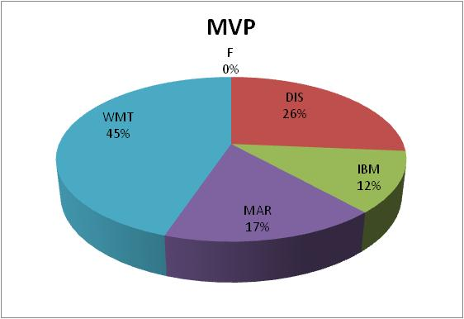
Equally Weighted versus MVP

Slide 32
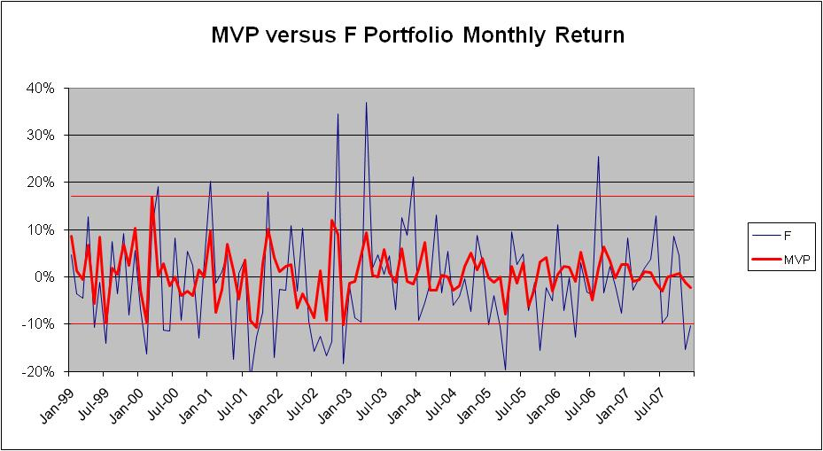
MVP versus F Portfolio

Slide 33
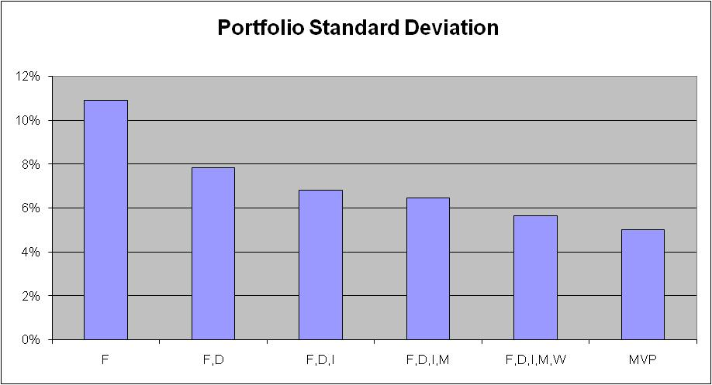
Decreasing Risk

Slide 34
A Well-Diversified Portfolio
‘Well-diversified’ portfolio
  Non-market risks eliminated by diversification
Assumption: All investors hold well-diversified portfolios.
  Index funds
    S&P 500
    Russell 3000
    Wilshire 5000

Slide 35
Implications
If investors hold well-diversified portfolios…
  Ignore non-market risk
  No compensation for non-market risk
  Only concern is market risk
Risk Identification.
  If you hold a well diversified portfolio, then your only exposure is to market risk

Slide 36
6.2 Markowitz Portfolio Theory

Slide 37
6.2 Markowitz Portfolio Theory
Assumptions regarding investor behavior:
  Investments represented by probability distribution
  Maximize one-period expected utility with utility curves with diminishing marginal utility of wealth
  Estimate portfolio risk as variability of returns
  Base decisions on return and risk
  Prefer higher returns and less risk

Slide 38
6.2 Markowitz Portfolio Theory
Asset or portfolio is efficient if no other asset or portfolio offers
Higher expected return with the same (or lower) risk or
Lower risk with the same (or higher) expected return
I.e., not dominated

Slide 39
6.2.1 Alternative Measures of Risk
Variance or standard deviation
Range of returns
Returns below expectations
  Semi-variance (only considers deviations below the mean)
  Assumes investors minimize damage from returns less than some target rate

Slide 40
6.2.1 Alternative Measures of Risk
Advantages variance/standard deviation
  Measure is somewhat intuitive
  Widely recognized risk measure
  Used in most asset pricing models

Slide 41
6.2.2 Expected Rates of Return
Expected rate of return
  For an individual investment
    Sum of potential returns multiplied by probability of returns
  For a portfolio of investments
    Weighted average of the expected rates of individual investments

Slide 42
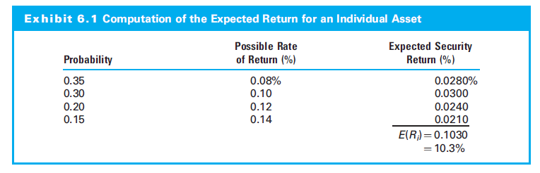
6.2.2 Expected Rates of Return

Slide 43
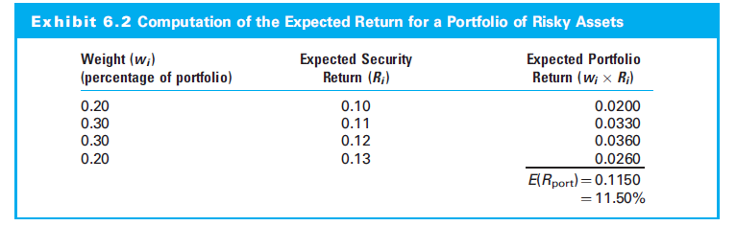
6.2.2 Expected Rates of Return

Slide 44
6.2.3 Variance of Returns for an Individual Investment
The variance is a measure of the variation of possible rates of return:

Slide 45
6.2.3 Variance of Returns for an Individual Investment
The standard deviation is also a measure of the variation of possible rates of return:

Slide 46
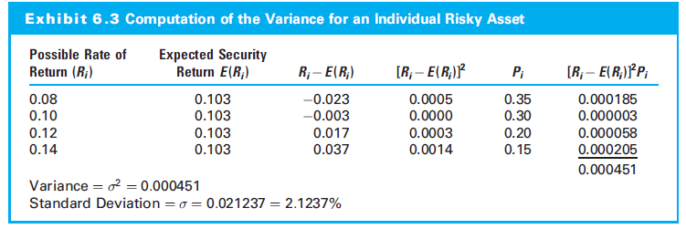
6.2.3 Variance (Standard Deviation) of Returns for an Individual Investment

Slide 47
6.2.4 Variance of Returns for a Portfolio
Covariance of Returns
Degree to which two variables “move together” over time

Slide 48
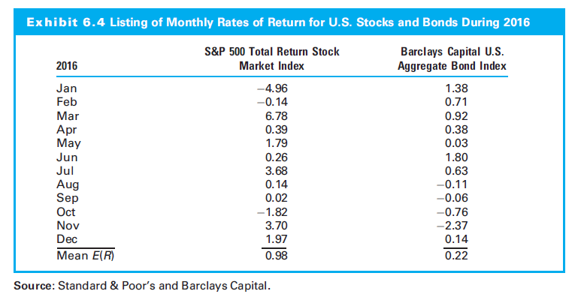
6.2.4 Variance of Returns for a Portfolio

Slide 49
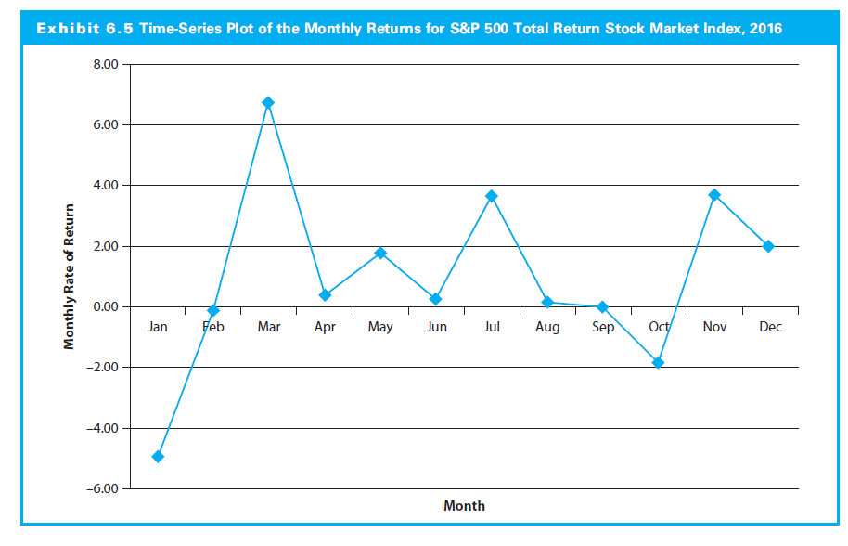
6.2.4 Variance of Returns for a Portfolio

Slide 50
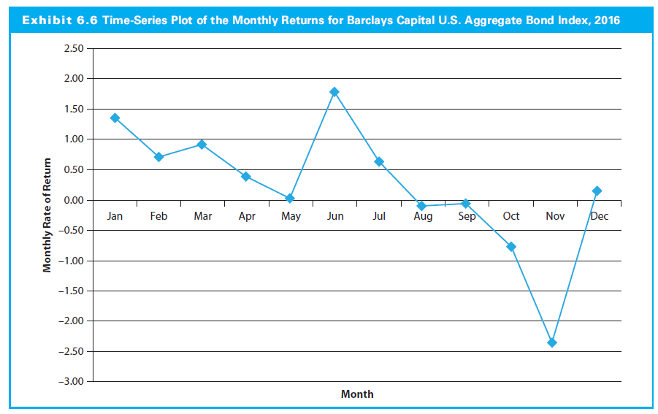
6.2.4 Variance of Returns for a Portfolio

Slide 51
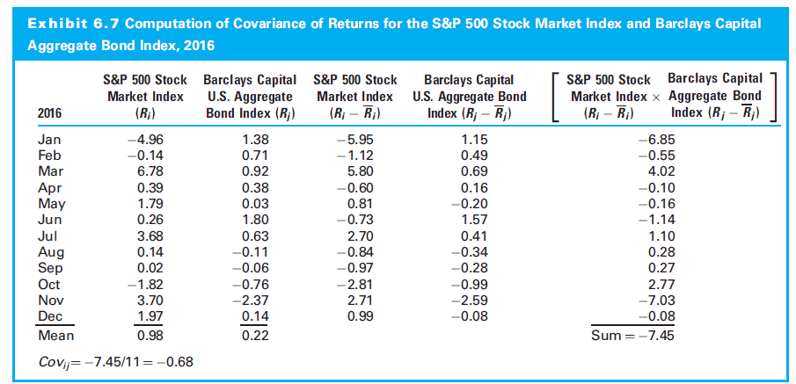
6.2.4 Variance of Returns for a Portfolio

Slide 52
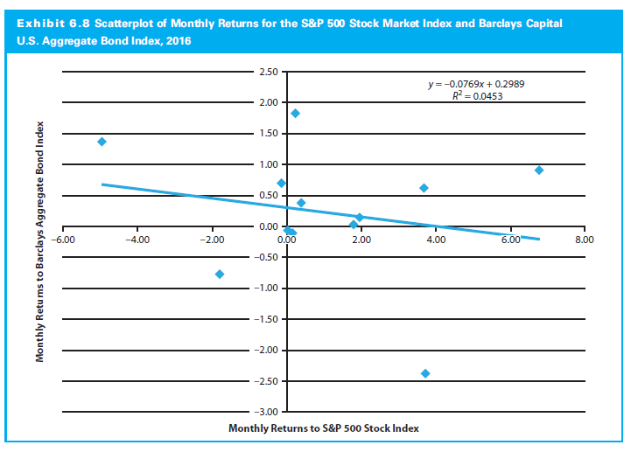
6.2.4 Variance of Returns for a Portfolio

Slide 53
6.2.4 Variance of Returns for a Portfolio
Covariance and Correlation
Correlation coefficient (ρ) standardizes covariance by dividing by the product of the individual standard deviations

Slide 54
6.2.4 Variance of Returns for a Portfolio
Correlation varies in the range +1 to -1
+1 indicates perfect positive correlation.
–1 indicates perfect negative correlation.

Slide 55
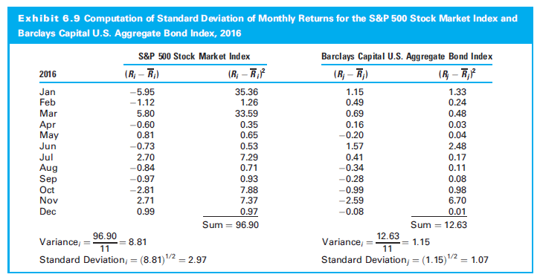
6.2.4 Variance of Returns for a Portfolio

Slide 56
6.2.4 Variance of Returns for a Portfolio
Portfolio Variance Formula

Slide 57
6.2.4 Variance of Returns for a Portfolio
Two-Asset Portfolio Variance Formula

Slide 58
6.2.5 Standard Deviation of Returns for a Portfolio
Portfolio Standard Deviation Formula

Slide 59
6.2.5 Standard Deviation of Returns for a Portfolio
Two-Asset Standard Deviation Variance Formula

Slide 60
6.2.5 Standard Deviation of a Portfolio
Any asset or portfolio described by two characteristics:
The expected rate of return
The standard deviation of returns

Slide 61
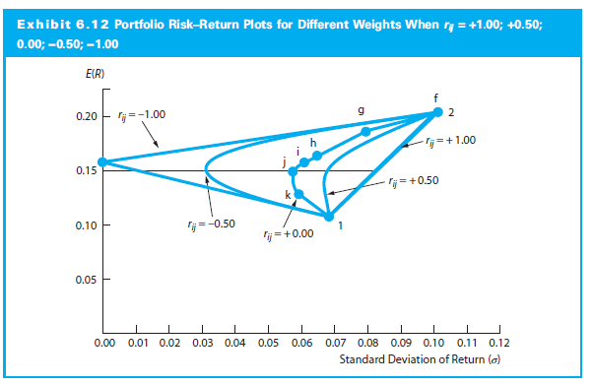
6.2.5 Standard Deviation of a Portfolio

Slide 62
Two Asset Portfolio: Example
Asset | Return | σ | Weight | ρ
A | 7% | 19% | 80% | 0.8
B | 11% | 22% | 20%
NOTE: σ_{p} < σ_{A} and σ_{p} < σ_{B}

Slide 63
Example
If I hold a stock with a standard deviation of 20%, would I get more diversification by adding a stock with a standard deviation of 10% or 30%?
If I added two stocks each with a standard deviation of 25%, the standard deviation of the portfolio could be anywhere from 25% to 0%–depending on the correlation.
  If ρ = 1, σ = 25%
  If ρ = -1, σ = 0% (with the optimal weights)

Slide 64
Standard Deviation and Stock Risk
Standard deviation tells nothing about…
  Stock’s diversification effect on a portfolio; or
  Whether including that stock will increase or decrease the exposure to market risk.
Thus, standard deviation (and variance)
  Not a correct measure of market risk, and
  Cannot be used as our measure of risk in the analysis of stocks.

Slide 65
6.2.6 A Three-Asset Portfolio
Extend results to n asset portfolio
More assets; more risk reduction
Amount of computation increases rapidly (geometrically)

Slide 66
6.2.7 Estimation Issues
Results depend on accurate statistical inputs
Estimates of
  Expected returns
  Standard deviation
  Correlation coefficient
    Among entire set of assets
    With 100 assets, 4,950 correlation estimates
Estimation risk refers to potential errors

Slide 67
6.2.7 Estimation Issues
With single market model (like CAPM), the number of correlations reduces to the number of assets
Single index market model:
R_{i} = a_{i} + b_{i}R_{m} + ε_{i}

Slide 68
6.3 The Efficient Frontier

Slide 69
6.3 The Efficient Frontier
Portfolios with maximum return for given level of risk (or the minimum risk for given level of return)
Portfolios on efficient frontier have either a higher return for same risk or lower risk for same return

Slide 70
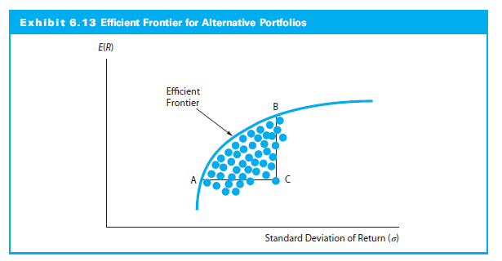
6.3 The Efficient Frontier
  Portfolio A dominates C because it has an equal return but less risk
  Portfolio B dominates C because it has equal risk but a higher expected return

Slide 71
6.3 The Efficient Frontier
Constrained optimization problem: Select investment weights that minimize portfolio risk while satisfying two restrictions:
    Produce a return at least as large as goal, R; and
    Weights must sum to 1.0
Mean-variance optimization: Minimize portfolio risk for a given expected return

Slide 72
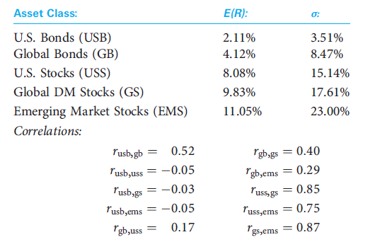
6.3.1 The Efficient Frontier: An Example
What would be the optimal asset allocation strategy using these five asset classes?

Slide 73
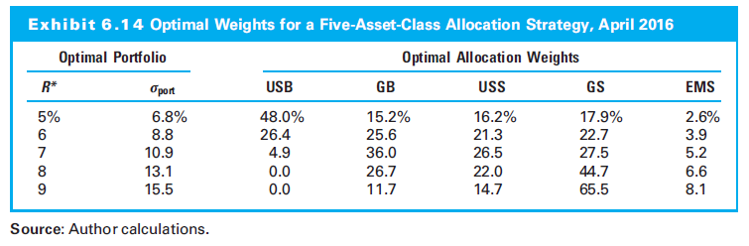
6.3.1 The Efficient Frontier: An Example

Slide 74
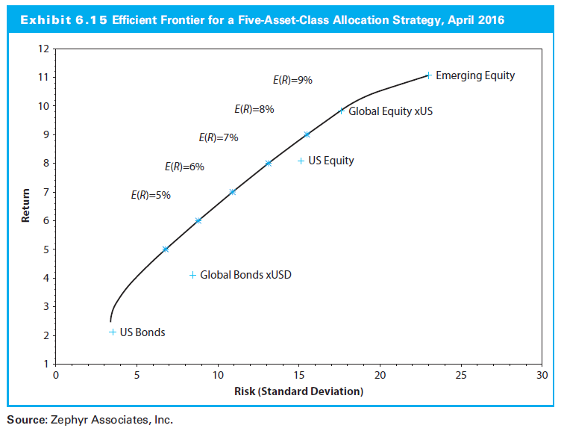
6.3.1 The Efficient Frontier: An Example

Slide 75
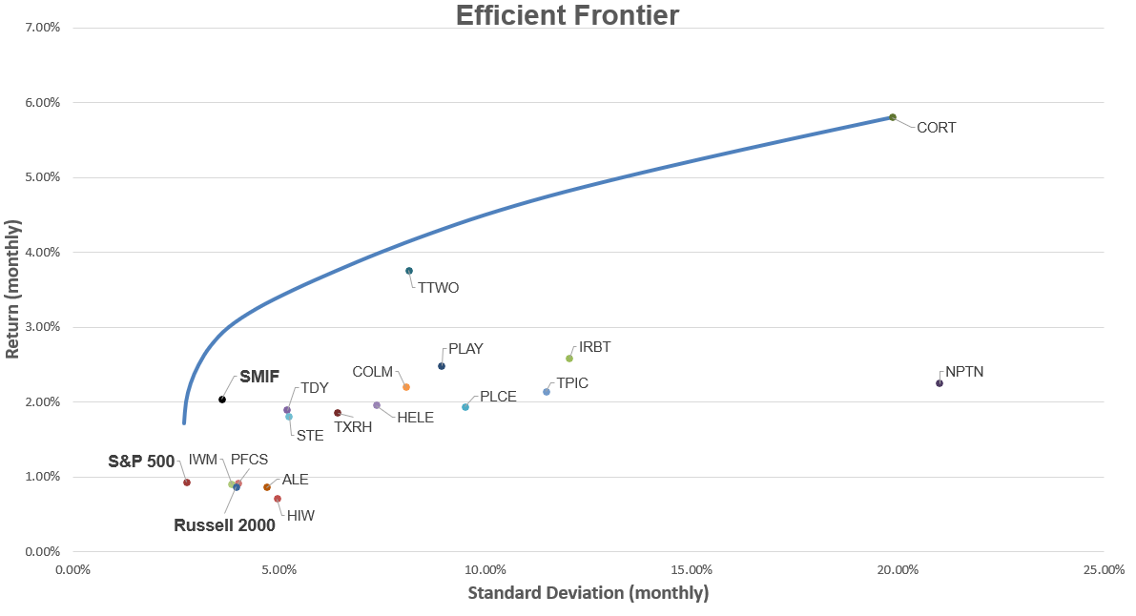
Student Managed Investment Fund

Slide 76
6.3.2 The Efficient Frontier and Investor Utility
Utility curve specifies trade-offs between expected return and risk
Slope of efficient frontier decreases steadily as you move upward
Interactions of these curves determines portfolio selected by individual investor
Optimal portfolio has highest utility

Slide 77
6.3.2 The Efficient Frontier and Investor Utility
The optimal lies at the point of tangency between the efficient frontier and the utility curve with the highest possible utility

Slide 78
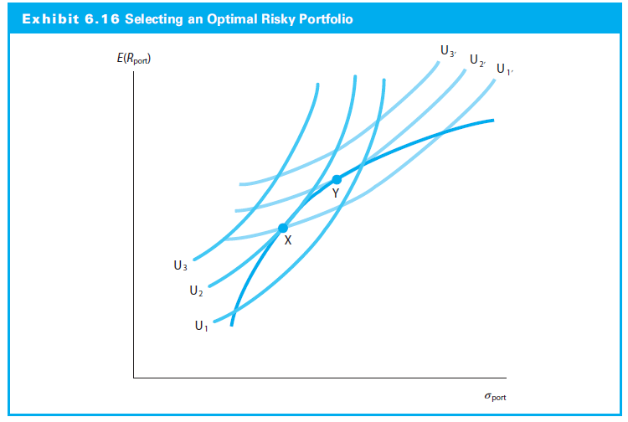
6.3.2 The Efficient Frontier and Investor Utility
  Investor X achieves the highest utility by investing at X
  Investor Y achieves the highest utility by investing at Y
  Which investor is more risk averse?

Slide 79
6.4 Capital Market Theory

Slide 80
6.4 Capital Market Theory: An Overview
Capital market theory extends efficient frontier to model valuing all risky assets
It has important implications for how portfolios are managed in practice
It depends on a risk-free asset, which leads to the designation of the market portfolio

Slide 81
6.4.1 Background for Capital Market Theory
Investor Assumptions:
  Markowitz-efficient who want to be on the efficient frontier
  Can borrow or lend any amount of money at r_{f}
  Homogeneous expectations
  Same one-period time horizon

Slide 82
6.4.1 Background for Capital Market Theory
Investor Assumptions (Continued)
  Investments infinitely divisible
  No taxes or transaction costs
  No inflation or changes in interest rates
  Capital markets are in equilibrium

Slide 83
6.4.2 Developing the Capital Market Line
Risky asset → future returns uncertain
Uncertainty measured by standard deviation
Risk-free return is risk-free
Risk-free standard deviation is zero

Slide 84
6.4.2 Developing the Capital Market Line
Covariance with a Risk-Free Asset
Covariance is:
Covariance/correlation between the risk-free asset and any risky asset or portfolio = 0

Slide 85
6.4.2 Developing the Capital Market Line
Combining Risk-Free Asset with a Risky Portfolio
Expected Return: Weighted average
E(R_{port}) = w_{rf} r_{f} + (1 - w_{rf})E(R_{m})
Standard Deviation: Linear proportion

Slide 86
6.4.2 Developing the Capital Market Line
The Risk-Return Combination
Return on risk-free and the risky asset/portfolio M equals risk-free rate plus compensation for the number of risk units (σ_{port}) they accept

Slide 87
6.4.2 Developing the Capital Market Line
The Capital Market Line
The risk-return relationship holds for every combination of risk-free and risky assets
When the risky portfolio is the market portfolio, this linear relationship is called the Capital Market Line (CML)

Slide 88
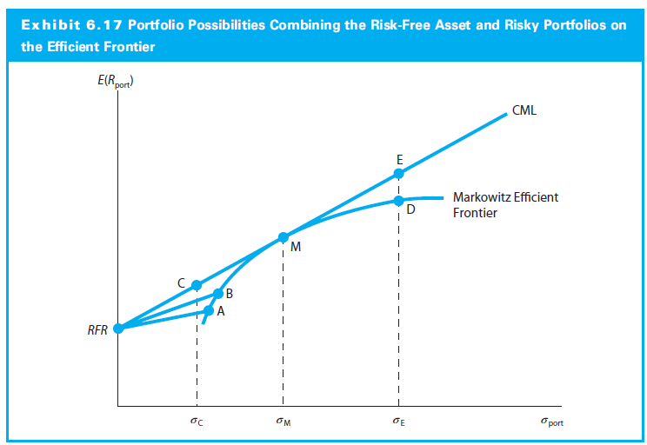
6.4.2 Developing the Capital Market Line
One can attain a higher expected return than is available at point M
One can invest along the efficient frontier beyond point M, such as point D
With risk-free asset, one can add leverage to the portfolio to achieve a point like E
Point E dominates point D
Reduce the investment risk by lending money at the risk-free asset to reach C

Slide 89
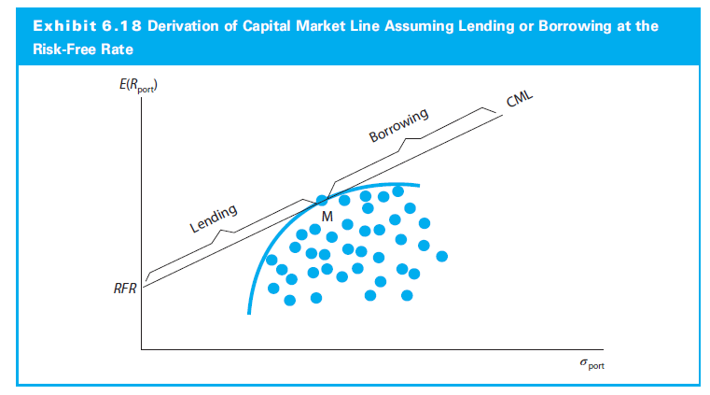
6.4.2 Developing the Capital Market Line

Slide 90
6.4.3 Risk, Diversification, and the Market Portfolio
M lies at the point of tangency and has the highest line
Everybody invests in M and borrows/lends to be on CML
M must include all risky assets
All assets in M are in proportion to their market values
M is completely diversified portfolio, that the unique risk (unsystematic risk) is diversified away

Slide 91
6.4.3 Risk, Diversification, and the Market Portfolio
Systematic risk
Only systematic risk remains in market portfolio
Systematic risk measured by standard deviation of market portfolio
Systematic risk caused by macroeconomic variables:
  Variability in growth of money supply
  Interest rate volatility
  Variability in factors like industrial production, corporate earnings, cash flow

Slide 92
6.4.3 Risk, Diversification, and the Market Portfolio
Diversification and the Elimination of Unsystematic Risk
Diversification reduces standard deviation of total portfolio
Assumes imperfect correlations exist among securities
With securities, average portfolio variance declines
How many securities to obtain a completely diversified portfolio?

Slide 93
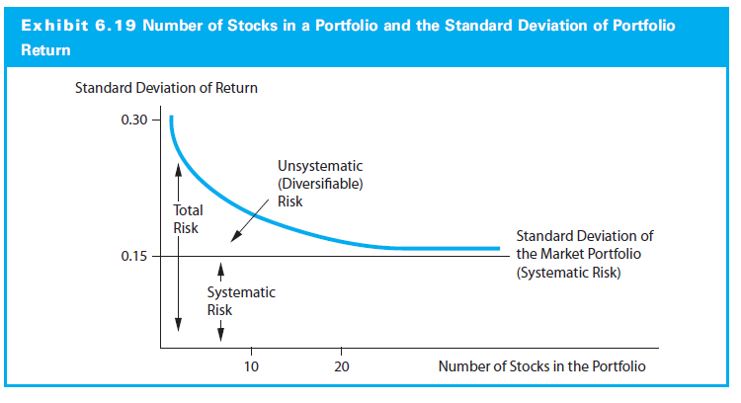
6.4.3 Risk, Diversification, and the Market Portfolio

Slide 94
6.4.3 Risk, Diversification, and the Market Portfolio
The CML and the Separation Theorem
The CML leads all investors to invest in the M portfolio
Individuals differ in position on the CML depending on risk preferences
How an investor gets to a point depends on financing
More risk averse investors lend at risk-free rate; less, borrow
Choosing point on CML separate from the financing decision

Slide 95
6.4.3 Risk, Diversification, and the Market Portfolio
A Risk Measure for the CML
Only relevant portfolio is the market portfolio.
Only important consideration for any individual risky asset is its average covariance with the market portfolio
This covariance, then, is the relevant risk measure for an individual risky asset

Slide 96
6.4.3 Risk, Diversification, and the Market Portfolio
Describe individual returns in relation to returns for Portfolio M using a linear model:
R_{it} = a_{i} +b_{i}R_{Mt} + ε
Variance of a risky asset:
Var(R_{it}) = Var(a_{i} +b_{i}R_{Mt} + ε)
= Var(a_{i}) + Var(b_{i}R_{Mt}) + Var(ε)
= 0 + Var(b_{i}R_{Mt}) + Var(ε)

Slide 97
6.4.3 Risk, Diversification, and the Market Portfolio
Var(b_{i}R_{Mt}): Variance of asset return relative to market variance of the return, i.e., systematic variance
Var(ε): Residual variance, i.e., variancenot related to the market portfolio
Residual variance is unsystematic or unique risk
Therefore:
Var(R_{it}) = Systematic Variance + Unsystematic Variance

Slide 98
6.4.4 Investing with the CML: An Example
Suppose you have a riskless security at 4% and a market portfolio with a return of 9% and a standard deviation of 10%. How should you go about investing your money so that your investment will have a risk level of 15%?
Portfolio Return
  E(R_{port}) = r_{f} + σ_{port}[(E(R_{M}) - r_{f})/σ_{M})
  = 4% + 15%[(9% - 4%)/10%] = 11.5%
Money invested in riskless security, w_{RF}
  11.5% = w_{RF} (4%) + (1 - w_{RF} )(9%) → w_{RF} = -0.5
The investment strategy is to borrow 50% and invest 150% of equity in the market portfolio

Slide 99
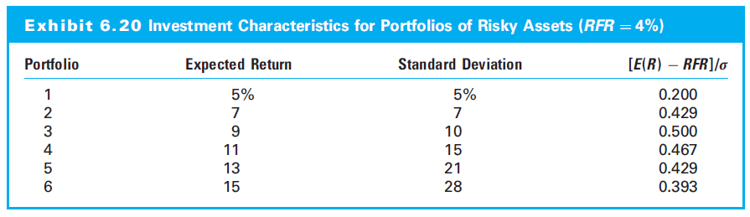
6.4.4 Investing with the CML: An Example

