Slide 1
FIN 377: Investments
Exam 1 Review: Topics 1-5
Larry Schrenk, Instructor

Slide 2
Overview
General Information/Study Suggestions
Topics
The Investment Setting
Organization and Functioning of Securities Markets
Asset Allocation and Security Selection
Introduction to Portfolio Management
Asset Pricing Models

Slide 3
General Information

Slide 4
Exam Policies
NOTE: You will be taking the exam via D2L.
Length: 50 minutes
You may use a financial calculator.
You must have the Lockdown Browser installed.
You may not use the textbook, notes, etc. The formulae below are provided for study only.
You may not substitute a phone or tablet for the calculator.
For calculations you must show work for any credit.
In yours answers, provide two decimal point accuracy for dollars, e.g., $14.13, and four decimal points for percentages, e.g., 0.0134 or 1.34%.
Make-up exams will only be given if there is official documentation of an emergency.

Slide 5
Exam Structure
Part 1: Short Answer
10 Questions
5 Points Each (50 points total)
Part 2: Calculation
5 Questions
10 Points Each (50 points total)

Slide 6
Study Suggestions

Slide 7
Study Suggestions
Study in groups
Use flashcards for ideas, definitions, theories, etc.
Do a lot of practice problems

Slide 8
Studying for Conceptual Questions
Study the slides–Anything that is the subject of a full slide is important.
Study the slides for the current issues covered on Mondays.
Review your class notes–Anything occurring multiple times is important especially if it is mentioned under different topics.
Read the textbook. IMPORTANT: You are responsible for the assigned textbook material even if we do not cover the material in class.
Know the material in the chapter summary and the key words from the textbook which are listed at the end of the chapter.
Answer the end of chapter questions

Slide 9
Studying for Calculations
Study the examples done in class and in the textbook.
Answer and understand the end of chapter problems.
Problems on MT assignments.

Slide 10
Topic 1: The Investment Setting

Slide 11
Overview
What Is An Investment?
Measures of Return and Risk
Determinants of Required Rates of Return
Relationship Between Risk and Return

Slide 12
Measures of Return and Risk
Measures of Central Tendency
Mean, Median, Mode
Measures of Dispersion
Standard Deviation, Variance
Higher Moments
Skewness, Kurtosis
Measures of Dependence
Covariance, Correlation

Slide 13
Mean (Average)
Equal Weighted Average (m, )
Applications
Calculation:

Slide 14
Mean (Average)
(Unequally) Weighted Average
Applications
Calculation:

Slide 15
Variance
Variance (σ²)
Applications
Calculation:
Sample versus Population

Slide 16
Standard Deviation
Standard Deviation (σ)

Slide 17
Covariance
Covariance (σ_{X,Y})
Applications
Calculation:
Variance versus Covariance

Slide 18
Correlation
Correlation (ρ_{X,Y})
Applications
Calculation:
Range: -1 < ρ <1

Slide 19
Statistical Calculations
On the exams you must be able to calculate the probability measures using formulae.
Using the calculator functions is not an acceptable substitute.

Slide 20
Coefficient of Variation (CV)

Slide 21
Sharpe Ratio

Slide 22
Holding Period Return (HPR)

Slide 23
Mean Historical Returns
Arithmetic Mean Return (AM)
Geometric Mean Return (GM)

Slide 24
Rate Conversions

Slide 25
Risk
Definition
Uncertainty vs. Ignorance
Upside vs. Downside
Three Steps
Expected vs. Realized/Actual
Dominance

Slide 26
Determinants of Required Rates of Return
Three Components of Required Return:
Opportunity cost
Inflation
Risk
Inflation
Real vs. Nominal
Market vs. Non-Market Risk
Risk Premium

Slide 27
Factors Influencing the Nominal Risk-Free Rate (NRFR)
Expected Rate of Inflation
Fischer equation.
An investor’s nominal required rate of return on a risk-free investment should be:

Slide 28
Real versus Nominal CFs

Slide 29
Topic 2: Organization and Functioning of Securities Markets

Slide 30
Overview
What is a Market?
Primary Capital Markets
Secondary Financial Markets
Classification of U.S. Secondary Equity Markets
Alternative Types of Orders

Slide 31
Markets
Characteristics of Good Markets
Efficient Markets
Three Forms
Money Markets vs. Capital Markets
Equity, Bond, Derivative Markets

Slide 32
Types of Orders
Limit Order
Stop Loss Order
Margin Transaction
Short Selling

Slide 33
Topic 3: Asset Allocation and Security Decision

Slide 34
Overview
Individual Investor Life Cycle
The Portfolio Management Process
Policy Statement
Asset Allocation
Global Investments
Alternative Investments

Slide 35
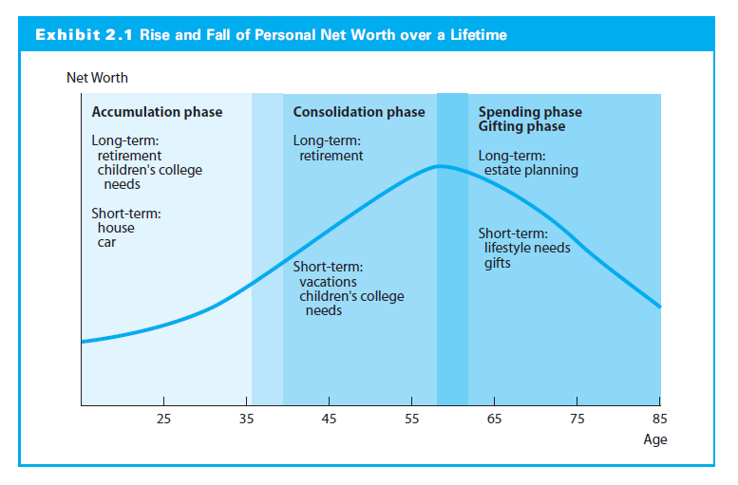
Investment Strategies over an Investor’s Lifetime

Slide 36
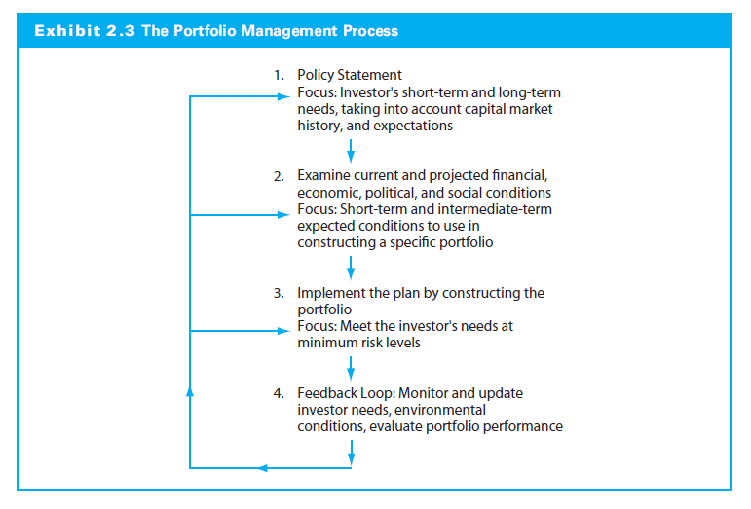
Portfolio Management Process

Slide 37
Policy Statement
Acts as a starting point for periodic portfolio review and client communication with managers
Managers should be judged by whether they consistently followed the client’s policy guidelines
Imposes an investment discipline on the client and the portfolio manager

Slide 38
Asset Allocation
The asset allocation decision dominates the portfolio’s returns over time
Investors seeking capital appreciation, income, or even capital preservation over long time periods should stipulate a sizable allocation to the equity portion in their portfolio
A strategy’s risk depends on the investor’s goals and time horizon
As an investor, you need to understand the differences among investments so you can build a properly diversified portfolio that conforms to your objectives

Slide 39
Global Investments
Three interrelated reasons why U.S. investors should think of constructing global investment portfolios:
Ignoring foreign markets reduces investment choices to less than 50 percent of available investment opportunities. Because more opportunities broaden risk-return choices, it makes sense to evaluate the full range of foreign securities when building a portfolio
The rates of return available on non-U.S. securities often have substantially exceeded those for U.S.-only securities
Diversification with foreign securities that have very low correlation with U.S. securities can substantially reduce portfolio risk

Slide 40
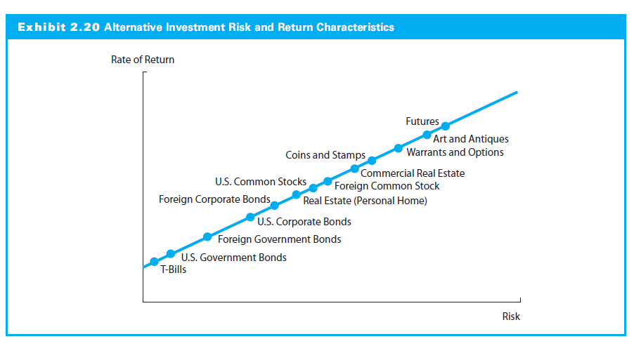
Historical Risk-Returns on Alternative Investments

Slide 41
Topic 4: An Introduction to Portfolio Management

Slide 42
Overview
Background Assumptions
Markowitz Portfolio Theory
The Efficient Frontier
Capital Market Theory

Slide 43
Background Assumptions
Investors want to maximize return from the total set of investments for a given level of risk
Portfolio includes all assets and liabilities
Relationship between the returns for assets in the portfolio is important
A good portfolio is not simply a collection of individually good investments

Slide 44
Diversification
Market vs. Non-Market Risk
Relationship between the returns for assets in the portfolio is important
A good portfolio is not simply a collection of individually good investments

Slide 45
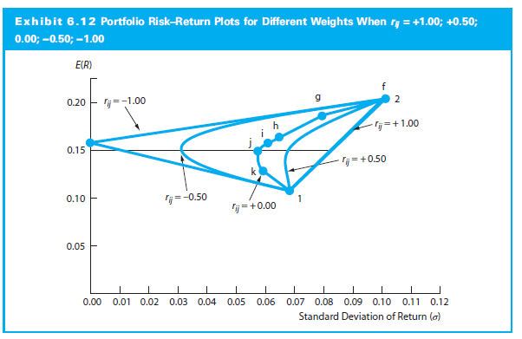
Standard Deviation of a Portfolio

Slide 46
Markowitz Portfolio Theory
A single asset or portfolio of assets is considered to be efficient if no other asset or portfolio of assets offers higher expected return with the same (or lower) risk or lower risk with the same (or higher) expected return

Slide 47
Portfolio Variance Formula

Slide 48
Two-Asset Portfolio Variance Formula

Slide 49
Portfolio Standard Deviation Formula

Slide 50
Two-Asset Standard Deviation Formula

Slide 51
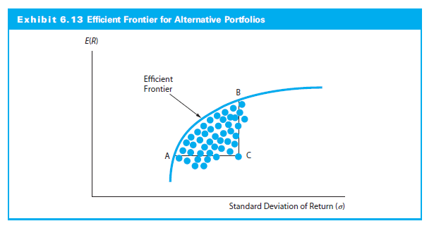
Efficient Frontier

Slide 52
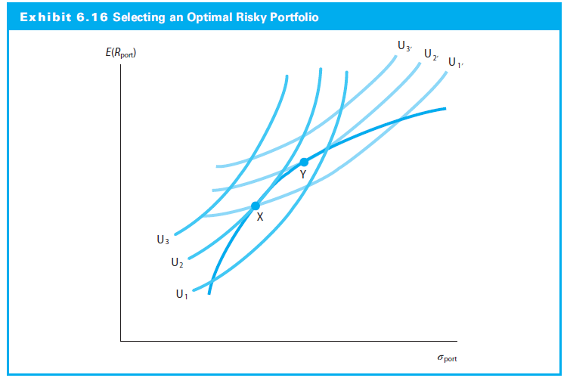
Efficient Frontier and Investor Utility

Slide 53
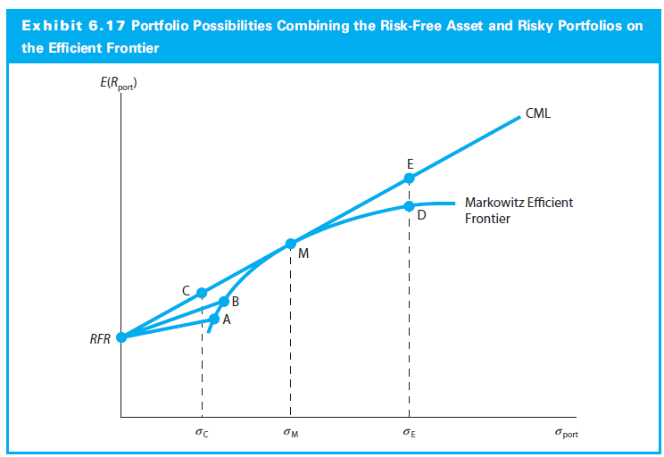
Capital Market Line

Slide 54
Combining Risk-Free Asset with a Risky Portfolio
Expected Return
Is the weighted average of the two returns:
E(R_{port}) = w_{rf} r_{f} + (1 - w_{rf})E(R_{m})
Standard Deviation
Is the linear proportion of the standard deviation of the risky asset portfolio

Slide 55
Topic 5: Asset Pricing Models

Slide 56
Overview
The Capital Asset Pricing Model
Empirical Tests of the CAPM
The Market Portfolio: Theory versus Practice
Arbitrage Pricing Theory
Multifactor Models and Risk Estimation

Slide 57
CAPM
Inserting this product into the CML and adapting the notation for the ith individual asset:
Let β_{i}=(σ_{i} r_{iM}) / σ_{M} be the asset beta measuring the relative risk with the market, the systematic risk
The CAPM indicates what should be the expected or required rates of return on risky assets
This helps to value an asset by providing an appropriate discount rate to use in dividend valuation models

Slide 58
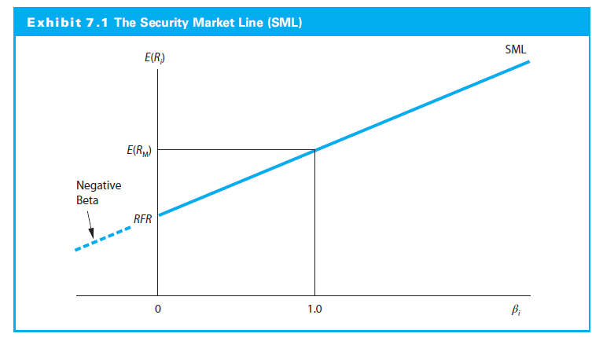
The Security Market Line (SML)

Slide 59
Empirical Tests of the CAPM
When testing the CAPM, there are two major questions
How stable is the measure of systematic risk (beta)?
Is there a positive linear relationship as hypothesized between beta and the rate of return on risky assets?

Slide 60
The Market Portfolio: Theory versus Practice
The true market portfolio should
Included all the risky assets in the world
In equilibrium, the assets would be included in the portfolio in proportion to their market value
Using U.S. Index as a market proxy
Most studies use an U.S. index
The U.S. stocks constitutes less than 15% of a truly global risky asset portfolio

Slide 61
Arbitrage Pricing Theory
Theory assumes that the return-generating process can be represented as a K factor model of the form:
where:
Notes:
15

Slide 62
Multifactor Models and Risk Estimation
In a multifactor model, the investor chooses the exact number and identity of risk factors, while the APT model does not specify either of them
where:
F_{it}= Period t return to the jth designated risk factor
R_{it} = Security i’s return that can be measured as either a nominal or excess return to Security i

