Slide 1
FIN 377: Investments
Topic 6: Bond Fundamentals and Valuation
Larry Schrenk, Instructor

Slide 2
Overview
12.1 Basic Features of a Bond
12.2 The Global Bond Market Structure
12.3 Survey of Bond Issues
12.4 Bond Yield Curves
12.5 Bond Valuation and Yields
13.1 Bond Analysis Tools

Slide 3
Learning Objectives
What are some of the basic features of bonds that affect their risk, return, and value?
What is the current country structure of the world bond market, and how has the makeup of the global bond market changed in recent years?
What are the major components of the world bond market?
What are bond ratings, and what is their purpose? What is the difference between investment-grade bonds and high-yield (junk) bonds?
What are the characteristics of bonds in the major bond categories, such as governments, agencies, municipalities, and corporates, and how are their prices quoted?
What are the important characteristics of corporate bond issues developed in the United States over the past decades, such as mortgage-backed securities, other asset-backed securities, zero-coupon bonds, and high-yield bonds?
What is a yield curve, and how is its shape determined?
What is the difference between the par and spot yield curves?
How do you determine the value of a bond based on the discounted cash flow formula?
How does bond valuation change when you are between two coupon dates?
How do you compute the following yields on bonds: current yield, yield to maturity, yield to call, and compound realized (horizon) yield?
What are implied forward rates, and how do you calculate these rates from a spot yield curve?
What is meant by the duration of a bond, how do you compute it, and what factors affect it?
What is modified duration, and what is the relationship between a bond’s modified duration and its price volatility?

Slide 4
Readings
Reilley, et al., Investment Analysis and Portfolio Management, Chap. 12 and 13.1

Slide 5
12.1 Basic Features of a Bond

Slide 6
12.1 Basic Features of a Bond
Public bonds
Long-term, fixed-obligation debt securities
Periodic fixed amount of interest
Fixed principal at the date of maturity
Interest is paid every six months
Principal is due at maturity
Par (or face) value

Slide 7
12.1 Basic Features of a Bond
Segments are based on maturity:
Short-term
Maturities of one year or less
Money market
Intermediate-term
Maturities 1 to 10 years
These instruments are known as notes
Long-term
Maturities in excess of 10 years
Callable bonds

Slide 8
12.1.1 Bond Characteristics
Intrinsic Features
Coupon
Term to maturity
Principal or par (face) value
Types of ownership
Bearer vs. registered bond

Slide 9
12.1.1 Bond Characteristics
Types of Issues
Secured bonds (mortgages)
Backed by legal claim on some specified property
E.g. mortgage bonds, equipment trust certificates
Unsecured bonds (debentures)
General claim on firm assets
Senior vs junior (subordinate) debentures

Slide 10
12.1.1 Bond Characteristics
Indenture provisions
The indenture is the contract between the issuer and the bondholder specifying the issuer’s legal requirements

Slide 11
12.1.1 Bond Characteristics
Features affecting a bond’s maturity
Call option
Deferred call
Call premium
Amount above par value for prematurely retiring the bond
Nonrefunding provision
Prohibits call
Sinking fund
Bond paid off systematically over its life

Slide 12
Features of a May Department Stores Bond
Terms Explanations
Amount of issue $125 million The company will issue $125 million worth of bonds.
Date of issue 2/28/86 The bonds were sold on 2/28/86.
Maturity 3/1/16 The principal will be paid in 30 years.
Annual coupon 9.25 The denomination of the bonds is $1,000. Each bondholder will receive $92.50 per bond per year (9.25% of the face value).
Offer price 100 The offer price will be 100% of the $1,000 face value per bond.

Slide 13
Features of a May Department Stores Bond (concluded)
Terms Explanations
Coupon payment dates 3/1, 9/31 Coupons of $92.50/2 = $46.25 will be paid on these dates.
Security None The bonds are debentures.
Sinking fund Annual, toward The firm will make annual payments the sinking fund. beginning 3/1/97 Call Provision Not callable The bonds have a deferred call before 2/28/93
Call price 106.48 initially, After 2/28/93, the company can buy declining to 100 back the bonds for $1,064.80 per bond, declining to $1,000 on 2/28/05.
Rating Moody’s A2 This is one of Moody’s higher ratings. The bonds have a low probability of default.

Slide 14
12.2 The Global Bond Market Structure

Slide 15
12.2 The Global Bond Market Structure
Fixed-income securities market substantially larger than equity exchanges
Equity less than 10 percent of all new security issues (US 2010)

Slide 16
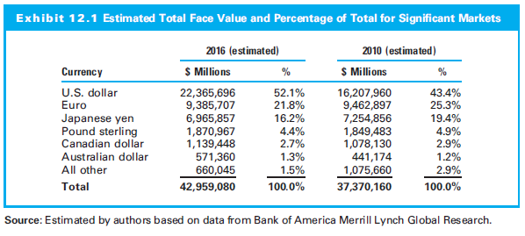
12.2 The Global Bond Market Structure

Slide 17
12.2.1 Participating Issuers
Sovereign bonds
Quasi and foreign governments (including agency bonds)
Securitized and collateralized bonds from governments or corporations
Directly issued corporate bonds
High-yield and/or emerging market bonds

Slide 18
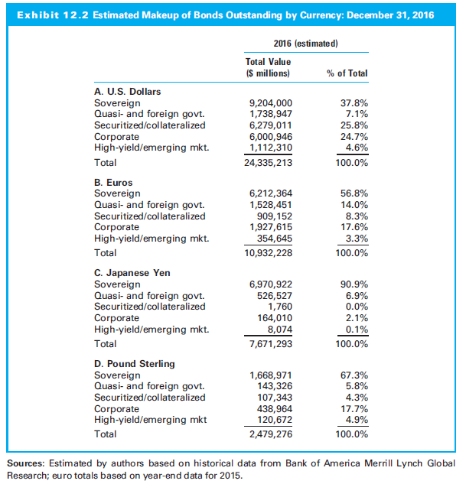
12.2.1 Participating Issuers

Slide 19
12.2.2 Participating Investors
Individual investors
Institutional investors
Life Insurance Companies
Commercial Banks
Property and Liability Insurance Companies
Pension Funds
Mutual Funds
Two factors
Applicable tax code
Institution’s liability structure

Slide 20
12.2.3 Bond Ratings
Primary risk: Default
The three major rating agencies
Moody’s
Standard and Poor’s
Fitch Investors Service
Description of bond ratings
Investment-grade securities
Speculative bonds
Income obligations or revenue bonds
Default
High yield or “junk bonds”

Slide 21
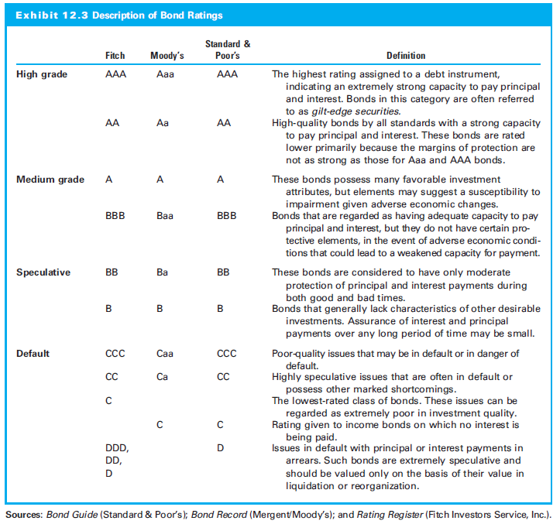
12.2.3 Bond Ratings

Slide 22
12.3 Survey of Bond Issues

Slide 23
12.3.1 Domestic Government Bonds
United States
T-bills, notes, bonds
Japan
Second-largest single country government bond market
United Kingdom
Gilts
Eurozone
Combined value larger than the Japanese market
All denominated in euros

Slide 24
12.3.2 Government Agency Issues
Government obligations issued through specific agency
Not direct Treasury issues, but carry the full faith and credit of U.S. government
Some subject to state and local income tax

Slide 25
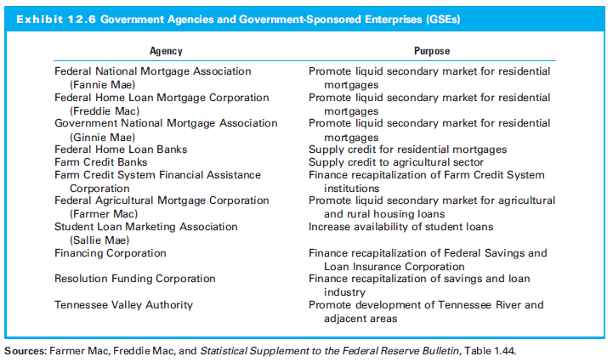
12.3.2 Government Agency Issues

Slide 26
12.3.3 Municipal Bonds
Types:
General obligation (GO) bonds
Revenue bonds
Interest payments are exempt from federal income tax
Convert the tax-free yield of a municipal to an equivalent taxable yield (ETY) as follows:
Where
ETY = equivalent taxable yield
i = yield of the municipal obligations
t = marginal tax rate of the investor

Slide 27
12.3.4 Corporate Bonds
U.S. Corporate Bond Market
Includes utilities, industrials, rail and transportation, and financial issues
Debentures
First-mortgage issues
Convertible obligations
Bonds with warrants
Subordinated debentures
Income bonds (similar to municipal revenue bonds)
Collateral trust bonds backed by financial assets
Equipment trust certificates
Asset-backed securities (ABS) - including mortgage-backed securities (MBS)
Collateralized mortgage obligations (CMOs)
Certificates for automobile receivables (CARs)
Credit card–backed securities
Collateralized debt obligations (CDOs)

Slide 28
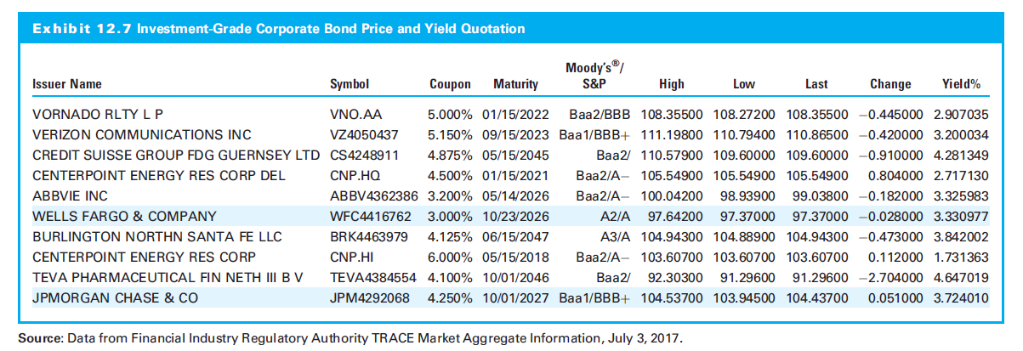
12.3.4 Corporate Bonds

Slide 29
12.3.5 Nontraditional Bond Coupon Structures
Variable-rate notes
Popular during periods of high interest rates,
Typically two unique features
Coupon rate allowed to adjust (“float”)
After the first year or two, the notes are redeemable at par, at the holder’s option, usually at six-month intervals

Slide 30
12.3.5 Nontraditional Bond Coupon Structures
Zero-coupon (or pure discount) bond:
No interim interest payments
Price is present value of principal
Return is difference between cost and principal

Slide 31
12.3.6 High-Yield Bonds
Also speculative or junk bonds
Rated below BBB, that is, non-investment grade bonds
Market exploded in the early 1980s
Major owners are mutual funds, insurance companies, and pension funds

Slide 32
12.3.7 International Bonds
Foreign bonds are sold in one country and currency by a borrower of a different nationality
Yankee bonds are U.S. dollar-denominated bonds sold in the U.S. but issued by a foreign firm
Eurobonds underwritten by international bond syndicates and sold in several national markets

Slide 33
12.3.7 International Bonds
United States
Yankee bonds register with SEC
Eurodollar bond market affected by changes in value of U.S. dollar
Japan
Samurai bonds: Yen denominated issued by non-Japanese firms in Japan
Euroyen bonds: Yen denominated, sold outside Japan

Slide 34
12.4 Bond Yield Curves (Chapter 12 and 13.1.1)

Slide 35
12.4 Bond Yield Curves
Bond’s yield to maturity (YTM) is perhaps the most important statistic
Yield to maturity is expected return to the bond

Slide 36
12.4.1 The Determinants of Bond Yields
Factors causing interest rates (i) to change:
i = RRFR + I + RP
Where:
RRFR = real risk-free rate of interest
I = expected rate of inflation
RP = risk premium

Slide 37
12.4.1 The Determinants of Bond Yields
Effect of Economic Factors
RRFR is economic cost of money−the opportunity cost necessary to forgo consumption
Determined by real growth rate of the economy with short-run effects due to easing or tightening in the capital market
The expected rate of inflation is the other economic influence on interest rates
Add expected level of inflation (I) to real risk-free rate (RRFR) to specify nominal r_{f}, which is an observable rate like the current yield on government T-bills

Slide 38
12.4.1 The Determinants of Bond Yields
The Impact of Bond Characteristics
Characteristics unique to individual securities, market sectors, or countries influence risk premium (RP)
Risk premium has four components:
Quality of the issue, i.e., risk of default
Term to maturity
Indenture provisions
Foreign bond risk, including exchange rate and country risk

Slide 39
12.4.2 Yield Curves and the Term Structure of Interest Rates
Term structure of interest rates (or yield curve) relates maturity to the yield of bonds at a given point in time
Cross section of comparable bonds
Quality should be constant with similar coupons and call features

Slide 40
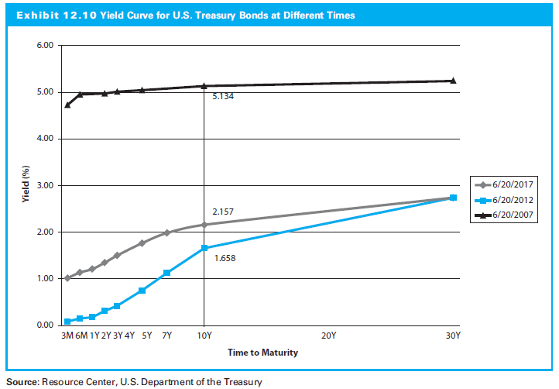
12.4.2 Yield Curves and the Term Structure of Interest Rates

Slide 41
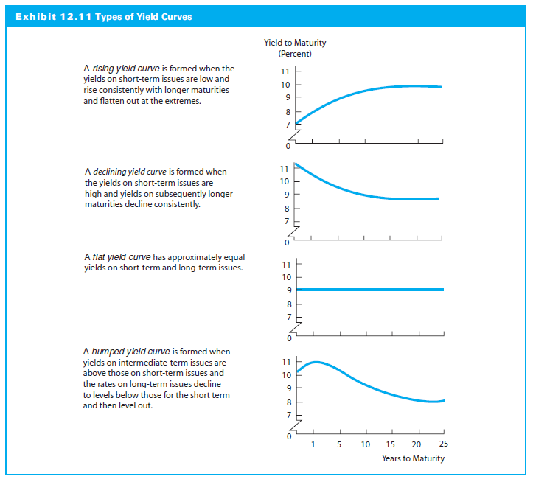
12.4.2 Types of Yield Curves

Slide 42
‘Implied’ Future Interest Rates
If I know the average return of
A one year bond (x), and
A two year bond (y)
I should be able to calculate
The interest rate in year 2 (f₂)
One Year Average (x)
Two Year Average (y)
Interest Rate in Year 2 (f₂)

Slide 43
‘Implied’ Future Interest Rates
Think of it this way…
What would the year 2 interest rate (f₂) need to be, to change the one year average (x) to the two year average (y)?
NOTE: f_{n} = implied future interest rate in year n
One Year Average (x)
Two Year Average (y)
Interest Rate in Year 2 (f₂)

Slide 44
Example: Future Interest Rates
Maturity | 1 | 2 | 3 | 4
Rate | 5.4 | 5.6 | 6.1 | 5.8
5.4%
5.6%
6.1%
5.8%

Slide 45
‘Implied’ Future Interest Rates
5.4%
???
5.6%
HPR one two-year bond (1.056)² - 1
HPR two one-year bonds 1.054(1+ f₂) - 1
These must be equal
1.054(1+ f₂) - 1 = (1.056)²- 1
Solve for f₂
f₂ = (1.056)² /1.054 – 1 = 5.8%

Slide 46
‘Implied’ Future Interest Rates
General Formula

Slide 47
‘Implied’ Future Interest Rates
Maturity | 1 | 2 | 3 | 4
Rate | 5.4 | 5.6 | 6.1 | 5.8
f_{n} | 5.4 | 5.8 | 7.1 | 4.9

Slide 48
12.4.4 Yield Curves for Credit-Risky Bonds
Credit spread
Yield differential representing the risk premium associated with the possibility that the corporate issuer will be unable to pay back what it has promised to the investor

Slide 49
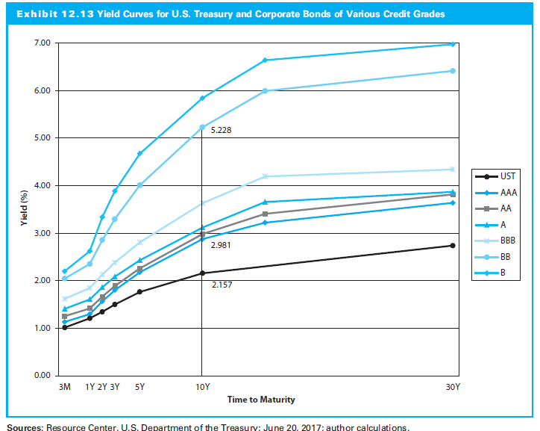
12.4.4 Yield Curves for Credit-Risky Bonds

Slide 50
12.4.5 Determining the Shape of the Term Structure
Expectations Hypothesis
Long-term interest rate is geometric mean of one-year interest rates over the life of the issue
Expectations short-term rates rising → rising yield curve
Expectations short-term rates falling → declining yield curve
Similarly for flat and humped yield curves

Slide 51
12.4.5 Determining the Shape of the Term Structure
Liquidity Preference Theory
Long-term securities provide higher returns because investors sacrifice some yields to avoid price volatility of long-maturity bonds
Yield curve should slope upward and any other shape viewed as a temporary aberration

Slide 52
12.4.5 Determining the Shape of the Term Structure
Segmented-Market Hypothesis
Different institutional investors have different maturity needs depending on the supply and demand within that maturity segment
Shape of the yield curve function of investment policies of major financial institutions

Slide 53
12.5 Bond Valuation and Yields

Slide 54
12.5 Bond Valuation and Yields with Coupons
Bond value:
Where:
C = period coupon rate
i = yield to maturity, stated on a period basis
n = maturity date of the bond, stated in periods

Slide 55
Bond Pricing Example I
Price of a semi-annual 30 year, 8% coupon bond. Market rate of interest is 10%.

Slide 56
Bond Pricing Example II
Price of a semi-annual 30 year, 8% coupon bond. Market rate of interest is 10%.
P/Y = 2; N = 60; I = 10; PV = $810.71;
PMT = -40; FV = -1000
NOTE: Negatives

Slide 57
12.5 Bond Valuation and Yields with Semiannual Coupons
The Yield (to Maturity YTM) Model
Price bonds in terms of their yields−expected rates of return
Use the observed current market price (MP0) and the expected cash flows to compute the expected yield on the bond
Equivalent to IRR

Slide 58
Yield to Maturity Example I
Suppose an 8% coupon, semi-annual 30 year bond is selling for $1276.76. What is its average rate of return?
r = 3% per half year
YTM = 6%

Slide 59
Yield to Maturity Example II
Suppose an 8% coupon, semi-annual 30 year bond is selling for $1276.76. What is its average rate of return?
P/Y = 2; N = 60; I = 6.00%; PV = 1276.76; PMT = -40; FV = -1000

Slide 60
12.5 Relationship between Bond Yields, Coupon Rates, and Prices
Price moves in the opposite direction to YTM
YTM < cr → premium bond
YTM > cr → discount bond
YTM = cr → par value bond
The price-yield relationship is convex
As yields decline, the price increases at an increasing rate;
As yields increase, the price declines at a declining rate

Slide 61
12.5 Relationship between Bond Yields, Coupon Rates, and Prices
Bond and Price Change Magnitude
Bond value inversely related to YTM
Magnitude of change depends on other characteristics, such as the coupon rate and time to maturity
Two additional facts:
Lower coupon rate → greater percentage price change for a given shift in yields
Same coupon rate, longer maturity → greater percentage price change for a given shift in yields

Slide 62
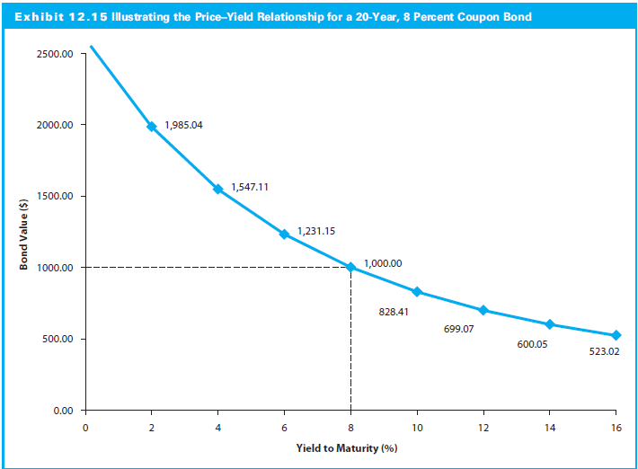
12.5 Relationship between Bond Yields, Coupon Rates, and Prices

Slide 63
12.5 Computing Other Bond Yield Measures
Current Yield
How much return comes from annual payments
Ratio of annual coupon to current price
Where
C is the fixed annual coupon
MP₀ is the bond’s current market price

Slide 64
Current Yield Example
Current Yield
Bond’s annual coupon payment divided by the bond price
Suppose an 8% coupon, semi-annual 30 year bond is selling for $1276.76. What is its current yield?

Slide 65
12.5 Computing Other Bond Yield Measures
Yield to Call (YTC)
Expected return is bond called at first opportunity
Adjust present value equation:
Where:
n_{call} = number of periods to first call date
P_{call} = call price of the bond

Slide 66
Yield to Call Example
Suppose an 8% coupon, 30 year semi-annual bond is selling for $1100.55. If it can be called in 2 years with a call price is $1,100 what is its yield to call?
P/Y = 2; N = 4; I = 7.25%; PV = 1100.55; PMT = -40; FV = -1100

Slide 67
12.5 Computing Other Bond Yield Measures
Realized (Horizon) Yield
Expected rate of return for some time horizon
Assumes holding period (hp, expressed in periods) less than n
Adjust discounted cash flow valuation:
where:
P_{hp} = anticipated selling price of the bond at the end of the investment horizon

Slide 68
13.1 Bond Analysis Tools (Chapter 13.1.2-3)

Slide 69
Bond Duration and Convexity
Convexity
Duration

Slide 70
13.1.2 Bond Duration
Calculating Bond Duration
Bond duration can be interpreted as a measure of the bond’s price volatility (interest rate sensitivity)
Duration is bond’s price elasticity coefficient with respect to yield changes

Slide 71
13.1.2 Bond Duration
Macaulay versus Modified Duration
Macaulay duration: How many years to be repaid bond’s price by the its total cash flows
Modified duration: Price change in a bond given a 1% change in interest rates

Slide 72
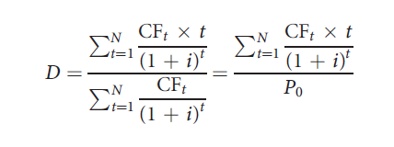
13.1.2 Bond Duration
Macaulay duration: Weighted average of the payment dates associated with an N-period bond:
where:
CF_{t} = cash flow (that is, coupon or principal) paid on date t
t = date on which payment is made
i = yield to maturity of the bond, stated on a periodic basis

Slide 73
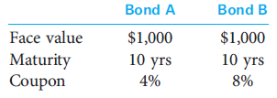
13.1.2 Bond Duration
Example:
Consider the following two bonds:
Assume YTM for both bonds is 8 percent and pay annual coupons

Slide 74
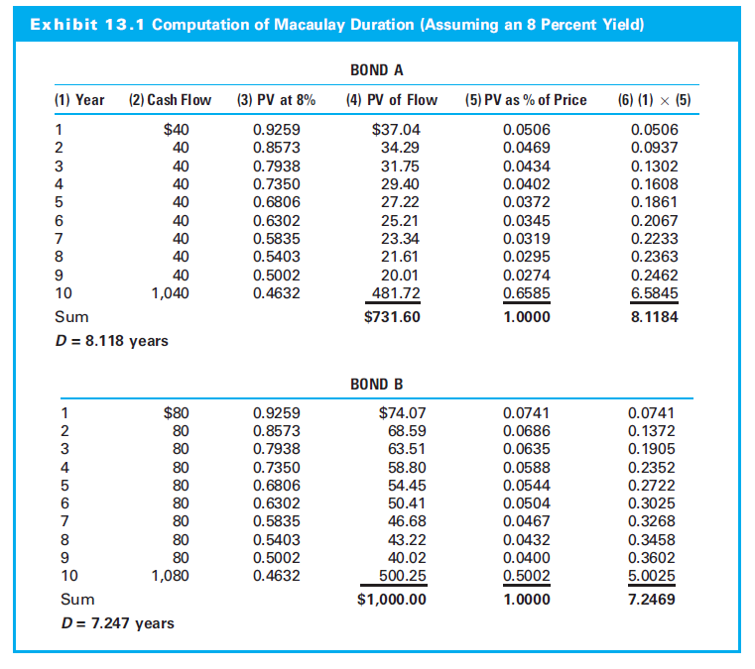
13.1.2 Bond Duration

Slide 75
13.1.2 Bond Duration
Duration is measured in units of time, not dollars
Weights are the PV of cash flow scaled by the PV (P₀) of the bond
Higher coupon → lower duration
More of the total cash flow is paid sooner
Zero-coupon bond → duration = maturity

Slide 76
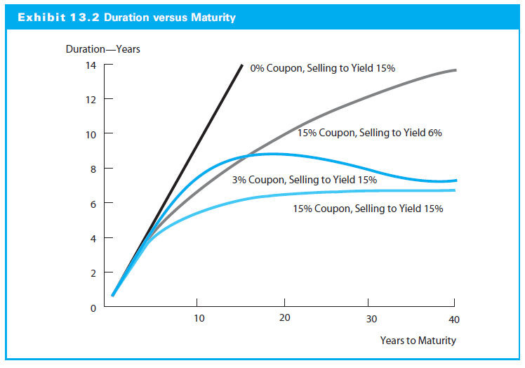
13.1.2 Bond Duration

Slide 77
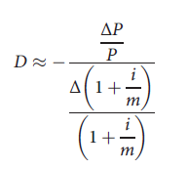
13.1.2 Bond Duration
Measuring Bond Price Volatility
Duration is bond’s price elasticity coefficient with respect to yield changes:
Where:

Slide 78
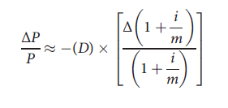
13.1.2 Bond Duration
Equation rewritten to “predict” change in a price for a small change in YTM:

Slide 79
13.1.2 Bond Duration
Bond price change inputs:
Macaulay duration of the bond, D
Prevailing bond yield, i
Forecasted change in the bond yield, Δi
Modified durations combines the first two components:

Slide 80
13.1.2 Bond Duration
The equation can be simplified to:
The basis point value (BPV) measures the dollar price change for a one basis point change in yields:

Slide 81
13.1.2 Bond Duration
Duration of a Portfolio
Duration of a portfolio is the weighted average of the payment dates for all of the cash flows across the collection of bonds
Estimated by a weighted average of the durations for each of the bonds using the investment weight of each position:

Slide 82
13.1.3 Bond Convexity
Trade-off between price and YTM is curved (convex) function
Mod D misses convexity property
Mod D estimates a curved line with a straight (tangent) line

Slide 83
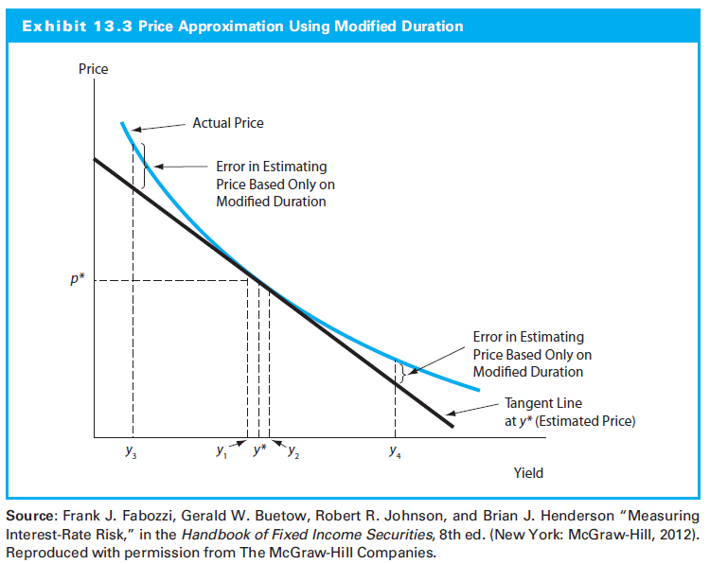
13.1.3 Bond Convexity

Slide 84
13.1.3 Bond Convexity
Duration approximation of the price-yield relationship is conservative
Overestimates price decline following yield increase
Underestimates price increase induced by yield decrease
Modified duration:
Approximates bond price change as interest rates changes
Convexity approximates how modified duration will change with yield curve shifts

Slide 85
13.1.3 Bond Convexity
Convexity formula:

Slide 86
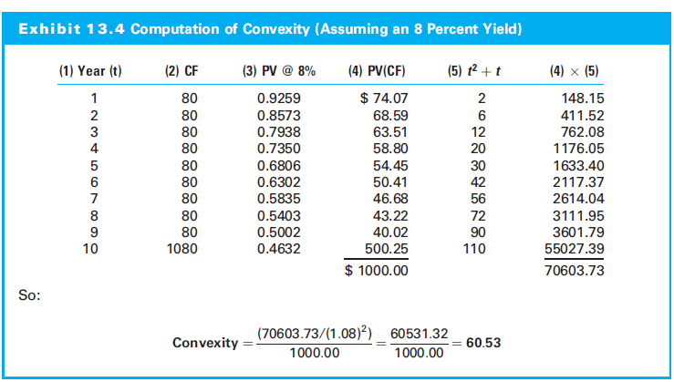
13.1.3 Bond Convexity

Slide 87
13.1.3 Bond Convexity
For annual bond, the formula modified by adding a second term involving the convexity statistic:

Slide 88
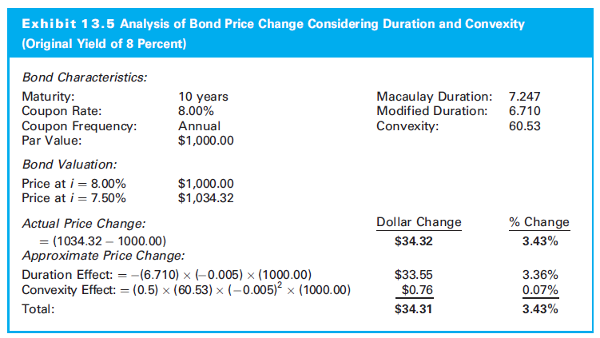
13.1.3 Bond Convexity

