Slide 1
FIN 377: Investments
Topic 8: An Introduction to Derivative Markets and Securities
Larry Schrenk, Instructor

Slide 2
Overview
14.1 Overview of Derivative Markets
14.2 Investing with Derivative Securities
14.3 Relationship between Forward and Option Contracts
14.4 Introduction to Derivatives in Portfolio Management

Slide 3
Learning Objectives
What distinguishes a derivative security, such as a forward, futures, or option contract, from more fundamental securities, such as stocks and bonds?
What are the important characteristics of forward, futures, and option contracts, and in what sense can they be interpreted as insurance policies?
How are the markets for derivative securities organized, and how do they differ from other security markets?
What terminology is used to describe derivative market transactions?
How are prices for derivative securities quoted, and how should this information be interpreted?
What are the similarities and differences between forward and futures contracts?
What do the payoff and profit diagrams look like for forward and futures contracts?
What do the payoff and profit diagrams look like for put and call option contracts?
How are forward contracts, put options, and call options related to one another?
How can derivatives be used in conjunction with stock and Treasury bills to replicate the payoffs to other securities and create arbitrage opportunities for an investor?
How can derivative contracts be used to restructure cash flow patterns and modify the risks in existing investment portfolios?

Slide 4
Readings
Reilley, et al., Investment Analysis and Portfolio Management, Chap. 14

Slide 5
14.1 Overview of Derivative Markets

Slide 6
14.1 Overview of Derivative Markets
A derivative instrument is one for which the ultimate payoff depends directly on the value of another security or commodity

Slide 7
14.1 Overview of Derivative Markets
Two basic kinds of derivatives available:
Forward and futures contracts
Option contracts
Only one forward contract is needed for any particular maturity and underlying asset
Two types of options
Calls
Puts
For each of these derivatives, an investor can enter into a transaction as:
The long position (the buyer)
The short position (the seller)

Slide 8
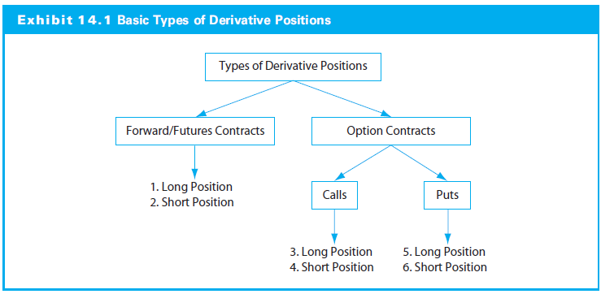
14.1 Overview of Derivative Markets

Slide 9
14.1.1 The Language and Structure of Forward and Futures Markets
Forward contract gives holder obligation to execute a transaction
At a predetermined date (maturity date)
At a predetermined price (contract price)
Two parties (counterparties)
The eventual buyer (or long position)
The eventual seller (or short position)

Slide 10
14.1.1 The Language and Structure of Forward and Futures Markets
Forward and Spot Markets
Forward contract is a trade agreement
Terms the same a bond transaction thatis settled immediately (i.e., a spot market transaction), but
The settlement date, at time T rather than 0
The contract price, F_{0, T} rather than S₀
No payments until expiration

Slide 11
14.1.1 The Language and Structure of Forward and Futures Markets
Forward and Futures Markets
Forward contracts over-the-counter, involve credit (or default) risk, and quite often illiquid
Futures contracts:
Standardized
Central market (futures exchange)
More liquidity
Less default risk: Margin requirements
Settlement price: Daily “marking to market”

Slide 12
14.1.1 The Language and Structure of Forward and Futures Markets
Futures exchange requires collateral, or margin, against the possibility of default
Margin accounts are:
Held by the exchange’s clearinghouse
Marked to market daily basis to ensure sufficient collateral
Futures price:
Analogous to the forward contract price
Set such that new position would not have initial premium

Slide 13
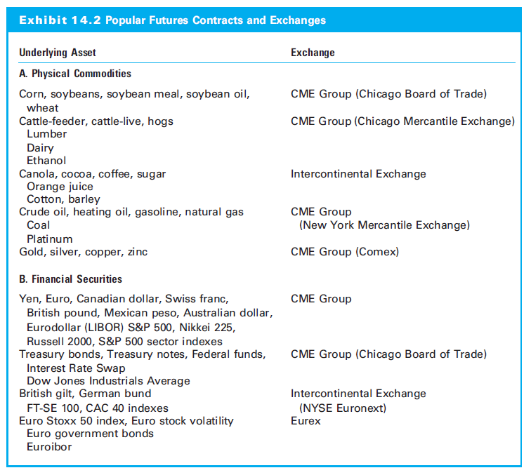
14.1.1 The Language and Structure of Forward and Futures Markets

Slide 14
14.1.2 Interpreting Futures Price Quotations: An Example
Spot and futures prices on the S&P 500 Index in June
Index at 2,439.07, spot price (S₀)
Consider the September futures contract
The settle (closing) contract price 2,436.00 (=F_{0,T})
Long position to buy in June 250 shares in S&P 500 Index at $2,436.00
Short position to sell 250 S&P shares under the same conditions
Except for the margin, no money changes hands until September

Slide 15
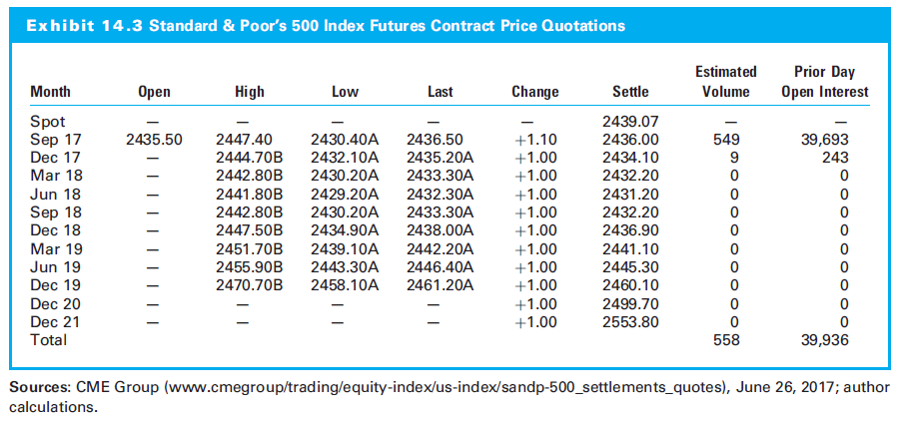
14.1.2 Interpreting Futures Price Quotations: An Example

Slide 16
14.1.2 Interpreting Futures Price Quotations: An Example
Payoff and net profit from the long position
Payoff is positive when the S&P index level rises (relative to 2,436.00); loss when falls
If at expiration index is 2,475.00, long position has profit of $39.00
If at expiration index is 2,415, long position has loss of $21.00

Slide 17
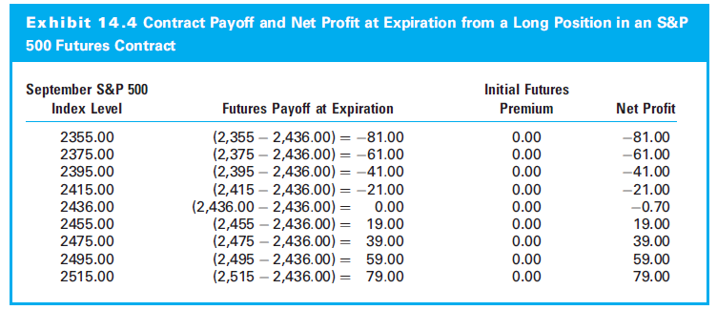
14.1.2 Interpreting Futures Price Quotations: An Example

Slide 18
14.1.3 The Language and Structure of Option Markets
Option contract gives right, but not the obligation to buy or to sell underlying at a predetermined future date and a predetermined price
Option to buy is a call option
Option to sell is a put option
Buyer has the long position in the contract
Seller (writer) has the short position in the contract
Buyer and seller are counterparties in the transaction

Slide 19
14.1.3 The Language and Structure of Option Markets
Option Contract Terms
Exercise price (X) is the price buyer will pay if the option exercised
Option premium (C_{0,T}) is the price buyer must pay to acquire the option contract
European options can only be exercised only at maturity (Date T)
American options can be exercised any time before and at the expiration date

Slide 20
14.1.3 The Language and Structure of Option Markets
Option Valuation Basics
Intrinsic value is value if option exercised immediately
In the money: An option with positive intrinsic value
Out of the money: The intrinsic value is zero
At the money: When the stock price is equal to exercise price, S₀ = X
The time premium component is simply the difference between the whole option premium and the intrinsic component

Slide 21
14.1.3 The Language and Structure of Option Markets
Option Trading Markets
Over-the-counter markets and on exchanges
Only seller post a margin
Options can be based on a wide variety of underlying securities, including futures contracts or other options

Slide 22
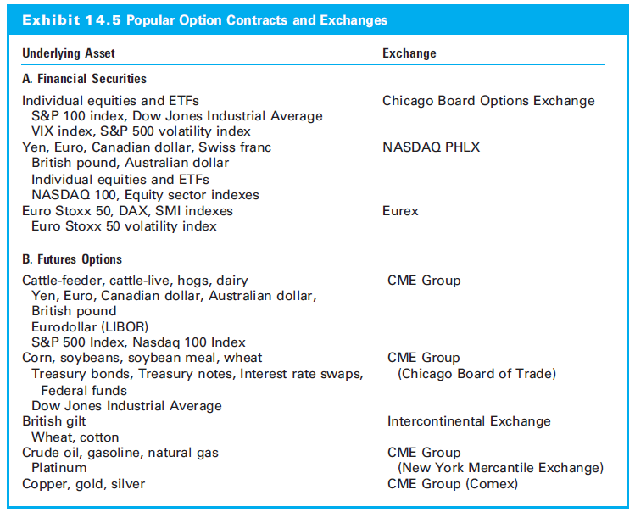
14.1.3 The Language and Structure of Option Markets

Slide 23
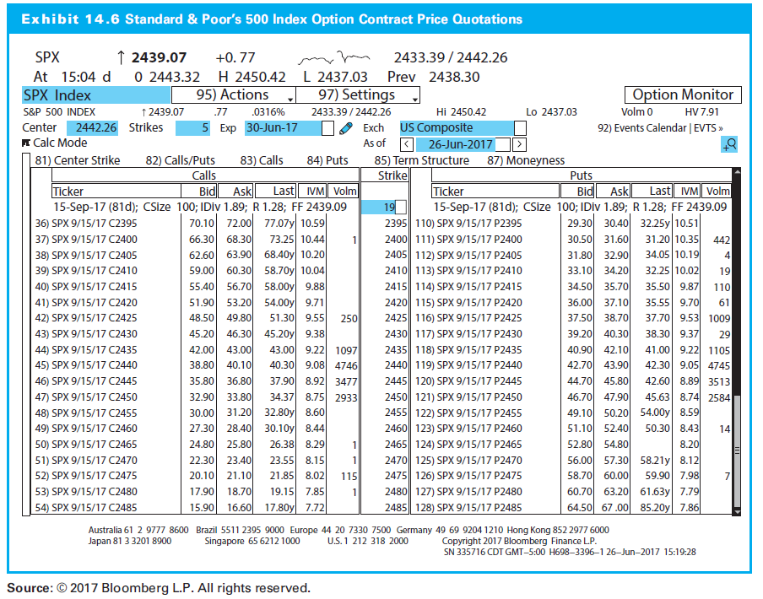
14.1.4 Interpreting Option Price Quotations: An Example

Slide 24
14.1.4 Interpreting Option Price Quotations: An Example
Two investors: one buys a September S&P call at 2,435 (X) and one a put
In June, each pays a premium‒of $43.00 (C₀,T) and $42.10 (P₀,T), respectively

Slide 25
14.1.4 Interpreting Option Price Quotations: An Example
Current (spot) price is 2439.07:
Call option:
Investor has the right, but not the obligation, to buy one S&P share for $2,435 in September
Call option is in the money
Premium of $43.00 = intrinsic value of $4.07 + time premium of $38.93
Put option:
Investor has the right, but not the obligation, to sell one S&P share for $2,435 in September
The put is out of the money (since this exercise price is lower than the current index level)
No intrinsic value, so $42.10 is all time premium

Slide 26
14.1.4 Interpreting Option Price Quotations: An Example
Call option payoffs:
Exercised only when S&P level is above 2,435
At or below 2,435, option expires worthless
Call is in the money if index above 2,435, BUT no net profit unless index above 2,478.00‒the exercise price plus the call premium (X + C_{0,T})

Slide 27
14.1.4 Interpreting Option Price Quotations: An Example
Put option payoffs
Exercised only when S&P level is below 2,435
No net profit unless index below 2,392.90 (X -P_{0,T})
If index above 2,435, put expires out of the money

Slide 28
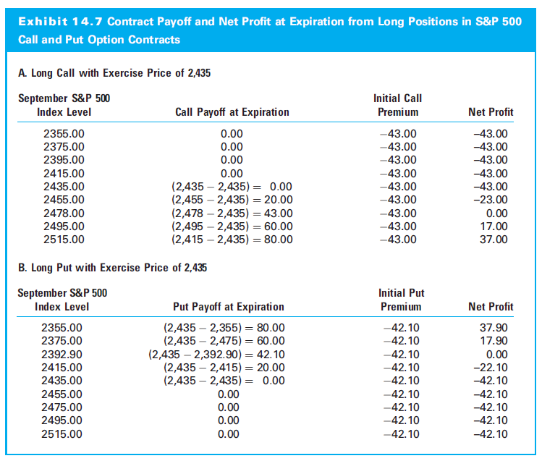
14.1.4 Interpreting Option Price Quotations: An Example

Slide 29
14.1 Investing with Derivative Securities

Slide 30
14.2 Investing with Derivative Securities
Forwards and options are similar in terms of the benefits for investors
The difference is how the investor must pay for those benefits

Slide 31
14.2.1 The Basic Nature of Derivative Investing
Investor decides to purchase a share in six months
Forward and call options available with prices F_{0,T} and C_{0,T} and call exercise price of the option, X, is F_{0,T}
Two choices to lock in the price now:
A long position in the forward
Does not require front-end payment
Requires future settlement payment
Purchase of a call option
Requires up front payment
Allows but does not require future settlement payment

Slide 32
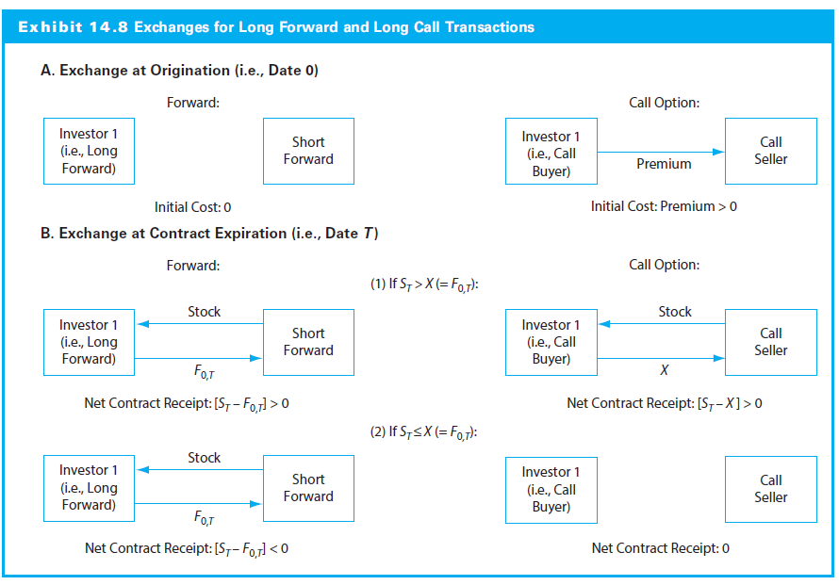
14.2.1 The Basic Nature of Derivative Investing

Slide 33
14.2.2 Basic Payoff and Profit Diagrams for Forward Contracts
Long and short forward payoffs are symmetric, mirror images
Forward contracts are zero-sum games
NOTE: Distinguish Payoff vs. Profit

Slide 34
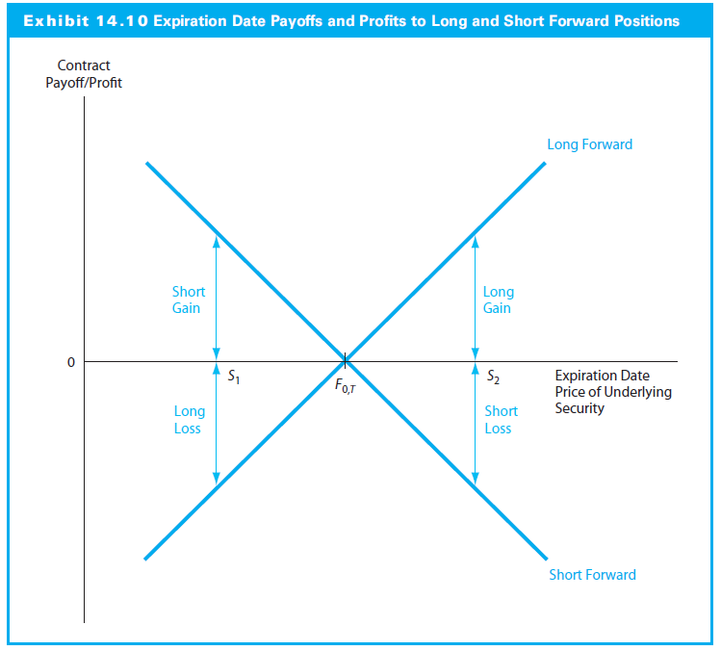
14.2.2 Basic Payoff and Profit Diagrams for Forward Contracts

Slide 35
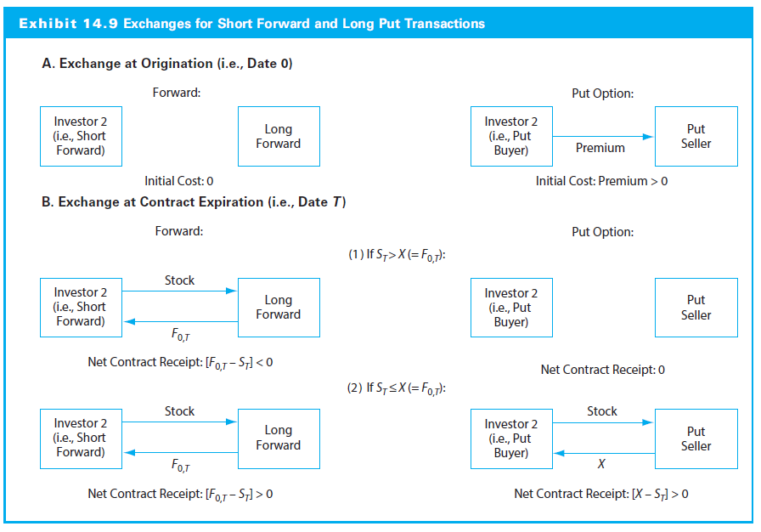
14.2.2 Basic Payoff and Profit Diagrams for Forward Contracts

Slide 36
14.2.3 Basic Payoff and Profit Diagrams for Call and Put Options
Difference between payoff and profit is the premium (cost), a sunk cost
Payoffs at expiration that are asymmetric, or one-sided
E.g., call buyer has unlimited upside potential with limited downside risk
Payoffs and profits for option buyers and sellers are zero-sum games, mirror images

Slide 37
14.2.3 Basic Payoff and Profit Diagrams for Call and Put Options
As investments, options are directional views on movements in the price of the underlying security (Delta strategies)
Call buyers and put sellers want S_{T} to rise
Put buyers and call sellers want S_{T} to fall
Option buyers always have limited liability‒they do not have to exercise an out-of-the-money position

Slide 38
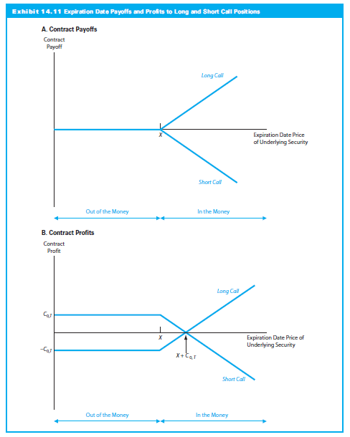
14.2.3 Basic Payoff and Profit Diagrams for Call and Put Options

Slide 39
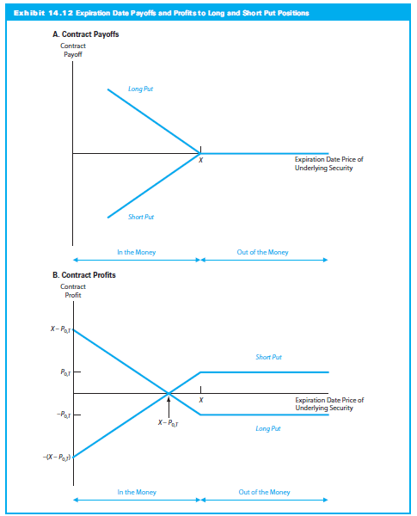
14.2.3 Basic Payoff and Profit Diagrams for Call and Put Options

Slide 40
14.2.4 Option Profit Diagrams: An Example
SAS sells for $40, and six different options (three calls and three puts) are available
The options all expire on the same date and have exercise prices of $35, $40, or $45

Slide 41
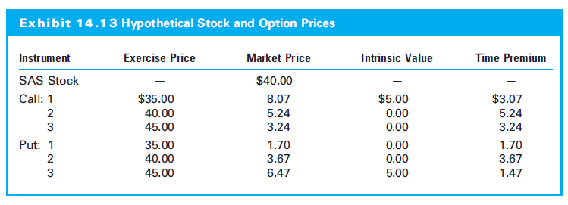
14.2.4 Option Profit Diagrams: An Example

Slide 42
14.2.4 Option Profit Diagrams: An Example
Call options
Most expensive, the deepest in-the-money contract (Call 1) becomes profitable the quickest, requiring only that S_{T} rise to $43:07 (= 35 + 8.07)
Least expensive requires the greatest movement in ‒ to $48.24 ‒ before it becomes profitable
Put options
Put 1 (the out-of-the-money contract) costs the least but needs the largest price decline to be profitable

Slide 43
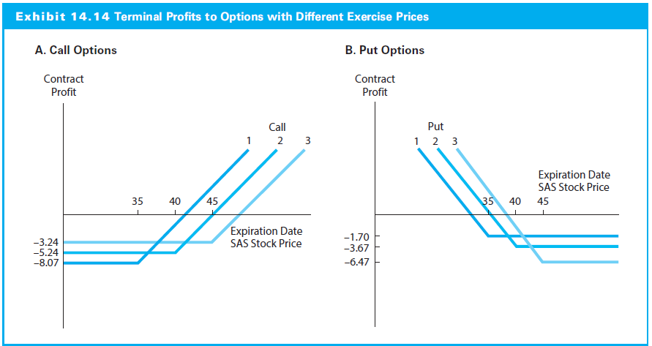
14.2.4 Option Profit Diagrams: An Example

Slide 44
14.2.4 Option Profit Diagrams: An Example
Options and Leverage
Compare Call 2 or Put 2 (the two at-the-money contracts) with direct investment in a share
Three possible prices: $30, $40, and $50
Two comparisons:
Long stock versus long call
Short stock versus long put

Slide 45
14.2.4 Option Profit Diagrams: An Example
Both puts and calls magnify positive and negative returns of investing in the underlying security
Long call option position
For $5.24, right to the price appreciation of a stock without spending $40 outright
100% loss when the stock price falls by a ¼ of that amount and a 91% gain when stock increase from $40 to $50
If price remains at $40, share owner losses nothing; call holder losses everything

Slide 46
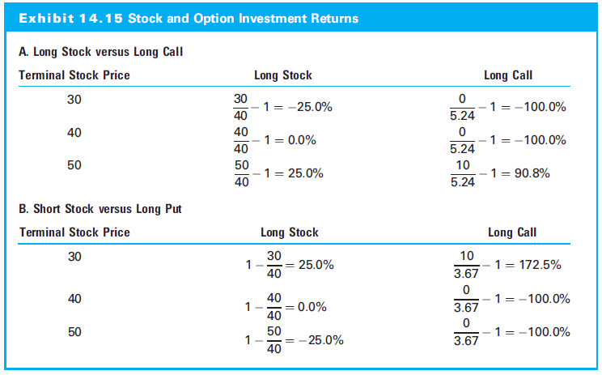
14.2.4 Option Profit Diagrams: An Example

Slide 47
14.3 The Relationship between Forward and Option Contracts

Slide 48
14.3 The Relationship between Forward and Option Contracts
Forwards and options have similar payoffs if the price moves in the anticipated direction
These instruments are connected
The put-call parity specifies how the put and call premia are related to one another
This is a relationship between these two option and either the spot or the forward price for the underlying asset
No arbitrage assumption

Slide 49
14.3.1 Put-Call-Spot Parity
Investor forms the following portfolio:
Buy common stock at S₀
Buy put at P_{0, T} to deliver stock at exercise price of X on expiration date, T
Sell a call for C_{0, T} to purchase stock at exercise price of X on expiration date, T

Slide 50
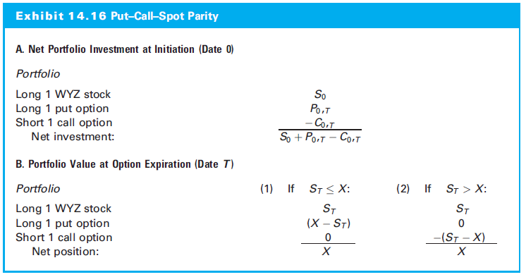
14.3.1 Put-Call-Spot Parity

Slide 51
14.3.1 Put-Call-Spot Parity
Net investment (S₀ + P_{0,T} – C_{0,T})
CF at expiration (no matter the stock price) X
The result is a risk-free investment
Because the risk-free rate equals the T-bill rate:
(Long Stock) + (Long Put) + (Short Call) = (Long T-bill)

Slide 52
14.3.2 Put-Call Parity: An Example
WYZ stock is at $53 and calls and puts with an exercise price of $50 sell for $6.74 and $2.51
Using the equation, create a synthetic T-bill: buy the stock, buy the put, and sell the call for a net price of $48.77
At expiration, portfolio is worth $50

Slide 53
14.3.2 Put-Call Parity: An Example
Risk free rate implied by this investment:
If rate on six-month T-bill with a face value of $50 is not 5.11%, there is an arbitrage opportunity

Slide 54
14.3.2 Put-Call Parity: An Example
Suppose T-bill rate is 6.25%.
Investor wanting a risk-free investment would choose the actual T-bill for the higher return, BUT someone seeking a loan would secure a 5.11% borrowing rate by short-selling the synthetic T-bill
Artificial short position:
(Short Stock) + (Short Put) + (Long Call) = (Short T-Bill)

Slide 55
14.3.2 Put-Call Parity: An Example
With no transaction costs, financial arbitrage possible: long position in the actual T-bill with PLUS short sale of synthetic portfolio
Given that the current value of the actual T-bill is
$48.51 [= $50(1:0625)^{-0.5}]

Slide 56
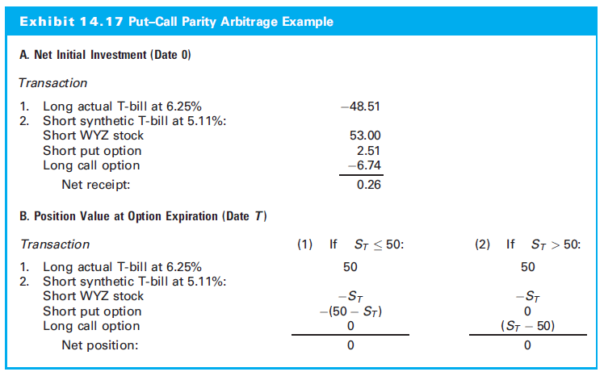
14.3.2 Put-Call Parity: An Example

Slide 57
14.3.3 Creating Synthetic Securities Using Put-Call Parity
Risk-free portfolio created by three risky securities: stock, a put option, and a call option
One of the four assets is always redundant because it can be defined in terms of the others.

Slide 58
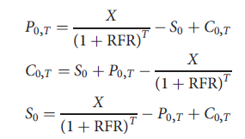
14.3.3 Creating Synthetic Securities Using Put-Call Parity
Three additional ways of expressing this result are:

Slide 59
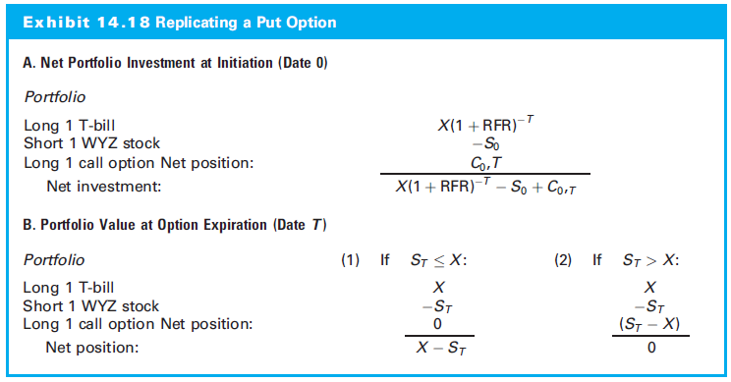
14.3.3 Creating Synthetic Securities Using Put-Call Parity

Slide 60
14.3.4 Adjusting Put-Call-Spot Parity for Dividends
Holders of derivatives do not get dividends
Parity adjusted for dividends:

Slide 61
14.4 An Introduction to the Use of Derivatives in Portfolio Management

Slide 62
14.4.2 Protecting Portfolio Value with Put Options
Manager wants the sale of stock when prices fall but to keep them when prices rise
Purchase a put to hedge downside risk is a protective put position
An example of a general set of derivative-based strategies known as portfolio insurance

Slide 63
14.4.2 Protecting Portfolio Value with Put Options
Manager buys 3-month, at-the-money puts on $100 million stock portfolio for premium of $1.324 million
Put 1) exactly offsets any expiration date share price decline while 2) allowing the position to increase as stock prices increase
Put is insurance against falling prices with no deductible

Slide 64
14.4.2 Protecting Portfolio Value with Put Options
Long in the stock and long in the put = at-the-money long call option “elevated” by $100 million
The Put-Call Parity can be rewritten:

Slide 65
14.4.2 Protecting Portfolio Value with Put Options
Protective put position generates the same payoff as (long position in a call option) and (long position in a T-bill with a face value equal to the options’ exercise price)
The manager has two ways of providing price insurance for the current stock holding:
Continue to hold the shares and purchase a put option, or
Sell shares and buy both a T-bill and a call option
The choice between them will come down to considerations such as relative option prices and transaction costs

Slide 66
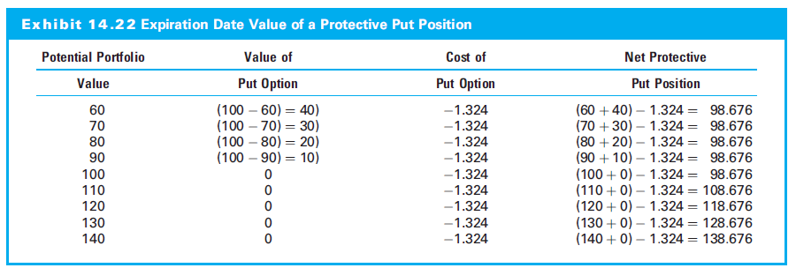
14.4.2 Protecting Portfolio Value with Put Options

Slide 67
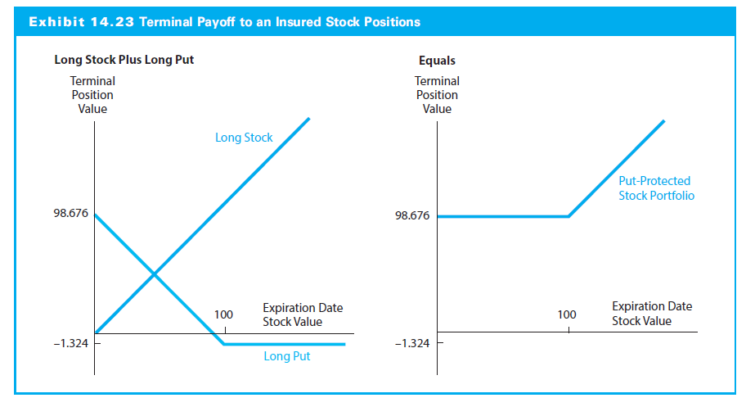
14.4.2 Protecting Portfolio Value with Put Options

Slide 68
14.4.3 An Alternative Way to Pay for a Protective Put
Third alternative
Manager makes two simultaneous decisions:
Buy 3-month, out-of-the-money protective put with an exercise price of $97 million and a lower initial cost of $0.560 million
Sell 3-month call option with exercise price of $108 million with premium of $0.560 million
Simultaneous purchase of an out-of-the-money put and sale of an out-of-the-money call is a strategy known as a collar

Slide 69
14.4.3 An Alternative Way to Pay for a Protective Put
Like the forward contract, no initial out-of-pocket expense
Payment for portfolio insurance is surrendering an equivalent amount of the portfolio’s future upside potential
In exchange for being compensated for any stock decline below $97 million, any stock price appreciation beyond $108 million is given up

Slide 70
14.4.3 An Alternative Way to Pay for a Protective Put
Upside gain potential stops at the exercise price of the call option
Collar around the portfolio for the next three months‒between $97 million and $108 million
If portfolio value is between these extreme levels, both of the options expire out of the money

Slide 71
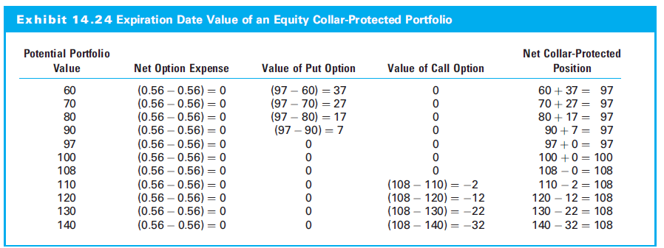
14.4.3 An Alternative Way to Pay for a Protective Put

Slide 72
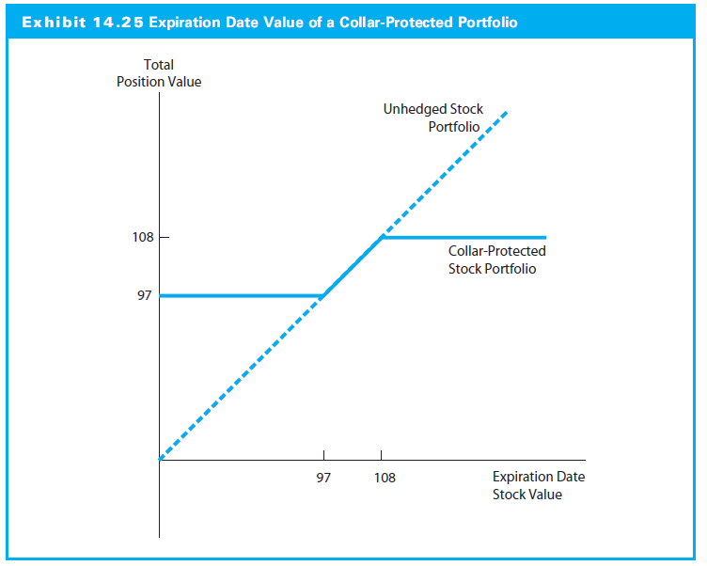
14.4.3 An Alternative Way to Pay for a Protective Put

