Slide 1
FIN 377: Investments
Exam 2 Review: Topics 5-8
Larry Schrenk, Instructor

Slide 2
Overview
General Information/Study Suggestions
Topics
Asset Pricing Models
Bond Fundamentals and Valuation
Equity Valuation
An Introduction to Derivative Markets and Securities

Slide 3
General Information

Slide 4
Exam Policies
NOTE: You will be taking the exam via D2L.
Length: 50 minutes
You may use a financial calculator.
You must have the Lockdown Browser installed.
You may not use the textbook, notes, etc. The formulae below are provided for study only.
You may not substitute a phone or tablet for the calculator.
For calculations you must show work for any credit.
In yours answers, provide two decimal point accuracy for dollars, e.g., $14.13, and four decimal points for percentages, e.g., 0.0134 or 1.34%.
Make-up exams will only be given if there is official documentation of an emergency.

Slide 5
Exam Structure
Part 1: Short Answer
10 Questions
5 Points Each (50 points total)
Part 2: Calculation
5 Questions
10 Points Each (50 points total)

Slide 6
Study Suggestions

Slide 7
Study Suggestions
Study in groups
Use flashcards for ideas, definitions, theories, etc.
Do a lot of practice problems

Slide 8
Studying for Conceptual Questions
Study the slides–Anything that is the subject of a full slide is important.
Study the slides for the current issues covered on Mondays.
Review your class notes–Anything occurring multiple times is important especially if it is mentioned under different topics.
Read the textbook. IMPORTANT: You are responsible for the assigned textbook material even if we do not cover the material in class.
Know the material in the chapter summary and the key words from the textbook which are listed at the end of the chapter.
Answer the end of chapter questions

Slide 9
Studying for Calculations
Study the examples done in class and in the textbook.
Answer and understand the end of chapter problems.
Problems on MT assignments.

Slide 10
Topic 5: Asset Pricing Models

Slide 11
Arbitrage Pricing Theory
Theory assumes that the return-generating process can be represented as a K factor model of the form:
where:
Notes:
15

Slide 12
Multifactor Models and Risk Estimation
In a multifactor model, the investor chooses the exact number and identity of risk factors, while the APT model does not specify either of them
where:
F_{it}= Period t return to the jth designated risk factor
R_{it} = Security i’s return that can be measured as either a nominal or excess return to Security i

Slide 13
Topic 6: Bond Fundamentals and Valuation

Slide 14
Overview
12.1 Basic Features of a Bond
12.2 The Global Bond Market Structure
12.3 Survey of Bond Issues
12.4 Bond Yield Curves
12.5 Bond Valuation and Yields
13.1 Bond Analysis Tools

Slide 15
12.3.3 Municipal Bonds
Types:
General obligation (GO) bonds
Revenue bonds
Interest payments are exempt from federal income tax
Convert the tax-free yield of a municipal to an equivalent taxable yield (ETY) as follows:
Where
ETY = equivalent taxable yield
i = yield of the municipal obligations
t = marginal tax rate of the investor

Slide 16
‘Implied’ Future Interest Rates
General Formula

Slide 17
12.5 Bond Valuation and Yields with Semiannual Coupons
The valuation formula can be adjusted by converting all of the relevant variables to a periodic basis
So, the formula for valuing a bond making semiannual payments becomes:
Where:
C = period coupon rate
i = yield to maturity, stated on a period basis
n = maturity date of the bond, stated in periods

Slide 18
12.5 Bond Valuation and Yields with Semiannual Coupons
The Yield (to Maturity YTM) Model
Instead of determining the value of a bond in dollar terms, investors often price bonds in terms of their yields—the promised rates of return on bonds under certain assumptions
To compute an expected yield, use the observed current market price (MP0) and the promised cash flows to compute the expected yield on the bond

Slide 19
12.5 Computing Other Bond Yield Measures
Current Yield
A measure of how much of the investor’s return comes in the form of annual cash payments would be to take the ratio of the bond’s annual coupon and its current price
Where
C is the fixed annual coupon
MP₀ is the bond’s current market price

Slide 20
12.5 Computing Other Bond Yield Measures
Yield to Call
Investors must estimate the return on certain callable bonds with a different measure: the promised yield to call (YTC)
To compute the YTC by the discounted cash flow method, adjust the semiannual present value equation to give:
Where:
n_{call} = number of periods to first call date
P_{call} = call price of the bond

Slide 21
12.5 Computing Other Bond Yield Measures
Realized (Horizon) Yield
Measures the expected rate of return of a bond that you anticipate selling prior to its maturity
Assumes that the investor has a holding period (hp, expressed in periods) that is less than n
Making the appropriate adjustment to the discounted cash flow valuation equation leaves:
where:
P_{hp} = anticipated selling price of the bond at the end of the investment horizon

Slide 22
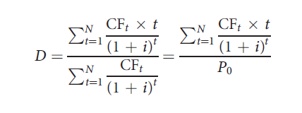
13.1.2 Bond Duration
Macaulay duration calculates a weighted average of the payment dates associated with an N-period bond:
where:
CF_{t} = cash flow (that is, coupon or principal) paid on Date t
t = date on which payment is made
i = yield to maturity of the bond, stated on a periodic basis

Slide 23
13.1.2 Bond Duration
The bond price change prediction formula in contains three components on the right-hand side:
The Macaulay duration of the bond, D
The prevailing bond yield, i
The forecasted change in the bond yield, Δi
It is often computationally convenient to combine the first two components as follows:

Slide 24
13.1.2 Bond Duration
When Macaulay duration is adjusted, it is called the modified duration, or Mod D
The equation can be simplified to:
An adaption of the basic duration statistic is the basis point value (BPV) of the bond
The BPV is a measure of the bond’s dollar price change for a one basis point change in yields:

Slide 25
13.1.2 Bond Duration
Duration of a Portfolio
Duration of a bond portfolio is the weighted average of the payment dates for all of the cash flows across the entire collection of bonds
Can be estimated by taking a weighted average of the duration statistics for each of the bonds, with the investment weight of each position (w_{j} is the percentage of capital allocated to Bond _{j}) in the averaging process:

Slide 26
13.1.3 Bond Convexity
The convexity statistic can be computed with the following formula:

Slide 27
Topic 7: Equity Valuation

Slide 28
Overview
8.1 Important Distinctions
8.2/3 Discounted Cash Flow
Discounted Dividend Model (DDM)
Free Cash Flow to Equity (FCFE)
Free Cash Flow to Firm (FCFF)
8.4 Relative Valuation
8.5 Ratio Analysis
8.6 The Quality of Financial Statements

Slide 29
8.3 Discounted Cash Flow
Present value of some measure of cash flow, including dividends, operating cash flow, and free cash flow:

Slide 30
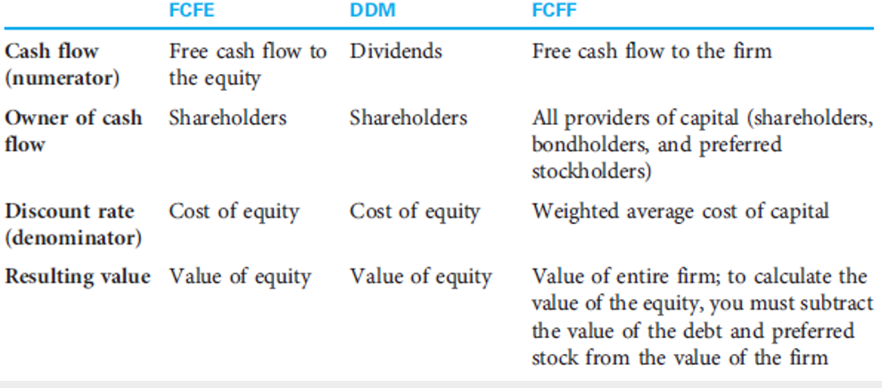
8.2.1 The Foundations of Discounted Cash Flow Valuation

Slide 31
DDM Patterns
Constant/No Growth Model
Dividends remain constant
Growth Model
Dividends change at a constant rate
Mixed/Multistage Model
Dividends change at different rates.

Slide 32
8.2.3 The No-Growth Model
In the no-growth model, the assumption is that a company’s cash flows are not growing
The no-growth assumption can be seen as a special case of the constant growth assumption

Slide 33
8.2.2 The Constant Growth Model
The constant growth model (the Gordon growth model)
Treats cash flow as a growing perpetuity
Assumes k > g

Slide 34
Estimating Dividend Growth Rates
g = growth rate in dividends
ROE = return on equity for the firm
b = plowback or retention percentage rate
(1 - dividend payout percentage rate)
What are the assumptions behind this formula?
What are the drawbacks to using a ‘formula’ approach?

Slide 35
Present Value of Growth Opportunities
Firm Value = Assets-in-Place + PVGO
The value of the firm equals the value of the assets already in place, the no-growth value of the firm...
Plus the NPV of its future investments, the present value of growth opportunities or PVGO.

Slide 36
Mixed/Multistage Model Formula

Slide 37
FCFF and FCFE
Free Cash Flow to Equity (FCFE)
CFs available to distribute to equity investors
Value: Total Equity of Firm
Discount with cost of equity
Free Cash Flow to the Firm (FCFF)
CFs available to distribute to all investors
Value: Total Value of Firm
Discount with WACC

Slide 38
8.4 Relative Valuation
Relative valuation attempts to value a company by comparing it to similar companies or the overall market or the stock’s own trading history
When analysts use multiples, they are typically used in one of the following ways:
Comparing multiples to comparable companies
Comparing a stock multiple to the market multiple
Comparing a stock’s multiple to its historic multiple
Comparing a stock’s multiple to recent transactions

Slide 39
8.5 Ratio Analysis
Ratio analysis:
Helps to make better estimates for the discounted cash flow model and to better understand the business
May also help to ask better questions

Slide 40
Topic 8: An Introduction to Derivative Markets and Securities

Slide 41
Overview
14.1 Overview of Derivative Markets
14.2 Investing with Derivative Securities
14.3 The Relationship between Forward and Option Contracts
14.4 An Introduction to the Use of Derivatives in Portfolio Management

Slide 42
14.1 Overview of Derivative Markets
Two kinds of derivatives available:
Forward and futures contracts
Option contracts
Only one forward contract is needed for any particular maturity date and underlying asset
Two types of options
Calls
Puts
For each of these derivatives, an investor can enter into a transaction as:
The long position (the buyer)
The short position (the seller)

Slide 43
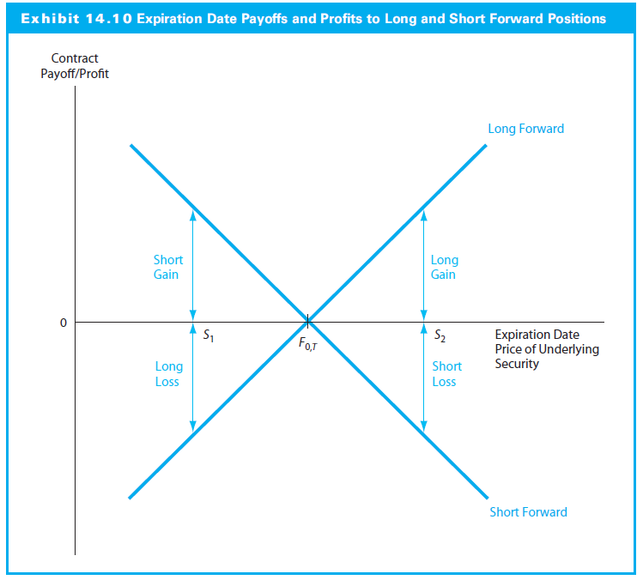
14.2.2 Basic Payoff and Profit Diagrams for Forward Contracts

Slide 44
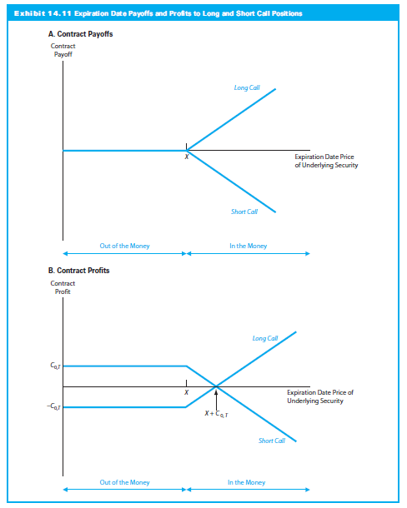
14.2.3 Basic Payoff and Profit Diagrams for Call and Put Options

Slide 45
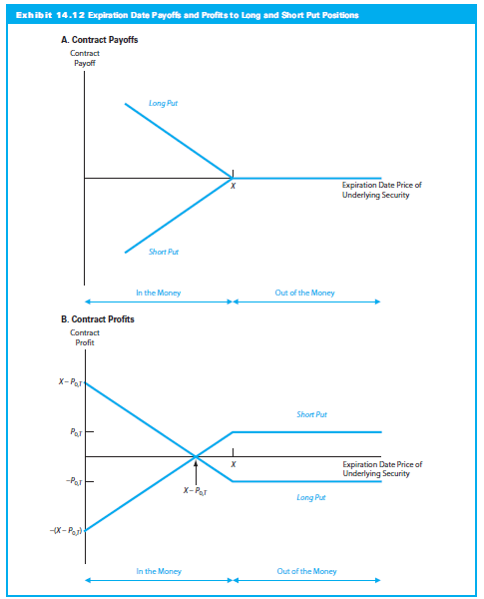
14.2.3 Basic Payoff and Profit Diagrams for Call and Put Options

Slide 46
14.3.1 Put-Call-Spot Parity
The net investment required to acquire this portfolio is (S₀ + P_{0,T} – C_{0,T})
The net positive at expiration date no matter at what level the stock price is would be the same, X
The result is a risk-free investment
Because the risk-free rate equals the T-bill rate:
(Long Stock) + (Long Put) + (Short Call)
= (Long T-bill)

Slide 47
14.3.4 Adjusting Put-Call-Spot Parity for Dividends
The holders of derivative contracts will not participate directly in the payment of dividends to the stockholder
If the dividend amounts and payment dates are known when puts and calls are written, then they are adjusted into the option prices

Slide 48
14.3.5 Put-Call-Forward Parity
This is a risk-free portfolio
Differences in cash flow patterns:
The net initial investment of (P_{0,T} C_{0,T}) is smaller than when the stock was purchased in the spot market
The riskless terminal payoff of (X F_{0,T}) is also smaller, as the stock is now purchased at Date T rather than at Date 0
This intuition leads to the put–call–forward parity condition:

