Slide 1
Stepan Company (SCL)
By: Samuel Fafinski, Obed Jean-Baptist, Jacob Carrigan

Slide 2
Who is Stepan?
A major global manufacturer of specialty and intermediate chemicals used in a broad range of industries.
Classified with other specialty chemical companies.
However, unique in the industry and does not have competitors to precisely match its businesses because its product niche.
Manufactures not only cleaning products but also surfactants, polymers, and specialty goods such as food and pharmaceutical products.
Notes:
Bigger Font and Less words
Don’t repeat stepan
4 bullet points

Slide 3
Industry Overview
Sector: Consumer Goods
Industry: Cleaning Products
Is a continually growing market, due to awareness in hygiene and spread of infectious diseases.
One of the major attractions of these products for today’s consumer is convenience.
Consumers having less and less time for household chores but eager to maintain high standards of hygiene and cleanliness.
These companies invest a lot in research and development.
Notes:
Same thing
Use Same font

Slide 4
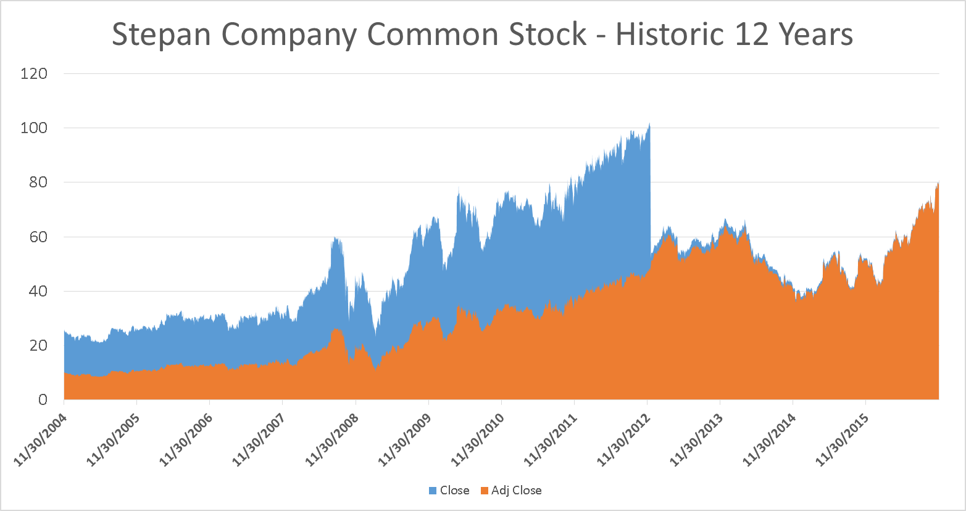
Notes:
Create own graph

Slide 5
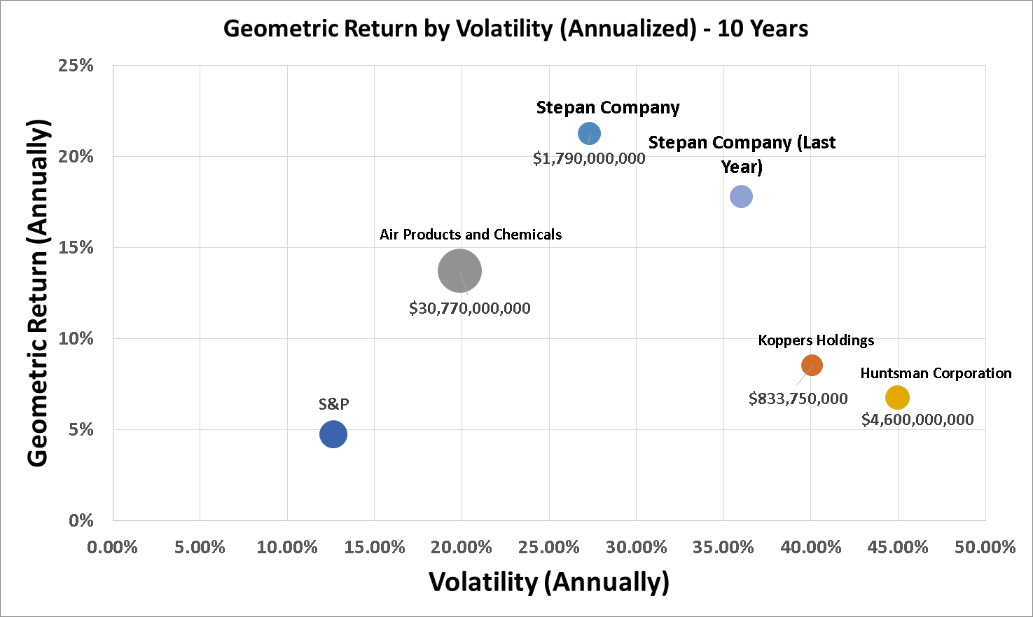

Slide 7
Notes:
Regression Statistics Multiple R 0.600502627 R Square 0.360603405 Adjusted R Square 0.360349171 Standard Error 0.019500977 Observations 2517 ANOVA df SS MS F Significance F Regression 1 0.53939914 0.53939914 1418.395983 1.51E-246 Residual 2515 0.956424619 0.000380288 Total 2516 1.495823759 Coefficients Standard Error t Stat P-value Lower 95% Upper 95% Intercept -0.000326893 0.000388711 -0.840967181 0.400446267 -0.00108912 0.000435334 X Variable 1 1.106519021 0.029380565 37.66159825 1.51E-246 1.048906446 1.164131596
Unlevered Beta = 0.781156703

Slide 8
Conclusion
Recommendation: Hold
High profitability and revenues (negative earnings in 2nd -3rd quarter.
Recession-Resistant
Constant acquisition
New product and service developments.
Government regulation
Notes:
Jun 02, 2016: Stepan Announces Expansion Of Poland Polyester Polyol Facility Apr 26, 2016: Stepan Reports Record First Quarter Earnings Feb 24, 2016: Stepan Reports Higher Fourth Quarter And Full Year 2015 Results Oct 21, 2015: Stepan Company Announces Appointment of New Company Director Jul 22, 2015: Stepan Reports Higher Second Quarter And First Half Results And Announces Dividend

