Slide 1
iRobot Equity Report
FIN 422 – Student Managed Investment Fund
James Edstrom| Taylor Field | Micah Stark

Slide 2
Company Information
Founded in 1990 by Colin Angle
Originally Focused on Commercial Robots
9/11 Exploration Robots
Developed “Roomba” Product Line in 2002
Accounts for Majority of Sales
Transitioned in 2016 to “Consumer As Our Customer” Moto
Eliminated Commercial Robots
“Braava” Mop Launched March 2016
Developing “Connected” Robots

Slide 3
Financial Information
IRBT – NASDAQ Exchange
Primary Sector and Industry: Consumer Goods in Appliances
Sell or Hold at current price
Market Capitalization: $1.8 Billion
Estimated Target Price: $39.39

Slide 4
Institutional Investors
Largest Institutional Investors | Company Percent Owned
Cumulative Institutional Investors | 63.7%
The Vanguard Group | 8.58%
BlackRock Fund Advisors | 7.89%
Lord Abbett & Co | 5.3%
Columbia Wanger Asset Management, L.P. | 4.6%
Oppenheimer Funds, Inc. | 4.08%

Slide 5
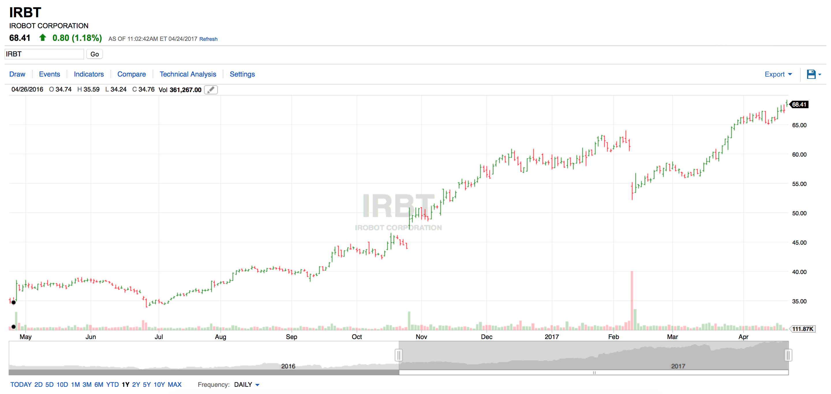
Stock Performance
96.59% Growth

Slide 6
Vacuum Market by Type

Slide 7
Market Share of Robotic Vacuums

Slide 8
Financial Ratios
iRobot
P/E = 36.8
Price/Book = 4
Price/Cash Flow = 27.2
Gross Profit Margin = 50.4%
Revenue Growth = 2.94%
Industry
P/E = 27.1
Price/Book = 3.2
Price/Cash Flow = 14.0
Gross Profit Margin = 26.8%
Revenue Growth = 19.5%

Slide 9
Short Interest
* Last 6 months

Slide 10
Forecasting Estimates
Year | 2016 | 2017 | 2018 | 2019 | 2020 | 2021 | 2022 | 2023 | 2024 | 2025 | 2026
Revenue Growth % |  | 15% | 15% | 15% | 10% | 10% | 7% | 7% | 7% | 7% | 5%
Revenue | 605 | 695 | 799 | 919 | 1,011 | 1,112 | 1,190 | 1,274 | 1,363 | 1,458 | 1,531
R&D | 80 | 92 | 106 | 122 | 124 | 126 | 135 | 144 | 154 | 165 | 173
Home Robots Margin | 49% | 49% | 49% | 49% | 49% | 49% | 49% | 49% | 49% | 49% | 49%
Total Operating Expenses | 262 | 296 | 341 | 392 | 396 | 424 | 454 | 486 | 520 | 556 | 584
Operating Income | 62 | 58 | 67 | 77 | 120 | 143 | 153 | 164 | 175 | 187 | 197
Taxes | 19 | 19 | 21 | 20 | 31 | 37 | 39 | 42 | 45 | 48 | 50
Net Income | 47 | 44 | 49 | 61 | 93 | 110 | 118 | 126 | 135 | 144 | 151
*Estimates In Millions
Estimated Stock Price $39.39

Slide 11
Future Business Risks
New Competitors
Samsung (150x Market Cap)
LG (6x Market Cap)
Dyson
Bissel
Neato
Limited Vendors
Heavily Reliant Upon China
Only a Couple Major Producers
Elimination of Commercial Division
Consistent Income

Slide 12
Management & Governance
CEO: Colin Angle (Chairman, CEO and Founder since 1990)
Eliminated 20% of Holdings in Last Year
COO: Christian Cerda (since 2003)
CFO: Alison Dean (since 2005)

Slide 13
iRobot Equity Report Decision
Sell or Hold
Elimination of Commercial Application Business
Influx of Major Competitors
Potential Trade Issues with Limited Chinese Producers
CEO has Eliminated 20% of Holdings

