Slide 1
FIN 422: Student Managed Investment Fund
Topic 4: Free Cash Flow Analysis
Larry Schrenk, Instructor

Slide 2
Overview
Approach
Steps
Initial FCFE
Forecasting FCFE
Terminal Value
Discount Rate
Final Calculation

Slide 3
Learning Objectives
@

Slide 4
Readings
Aswath Damodaran, Investment Valuation 2e, Chap. 14 “Free Cash Flow to Equity Discount Models”
Further Resources:
Aswath Damodaran. Investment Valuation: Tools and Techniques for Determining the Value of any Asset. 3rd ed. Wiley, 2012.
Tim Koller, et al. Valuation: Measuring and Managing the Value of Companies. 6th ed. Wiley, 2015.

Slide 5
1. Approach

Slide 6
FCF Types
Free Cash Flow to the Firm
  FCF to all investors
Free Cash Flow to Equity
  FCF to equity investors

Slide 7
FCF Approach
FCFE: How much cash is available to be paid out to stockholders after meeting reinvestment needs
FCFF: How much cash is available to be paid out to all investors after meeting reinvestment needs

Slide 8
Generic DCF Valuation Model
8

Slide 9
Same ingredients, different approaches…
9
Input | Dividend Discount Model | FCFE (Potential dividend) discount model | FCFF (firm) valuation model
Cash flow | Dividend | Potential dividends = FCFE = Cash flows after taxes, reinvestment needs and debt cash flows | FCFF = Cash flows before debt payments but after reinvestment needs and taxes.
Expected growth | In equity income and dividends | In equity income and FCFE | In operating income and FCFF
Discount rate | Cost of equity | Cost of equity | Cost of capital
Steady state | When dividends grow at constant rate forever | When FCFE grow at constant rate forever | When FCFF grow at constant rate forever

Slide 10
2. Steps

Slide 11
FCFE Steps
Determine Initial FCFE
Estimate ST Growth Pattern
Forecast ST FCFE
Estimate Terminal Value (TV)
Estimate Discount Rate
Calculate PV of FCFE

Slide 12
FCFE Steps
2) Growth Rates
1) FCFE₀
3) FCFE₁ FCFE₂ FCFE₃…
4) TV
6) PV
5) Discount Rate

Slide 13
3. Initial FCFE

Slide 14
FCFE Steps: Initial FCFE
2) Growth Rates
1) FCFE₀
3) FCFE₁ FCFE₂ FCFE₃…
4) TV
6) PV
5) Discount Rate

Slide 15
Steps in Cash Flow Estimation
Estimate current earnings of the firm
  FCFE: Earnings after interest expenses, i.e. net income
  FCFF: Operating earnings after taxes
How much must firm invest for future growth?
  If not expensed, categorized as capital expenditures.
  To the extent that depreciation provides a cash flow, it will cover some of these expenditures.
  Increasing working capital needs are also investments
Notes:
Sets up the process. Much as we do not trust accounting statements, that is where we go for the information. Accounting earnings are not cash flows.
We do not draw a distinction between discretionary and required capital expenditures. Once you introduce growth in earnings, the distinction becomes largely symbolic.
Draws a distinction between cashflows to equity and the firm again.

Slide 16
Measuring Cash Flow to Equity
Cash flows to Equity
  Net Income
  + Depreciation
  - Capital Expenditures
  - Changes in Non-Cash Working Capital
  = Free Cash flow to Equity
Notes:
Note the differences between this and Free cashflow to firm:
Start with net income (equity earnings) rather than operating earnings. Interest expenses are subtracted out from earnings and the tax benefits are reflected.
Net out net debt payments. If a firm raises more new debt than it pays off, this can be a positive number which, if large enough can make the free cashflow to equity higher than the free cashflow to the firm.

Slide 17
Issues
Updating Earnings
Correcting Accounting Earnings
One-Time and Non-Recurring Charges
Accounting Malfeasance
Notes:
For larger and more mature firms, you can get away with using the most recent annual report. The younger the firm and the more tumultuous the times (the economy entering a recession, for instance), the more you have to worry about using dated information.
Your objective in valuation is simple. You want to use the most recent information you can get for every input, even if it means that your inputs are observed at different points in time - the market values may be from today and the accounting information from the most recent quarterly report.

Slide 18
I. Updating Earnings
Update annual reports using:
  Trailing 12-month data from quarterly earnings reports.
  Informal/unofficial news reports, if quarterly reports unavailable.
Updating most important for smaller and more volatile firms and firms with significant restructuring.
Notes:
For larger and more mature firms, you can get away with using the most recent annual report. The younger the firm and the more tumultuous the times (the economy entering a recession, for instance), the more you have to worry about using dated information.
Your objective in valuation is simple. You want to use the most recent information you can get for every input, even if it means that your inputs are observed at different points in time - the market values may be from today and the accounting information from the most recent quarterly report.

Slide 19
II. Correcting Accounting Earnings
Are financial expenses mixed with operating expenses?
  Financial expense: Any commitment that is tax deductible that you have to meet no matter what your operating results: Failure to meet it leads to loss of control of the business.
  Example: Operating Leases: While accounting convention treats operating leases as operating expenses, they are really financial expenses and need to be reclassified as such. This has no effect on equity earnings but does change the operating earnings
Are capital expenses mixed with operating expenses?
  Capital expense: Any expense that is expected to generate benefits over multiple periods.
  R & D Adjustment: Since R&D is a capital expenditure (rather than an operating expense), the operating income has to be adjusted to reflect its treatment.
Notes:
Financial expense: Any commitment that is tax deductible that you have to meet no matter what your operating results: Failure to meet it leads to loss of control of the business.
Capital expense: Any expense that is expected to generate benefits over multiple periods.
These are two fairly standard adjustments you have to make to almost every firm that you encounter though the consequences are going to be larger for some firms than others.

Slide 20
Two Examples
Operating leases as financing expenses (not operating expenses)
R&D as capital expenditures (not operating expenses)
Notes:
Financial expense: Any commitment that is tax deductible that you have to meet no matter what your operating results: Failure to meet it leads to loss of control of the business.
Capital expense: Any expense that is expected to generate benefits over multiple periods.
These are two fairly standard adjustments you have to make to almost every firm that you encounter though the consequences are going to be larger for some firms than others.

Slide 21
Dealing with Operating Lease Expenses
Operating Lease Expenses are treated as operating expenses in computing operating income.
Operating lease expenses should be financing expenses, with the following adjustments to earnings and capital:
  Debt Value of Operating Leases = Present Value of Operating Lease Commitments at the pre-tax cost of debt
  When you convert operating leases into debt, you also create an asset to counter it of exactly the same value.
  Adjusted Operating Earnings
    Adjusted Operating Earnings = Operating Earnings + Operating Lease Expenses - Depreciation on Leased Asset
    As an approximation, this works:
    Adjusted Operating Earnings = Operating Earnings + Pre-tax cost of Debt * PV of Operating Leases.
Notes:
From an intuitive standpoint, there is little difference between a term loan (where you pay off a loan in equal annual installments) and an operating lease. It may be more like unsecured debt than secured debt but it is debt.
It is not just debt that is affected when you convert operating leases to debt. The operating income also will change.

Slide 22
Operating Leases at The Gap
The Gap has conventional debt of about $ 1.97 billion on its balance sheet and its pre-tax cost of debt is about 6%. Its operating lease payments in the 2003 were $978 million and its commitments for the future are below:
  Year Commitment (millions) Present Value (at 6%)
  1 $899.00 $848.11
  2 $846.00 $752.94
  3 $738.00 $619.64
  4 $598.00 $473.67
  5 $477.00 $356.44
  6&7 $982.50 each year $1,346.04
  Debt Value of leases = $4,396.85 (Also value of leased asset)
Debt outstanding at The Gap = $1,970 m + $4,397 m = $6,367 m
Adjusted Operating Income = Stated OI + OL exp this year - Deprec’n
= $1,012 m + 978 m - 4397 m /7 = $1,362 million (7 year life for assets)
Approximate OI = $1,012 m + $ 4397 m (.06) = $1,276 m
Notes:
The Home Depot reports its lease commitments in its financial statements. The present value of operating lease expenses is computed using the pre-tax cost of debt. (An argument can be made that the unsecured cost of debt should be used.)

Slide 23
R&D Expenses:
Operating or Capital Expenses
GAP considers R&D operating expense even though it is designed to generate future growth.
More logical to treat it capital expenditures.
To capitalize R&D,
  Specify an amortizable life for R&D (2 - 10 years)
  Collect past R&D expenses for the amortizable life
  Sum up the unamortized R&D over the period.
    If amortizable life is 5 years, research asset can be obtained by adding up 1/5th of the R&D expense from five years ago, 2/5th of the R&D expense from four years ago...:
Notes:
The argument used by accountants - that R&D yields uncertain benefits - is specious. You could make the same argument about other investments - investing in a factory in an emerging market, deciding to build a concept car - and you are forced to treat these as capital expenditures.
To capitalize R&D, you need to specify
On average, how long it takes between the time you do research and a commercial product emerges from the research. (This is the amortizable life)
R&D expenses from the past (for a period equivalent to the amortizable life). If your firm has not been in existence for that long, you would go back for as many years as you can.
Depreciation schedules - stick with the simplest which is straight line depreciation.

Slide 24
Capitalizing R&D Expenses: SAP in 2004
R & D assumed to have a 5-year life.
Year R&D Expense Unamortized portion Amortization this year
Current 1020.02 1.00 1020.02
-1 993.99 0.80 795.19 € 198.80
-2 909.39 0.60 545.63 € 181.88
-3 898.25 0.40 359.30 € 179.65
-4 969.38 0.20 193.88 € 193.88
-5 744.67 0.00 0.00 € 148.93
Value of research asset = € 2,914 million
Amortization of research asset in 2004 = € 903 million
Increase in Operating Income = 1020 - 903 = € 117 million
Notes:
The amortizable life is an assumption based upon Cisco’s business (telecom equipment and software). It would be shorter in other businesses (such as computer chips) and longer in businesses that need regulatory approval (such as pharmaceuticals).
Note that the amortization is 1/5 of the R&D expense each year.
We are also assuming that R&D expenses are spent at the end of each year - not realistic, but simplifies analysis - that is why there is no amortization of the current year’s expense.
The effect of capitalizing R&D will be greatest at firms where R&D is growing over time and be non-existent at firms with flat R&D.

Slide 25
III. One-Time and Non-Recurring Charges
Unusual or Infrequent items: Gains or losses from the divestiture of an asset or division or restructuring costs.
Extraordinary items: Events that are unusual in nature, infrequent in occurrence and material in impact, e.g., gains or losses from marketable securities
Losses associated with discontinued operations: E.g., estimated loss on the sale of the operations.
Gains or losses associated with accounting changes
Notes:
If it is truly a one-time change, you should use a profit of $ 500 million.
If the firm is playing games (consolidating expenses and reporting them as one-time charges every five years), you should take the average annual expense of $ 200 million (1/5 of $ 1 billion) and estimate a profit of $ 300 million.
Don’t take company characterizations of non-recurring charges at face value. Look at the firm’s history.

Slide 26
IV. Accounting Malfeasance….
More aggressive firms will show higher earnings than more conservative firms.
Warning signals in financial statements and correct for them:
  Income from unspecified sources
  Income from asset sales or financial transactions (for a non-financial firm)
  Sudden changes in standard expense items
  Frequent accounting restatements
Notes:
This is a challenge. There are clues, though none of them are fool proof and it makes sense to be skeptical about accounting numbers post-Enron.
Check the footnotes. Bear in mind that this what forensic accounting tries to do and there are relatively few good forensic accountants around.

Slide 27
What Tax Rate?
Options:
  The effective tax rate in the financial statements (taxes paid/Taxable income)
  The marginal tax rate for the country in which the company operates
Notes:
The effective tax rate is defined as taxes paid/ taxable income, as defined in the reporting books. The marginal tax rate is the tax rate on the last dollar of income. The effective tax rate is lower than the marginal tax rate for most firms. Why?
Bracket creep: Can be a reason for small private businesses but not for large publicly traded firms where most of the income is at the highest marginal tax rate anyway.
Cosmetic factors: Two sets of books with different accounting standards for tax and reporting books.
Real factors: Capacity to defer taxes to the future.

Slide 28
The Right Tax Rate to Use
Choice is between the effective and the marginal tax rate.
  Safer to use the marginal tax rate since effective tax rate reflects difference between the accounting and the tax books.
Marginal tax rate understates the after-tax operating income in the earlier years, but is more accurate in later years
If effective tax rate, adjust the tax rate towards the marginal tax rate over time.
Notes:
If you have a choice, you would prefer to do valuation with the tax books in front of you, but since you do not have that choice as an outsider you have to choose between the effective tax rate and the marginal tax rate.
If you use the effective tax rate all the way through, you are assuming that taxes can be deferred forever. This is unrealistic - tax deferrals catch up with you as your growth flags - and will result in an overvaluation of your firm.
If you use a marginal tax rate, you are assuming that you cannot defer taxes from this point on. This is far too conservative and will yield too low a value for your firm.
Suggestion: Start with the effective tax rate in the early years and move towards the marginal tax rate in the terminal year.

Slide 29
Net Capital Expenditures
Net capital expenditures is difference between capital expenditures and depreciation.
  Depreciation is cash inflow that pays for some or all capital expenditures.
Net capital expenditures function of how fast a firm is growing.
Assumptions about net capital expenditures never independent of growth assumptions
Notes:
It is dangerous to have three separate (and unconnected) line items for capital expenditures, depreciation and growth in a valuation. Analysts very quickly discover the secret of value creation (at least on paper) - decrease cap ex, increase depreciation and increase growth.

Slide 30
Capital Expenditures include
Research and development expenses (re-categorized as capital expenses)
  Adjusted Net Capital Expenditures = Net Capital Expenditures + Current year’s R&D expenses - Amortization of Research Asset
Acquisitions of other firms
  Adjusted Net Cap Ex = Net Capital Expenditures + Acquisitions of other firms - Amortization of such acquisitions
  Two caveats:
  Most firms do not do acquisitions every year. Use normalized measure of acquisitions (average over time)
  Find acquisitions in the statement of cash flows, ategorized under other investment activities
Notes:
The accounting definition of cap ex is too narrow. It excludes external cap ex (which is what acquisitions are) and intangible cap ex (which is what R&D is).
We would include all acquisitions, including stock swaps acquisitions. To those who would argue that there is no cashflow associated with stock swaps, we would suggest that all that has occurred is that the firm has just skipped a step - the firm could have issued the stock to the market and used the cash on the acquisitions.
It is true that incorporating acquisitions into valuation can be messy for firms that do relatively few and very diverse acquisitions over time. You have the option of ignoring these acquisitions when you do valuation but make sure that the expected growth rate in earnings does not then include the expected growth from acquisitions. You are implicitly assuming that acquisitions in the future will be done at fair value and hence have no value impact.

Slide 31
Working Capital Investments
In accounting terms, working capital is difference between current assets and current liabilities
Cleaner, difference between non-cash current assets (inventory and accounts receivable) and non-debt current liabilities (accounts payable)
Working capital ties up cash; increases in working capital reduces cash flows
Forecast effects of growth on working capital needs
Notes:
We remove cash from current assets because cash is not a wasting asset for most firms with substantial cash balances. Cash today tends to be invested in treasuries or commercial paper which yields a fair return for the risk taken (which is little or none). There are some analysts who still use operating cash (which they estimate as a percent of revenues) as part of working capital, but we believe that this is no longer appropriate for firms in markets with well developed banking systems and investment alternatives.
The debt in current liabilities is included in the debt used for cost of capital.

Slide 32
Measuring FCFE
Earnings cannot represent potential dividends:
  Earnings are not cash flows; there are non-cash revenues and expenses in earnings
  Some earnings must be invested in new assets
  Valuation models discounting earnings over-estimate the value of the equity
Potential dividends are cash flows after firm has made “investments” to create future growth and net debt repayments
Notes:
Models that discount earnings and assume a growth rate in earnings at the same time will systematically overvalue companies because they assume that firms can grow earnings without any reinvestment. (Glassman and Hassett made this mistake in their book Dow 36000, where the discounted earnings at close to the riskfree rate and assumed real growth in perpetuity.)

Slide 33
4. Forecasting FCF

Slide 34
FCFE Steps: Growth Rates
2) Growth Rates
1) FCFE₀
3) FCFE₁ FCFE₂ FCFE₃…
4) TV
6) PV
5) Discount Rate

Slide 35
Overview
Historical Growth
Analyst Estimates
Growth from Fundamentals

Slide 36
Ways of Estimating Growth in Earnings
Look at the past
  The historical growth in earnings per share is usually a good starting point for growth estimation
Look at what others are estimating
  Analysts estimate growth in earnings per share for many firms. It is useful to know what their estimates are.
Look at fundamentals
  Ultimately, all growth in earnings can be traced to two fundamentals
    How much the firm is investing in new projects, and
    What returns these projects are making for the firm.

Slide 37
4.1 Historical Growth

Slide 38
Historical Growth
Historical growth rates can be estimated in a number of different ways
  Arithmetic versus Geometric Averages
  Simple versus Regression Models
Historical growth rates can be sensitive to
  The period used in the estimation (starting and ending points)
  The metric that the growth is estimated in.
In using historical growth rates, you have to wrestle with the following:
  How to deal with negative earnings
  The effects of scaling up

Slide 39
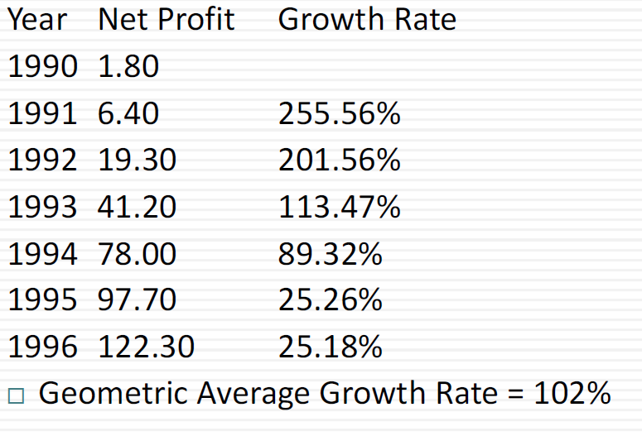
The Effect of Size on Growth: Callaway Golf

Slide 40
Extrapolation and its Dangers
Year Net Profit (millions)
(Extrapolated)
1996 $ 122.30
1997 $ 247.05
1998 $ 499.03
1999 $ 1,008.05
2000 $ 2,036.25
2001 $ 4,113.23
If net profit continues to grow at the same rate as it has
in the past 6 years, the expected net income in 5 years
will be $ 4.113 billion.

Slide 41
4.2 Analyst Estimates

Slide 42
Analyst Forecasts of Growth
A significant proportion of an analyst’s time (outside of selling) is spent forecasting earnings per share.
  Most of this time, in turn, is spent forecasting earnings per share in the next earnings report
  While many analysts forecast expected growth in earnings per share over the next 5 years, the analysis and information (generally) that goes into this estimate is far more limited.
Analyst forecasts of earnings per share and expected growth are widely disseminated by services such as Zacks and IBES, at least for U.S companies.

Slide 43
How Good are Analysts at Forecasting Growth?
Analysts forecasts of EPS tend to be closer to the actual EPS than simple time series models, but the differences tend to be small:
Study Group Tested Analyst Time Series
Error Model Error
Collins & Hopwood Value Line Fore. 31.7% 34.1%
Brown & Rozeff Value Line Fore. 28.4% 32.2%
Fried & Givoly Earnings Fore. 16.4% 19.8%
The advantage that analysts have over time series models
  Tends to decrease with the forecast period (next quarter versus 5 years)
  Tends to be greater for larger firms than for smaller firms
  Tends to be greater at the industry level than at the company level
Forecasts of growth (and revisions thereof) tend to be highly correlated across analysts.

Slide 44
The Five Deadly Sins of an Analyst
Tunnel Vision: Becoming so focused on the sector and valuations within the sector that you lose sight of the bigger picture.
Lemmingitis: Strong urge felt to change recommendations & revise earnings estimates when other analysts do the same.
Stockholm Syndrome: Refers to analysts who start identifying with the managers of the firms that they are supposed to follow.
Factophobia (generally is coupled with delusions of being a famous story teller): Tendency to base a recommendation on a “story” coupled with a refusal to face the facts.
Dr. Jekyll/Mr. Hyde: Analyst who thinks his primary job is to bring in investment banking business to the firm.
NOTE: Analysts are subject to all the bias revealed by behavioral finance.

Slide 45
Propositions about
Analyst Growth Rates
Proposition 1: Far less private information and far more public information in most analyst forecasts than claimed.
Proposition 2: The biggest source of private information for analysts remains the company itself which might explain
  More buy than sell recommendations
  High correlation across analysts forecasts and revisions
Proposition 3: Value to knowing what analysts are forecasting as earnings growth for a firm.
  Danger when they agree too much (lemmingitis)
  Danger when they agree to little (in which case the information that they have is so noisy as to be useless).

Slide 46
4.3 Growth from Fundamentals

Slide 47
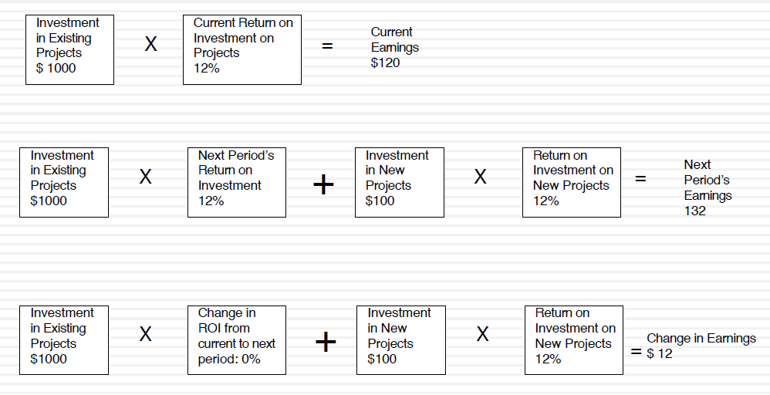
Fundamental Growth Rates

Slide 48
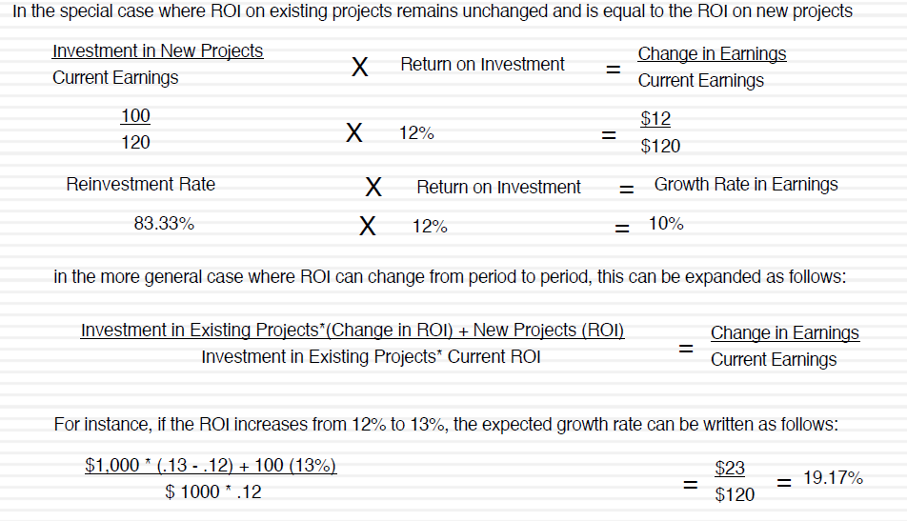
Growth Rate Derivations

Slide 49
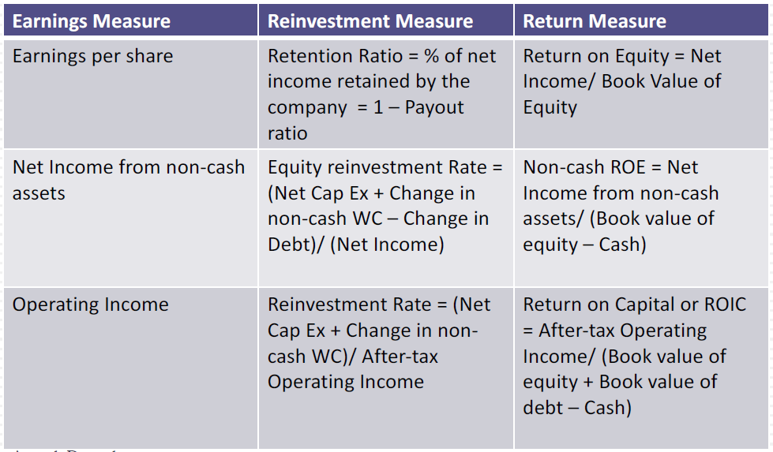
Estimating Fundamental Growth from New Investments: Three Variations

Slide 50
Three Variations
Expected Long Term Growth in EPS
Expected Growth in Net Income from Noncash Assets
Expected Growth in EBIT And Fundamentals: Stable ROC and Reinvestment Rate

Slide 51
A. Expected Long Term Growth in EPS
When looking at growth in earnings per share, these inputs can be cast as follows:
  Reinvestment Rate = Retained Earnings/Current Earnings = Retention Ratio
  Return on Investment = ROE = Net Income/Book Value of Equity
In the special case where the current ROE is expected to remain unchanged
Proposition 1: The expected growth rate in earnings for a company cannot exceed its return on equity in the long term.

Slide 52
Estimating Expected Growth in EPS: Wells Fargo in 2008
Return on equity (based on 2008 earnings) = 17.56%
Retention Ratio (based on 2008 earnings and dividends) = 45.37%
Expected growth rate in earnings per share for Wells Fargo, if it can maintain these numbers.
  Expected Growth Rate = 0.4537 (17.56%) = 7.97%

Slide 53
One Way to Increase ROE:
Use More Debt
Note that Book Value of Capital
  = Book Value of Debt + Book Value of Equity - Cash.

Slide 54
Decomposing ROE: Brahma in 1998
Brahma (now Ambev) had an extremely high return on equity, partly because it borrowed money at a rate well below its return on capital
  Return on Capital = 19.91%
  Debt/Equity Ratio = 77%
  After-tax Cost of Debt = 5.61%
  Return on Equity = ROC + D/E (ROC - i(1-t))
  = 19.91% + 0.77 (19.91% - 5.61%) = 30.92%
This seems like an easy way to deliver higher growth in earnings per share. What (if any) is the downside?

Slide 55
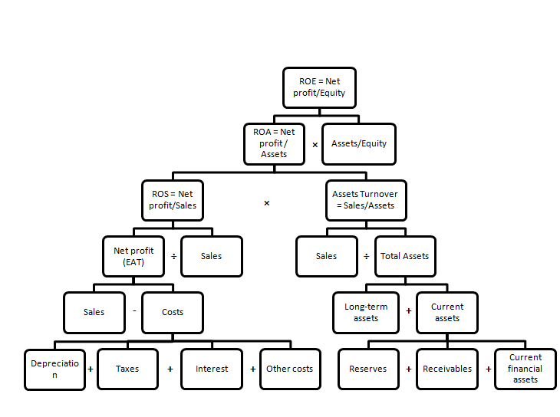
DuPont Equation

Slide 56
B. Expected Growth in Net Income from Noncash Assets
EPS fundamental growth equation focuses on per share earnings and assumes that reinvested earnings are invested in projects earning the return on equity.
A more general version: Substitute equity reinvestment into real investments (net capital expenditures and working capital) and exclude cash:

Slide 57
C. Expected Growth in EBIT and Fundamentals: Stable ROC and Reinvestment Rate
Growth in operating income
Reinvestment Rate and Return on Capital
Proposition: The net capital expenditure needs of a firm, for a given growth rate, should be inversely proportional to the quality of its investments.

Slide 58
Estimating Growth when Operating Income is Negative or Margins are Changing
Operating income negative or margins change over time: three step process to estimate growth:
  Estimate growth rates in revenues over time
    Determine the total market and estimate the market share
    Decrease the growth rate as the firm becomes larger
    Keep track of absolute revenues to make sure that the growth is feasible
  Estimate expected operating margins each year
    Set a target margin that the firm will move towards
    Adjust the current margin towards the target margin
  Estimate the capital that needs to be invested to generate revenue growth and expected margins
    Estimate a sales to capital ratio that you will use to generate reinvestment needs each year.

Slide 59
5. Terminal Value (TV)

Slide 60
FCFE Steps: Terminal Value
2) Growth Rates
1) FCFE₀
3) FCFE₁ FCFE₂ FCFE₃…
4) TV
6) PV
5) Discount Rate

Slide 61
Getting Closure in Valuation
A publicly traded firm potentially has an infinite life.
Cannot estimate cash flows forever, so estimate cash flows for a “growth period” and then estimate a terminal value (TV), to capture the value at the end of the period:
Notes:
To put closure on valuation, we assume that we stop forecasting cashflows at some point in time and estimate a terminal value.

Slide 62
Estimating Terminal Value
Notes:
Firms have infinite lives. Since we cannot estimate cash flows forever, we assume a constant growth rate forever as a way of closing off the valuation.
A very commonly used variant is to use a multiple of the terminal year’s earnings. This brings an element of relative valuation into the analysis. In a pure DCF model, the terminal value has to be estimated with a stable growth rate.
The real choice is between stable growth models and liquidation value. One values the firm as a going concern and the other is based upon shutting the firm down and getting what you can for its assets.

Slide 63
Stable Growth and Terminal Value
If cash flows grow at a “constant” rate forever, value as growing perpetuity:
“Constant” growth rate is called a stable growth rate and cannot be higher than the growth rate of the economy in which the firm operates.
Companies can maintain high growth rates for extended periods, but they will all approach “stable growth” at some point in time.
Notes:
In a stable growth model, the cashflows grow at a constant rate forever. Consequently, this growth rate cannot exceed the growth rate of the economy in which the firm operates - in nominal (real) terms, if you are doing a nominal (real) valuation. In fact, as a simple rule of thumb, the stable growth rate should not be higher than the riskfree rate, since the riskless rate can be viewed as the sum of expected inflation and real growth.

Slide 64
Limits on Stable Growth
Stable growth rate cannot exceed growth rate of the economy, but it can be set lower.
  If economy has high growth and stable growth firms, the growth rate of the latter will probably be lower than average.
  The stable growth rate can be negative.
    You are assuming that your firm will disappear over time.
One simple proxy for the nominal growth rate of the economy is the riskfree rate.
Notes:
(If the overall economy is composed of high growth and mature companies, and is growing at 5%, the mature companies must be growing at a rate less than 5%).
The stable growth rate can be a negative number. This is an intermediate solution between the infinite growth model and liquidation value. Using a negative stable growth rate will make your firm disappear gradually over time.

Slide 65
Stable Growth and Excess Returns
TV not as much a function of stable growth as excess returns in stable growth.
  Differential between stable growth and cost of capital!
If firm earns a return on capital equal to its cost of capital, the terminal value will not change as the growth rate changes.
If firm earns positive (negative) excess returns in perpetuity, the terminal value will increase (decrease) as the stable growth rate increases.

Slide 66
Getting to Stable Growth: High Growth Patterns
Possible assumptions about high growth:
  There is no high growth; firm is already in stable growth
  High growth for a period, then stable growth rate (2-stage)
  Each year will have different margins and different growth rates, then stable growth rate (n stage)
Concurrently, make assumptions about excess returns.
  Generally, excess returns large and positive in high growth period and decrease toward stable growth
  Rate of decrease is often titled the ‘fade factor’
Notes:
In each and every pattern, your firm ends in stable growth. It is not a question of whether, it is a question of when.

Slide 67
Determinants of Growth Patterns
Firm size
  Success makes firm larger.
  Difficult for larger firms to have high growth rates
Current growth rate
  Correlation between current growth and future growth.
Barriers to entry and differential advantages
  High growth from high project returns from barriers to entry and differential advantages.
  Question of how long growth will last and how high its about barriers to entry, how long they will stay up and how strong they will remain
Notes:
When looking at the firm, you probably want to also look at the size of the market and the growth rate in that market. Even large firms may be able to get some breathing room on growth if they operate in markets that are growing - eg. Microsoft in the software market.
You want to give some weight to momentum in past growth. I would weight revenue growth a lot more than income growth, since accounting rules can be used to pump up the latter.
Ultimately, though, it is not growth that creates value but excess returns. The essence of value creating growth then is the existence of competitive advantages that are large and sustainable. The larger and more sustainable these advantages are, the longer the growth period can be.
Company Competitive Advantage Assessment
Coca Cola Brand Name Large and sustainable. Difficult to replicate brand name.
Bristol Myers Patents, R&D Large and sustainable because of legal protection in the U.S. Less so in overseas expansion.
Amazon First Mover, Technological, Firm seems to be still searching
Brand Name for its advantage.

Slide 68
Stable Growth Characteristics
Risk of the firm
  Beta should move towards one
  The cost of debt should reflect stable firms (BBB or higher)
Debt ratio higher reflecting larger/more stable earnings
  Debt ratio might mov to optimal or an industry average
  If managers deeply averse to debt, this may never happen
Reinvestment rate should reflect expected growth rate and the firm’s return on capital
  Reinvestment Rate = Expected Growth Rate/Return on Capital

Slide 69
Stable Growth and Fundamentals
Growth rate driven by fundamentals‒how much it reinvests and how high project returns are. As growth rates approach “stability”, the firm should be given the characteristics of a stable growth firm.
Model High Growth Firms Stable growth firms
DDM 1. Pay no/low dividends 1. Pay high dividends
2. Have high risk 2. Have average risk
3. Earn high ROC 3. Earn ROC closer to WACC
FCFE/ 1. Have high net cap ex 1. Have lower net cap ex
FCFF 2. Have high risk 2. Have average risk
3. Earn high ROC 3. Earn ROC closer to WACC
4. Have low leverage 4. Have leverage closer to industry average
Notes:
As growth rate drops to stable growth, the rest of the characteristics of the firm should change to reflect the lower growth. The firm’s risk should move towards the market average (beta towards one), the excess returns should move towards zero (if not to zero) and the firm should use more debt as its cashflows increase and growth decreases.

Slide 70
The FCFE/FCFF Models: Estimating Stable Growth Inputs
Estimating reinvestment rates in stable growth by expected growth and returns on capital:
Reinvestment Rate = Growth in Operating Income/ROC
Cisco expects stable growth in 13 years, growing at 5% and earning ROC of 16.52% (industry average).
Reinvestment Rate = 5%/16.52% = 30.27%
Not stable growth rate but your excess returns that drives value.
  If ROC equal to cost of capital, terminal value unaffected by stable growth assumption.
Notes:
Similar to what we did for Amro, with cashflows and reinvestment rates.
As an exercise, if you assume that Cisco’s return on capital in stable growth will drop to 10% instead of 16.52%, the reinvestment rate in stable growth would be much higher and the terminal value much lower.
In fact, it is not the stable growth rate that is the key input in valuation, it is the return on capital. If the return on capital is equal to the stable growth rate, the terminal value will be unaffected by changes in the stable growth rate. Whatever you gain with a higher growth rate will be exactly offset by what you lose because of a higher reinvestment rate.

Slide 71
Closing Thoughts on TV
TV always large proportion of the total value.
  Bulk of returns from holding a stock from price appreciation.
  As growth increases, proportion of value from TV go up.
  PV of TV can be greater than 100% of the current value of the stock.
Key assumption in TV not growth rate but excess return

Slide 72
6. Discount Rate

Slide 73
FCFE Steps: Discount Rate
2) Growth Rates
1) FCFE₀
3) FCFE₁ FCFE₂ FCFE₃…
4) TV
6) PV
5) Discount Rate

Slide 74
Estimating Inputs: Discount Rates
74
Discount rate consistent with both the riskiness and type of cashflow.
  Equity versus Firm:
    Cash flows to equity → cost of equity
    Cash flows to the firm → cost of capital.
  Nominal versus Real:
    Nominal cash flows → nominal discount rate
    Real cash flows → real discount rate

Slide 75
Classic Risk & Return: Cost of Equity
75
CAPM:
    Cost of Equity = r_{f}+ β(Equity Risk Premium)
APT or Multi-factor models: risk free rate, as well as betas and risk premiums to go with each factor.
To use any risk and return model, you need
  A risk free rate as a base
  A single equity risk premium (in the CAPM) or factor risk premiums, in the the multi-factor models
  A beta (in the CAPM) or betas (in multi-factor models)

Slide 76
The Risk Free Rate: Laying the Foundations
76
Riskfree investment: Actual return equal to expected return
For an investment to be riskfree,
  No default risk
  No reinvestment risk
To estimate a risk free rate:
  Time horizon matters
  Not all government securities are riskfree

Slide 77
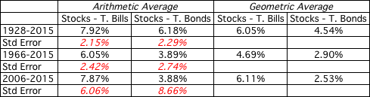
Equity Risk Premium
77
Historical premium is premium stocks historically earned over riskless securities.
Sensitive to
  How far back you go in history…
  Whether you use T. bill rates or T. bond rates
  Whether you use geometric or arithmetic averages.
US:

Slide 78
The perils of trusting the past…….
78
Noisy estimates:
  Substantial standard error
  Go back to 1928 (80 years of history) and assume a standard deviation of 20% in annual stock returns, standard error of greater than 2%:
Standard Error in Premium = 20%/√80 = 2.26%
Survivorship Bias: Historical data from the U.S. equity markets over the twentieth century creates sampling bias.

Slide 79
Beta Strategies
Historical Beta
Bottom-Up Beta
Accounting Beta

Slide 80
Historical Beta

Slide 81
Estimating Beta
Standard procedure for betas regress stock returns (R_{j}) against market returns (R_{m}):
    where a is the intercept and b is the slope of the regression.
The slope of the regression corresponds to the beta
Measures:
  Beta
  Alpha
  R²
  Other, e.g., standard error
This beta has three problems:
  It has high standard error
  It reflects the firm’s business mix over the period of the regression, not the current mix
  It reflects the firm’s average financial leverage over the period rather than the current leverage.

Slide 82
Estimating Beta
Parameters
  Time period
  Return Interval
  Market Index

Slide 83
Solutions to the
Regression Beta Problem
Modify the regression beta by
  Changing the index used to estimate the beta
  Adjusting the regression beta estimate with fundamentals of the company
Estimate the beta for the firm using
  The standard deviation of prices instead of a regression against an index
  Accounting earnings or revenues, which are less noisy than market prices.
Estimate the beta for the firm from the bottom up without employing the regression technique. This will require
  Understanding the business mix of the firm
  Estimating the financial leverage of the firm
Use an alternative measure of market risk not based upon a regression.

Slide 84
Bottom-Up Beta

Slide 85
Determinants of Betas
Business/Fundamental Beta (β_{F})
+ Operating Leverage
= Unlevered Beta (β_{U})
+ Financial Leverage
= Levered Beta (β_{L})

Slide 86
Operating Leverage
Function of Fixed vs. Variable Costs

Slide 87
Financial Leverage
Function of Debt vs. Equity

Slide 88
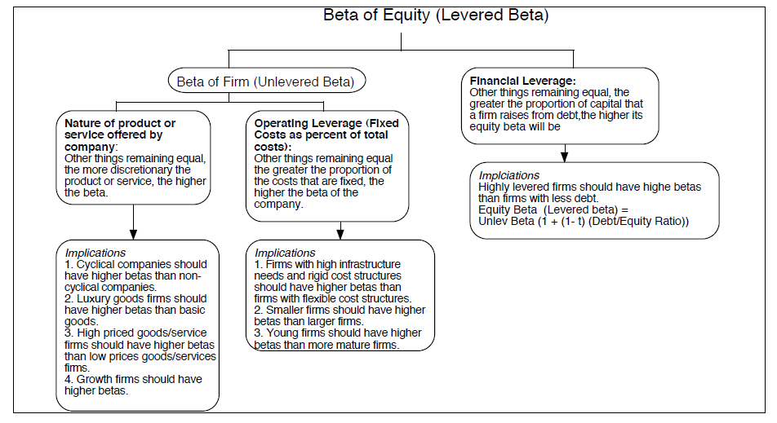
Determinants of Betas

Slide 89
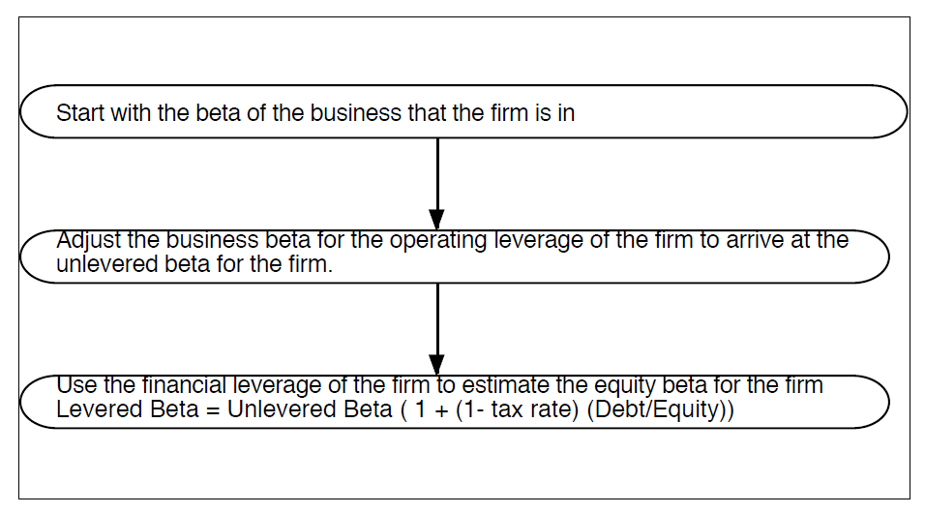
In a Perfect World, We Would Estimate the Beta of a Firm by Doing the Following...

Slide 90
Adjusting for Operating Leverage…
Firms with lower fixed costs should have lower unlevered betas.
  If you can compute fixed and variable costs for each firm in a sector, you can break down the unlevered beta into business and operating leverage components.
Information difficult on fixed and variable costs for individual firms.
In practice, assume that the operating leverage similar and use the same unlevered beta for every firm.

Slide 91
Adjusting for Financial Leverage…
Conventional approach: Assume that debt carries no market risk (beta of zero)
Debt Adjusted Approach: Estimate the beta of debt, you can estimate the levered beta as follows:
While the latter is more realistic, estimating betas for debt difficult

Slide 92
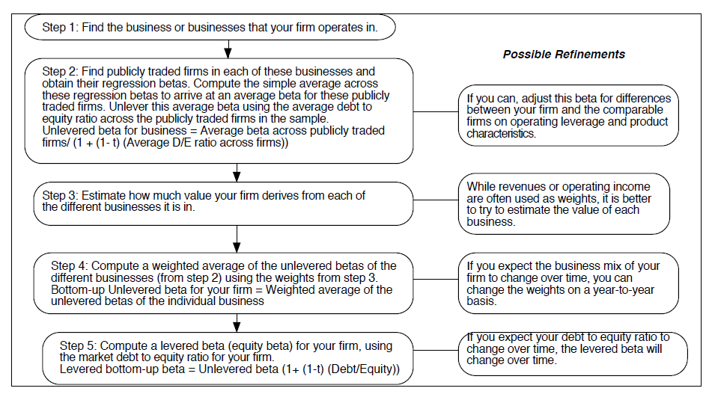
Bottom-Up Betas

Slide 93
Why Bottom-Up Betas?
The standard error in a bottom-up beta will be significantly lower:
The bottom-up beta can be adjusted to reflect changes in the firm’s business mix and financial leverage.
You can estimate bottom-up betas even when you do not have historical stock prices.

Slide 94
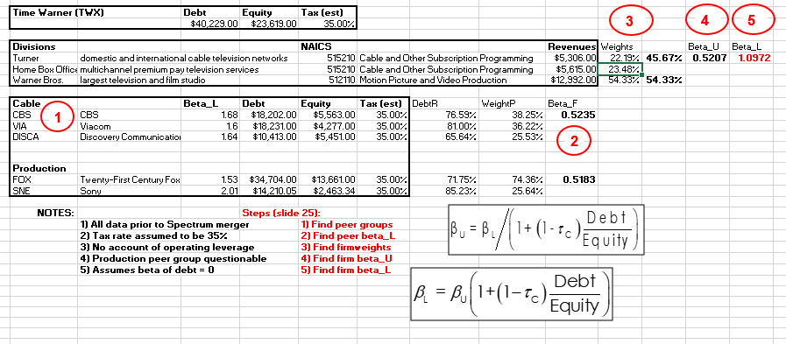
Bottom-Up Beta: Time Warner

Slide 95
Accounting Beta

Slide 96
Accounting Betas
Key Measure
  Change in Firm Earnings vs Change in Market Earnings
  This replaces stock return vs market return in historical approach
Advantages
  Use when historical prices unavailable or unreliable
  Can be applied at the division level

Slide 97
Accounting Betas Problems
Accounting earnings smoothed
  Expensing over time
  Closer to 1 than historical betas
Influenced by nonoperating factors
  depreciation or inventory methods
  allocations of corporate expenses at the divisional level
Measured quarterly (or annually)
  Fewer data points

Slide 98
Strategy Comparison
Historical Betas
  Standard error
  Input parameters
Bottom-Up Betas
  Incorporate changes in business and financial mix
  Use average betas across large numbers of firms
  Calculate betas by area of business for a firm,
Accounting Betas
  Problems (see above)

Slide 99
7. Final Calculation

Slide 100
FCFE Steps: Final Calculation
2) Growth Rates
1) FCFE₀
3) FCFE₁ FCFE₂ FCFE₃…
4) TV
6) PV
5) Discount Rate

Slide 101
Discounted Cash Flow Models (DCF)
The value of any asset should be the present value of all expected cash flows.

Slide 102
FCFE Models
FCFE says equity should equal PV of all expected FCFE:
  V = current value of equity
  FCFE_{t} = Free cash flow to equity at t
  k = equity required rate of return

Slide 103
FCFE Models
NOTE: FCFE can be done either on a
  Total firm basis (market value of equity)
  Per share basis (share price)

Slide 104
FCFE Applications
Constant Model
  FCFE remain constant
Growth Model
  FCFE change at a constant rate
Mixed/Multistage Model
  FCFE change at different rates.

Slide 105
Constant FCFE
Value the equity as a perpetuity of dividends:
    V = value/price of equity
    FCFE = constant FCFE
    k = equity required rate of return

Slide 106
Constant Growth FCFE
Value the equity as a perpetuity of growing FCFE:
    k = Equity required rate of return
    g = FCFE growth rate
NOTE: g can be negative.

Slide 107
Mixed Model Strategy
Typically the growth in FCFE is more complicated:
  Short Term Prediction/Horizon
  Long Term Prediction/Horizon
Short Term Long Term
0
1
2
3
4
FCFE ₀
FCFE ₁
FCFE ₂
FCFE₃
FCFE₄

Slide 108
Mixed Model: Short Term
Period over which we can reasonably estimate the expected FCFE:
  As specific dollar amounts, or
    E.g., $4.00 $4.15 $4.25 $4.90 (in millions)
  As subject to some growth forecast
    E.g., $4.00 growing at 10% for 4 years

Slide 109
Mixed Model: Long Term
Period over which we cannot predict FCFE.
We cannot ignore the long term,
  For many firms the long term provides much of the value of the firm.
    NOTE: The more value is derived from the future, the harder to use the FCFE as a method.

Slide 110
The Long Term Solution
Estimate the long term FCFE as growing at a reasonable, constant growth rate.
  Estimate as constant or growing perpetuity.
  Infinite growth rate cannot be very large.
  One good estimate is the long term growth for the economy, perhaps 3 or 4%.

Slide 111
Calculations
Value of the short term FCFE is PV of the individual FCFE.
2) Value of the long term FCFE as a delayed growing perpetuity.
  NOTE: It is a delayed growing perpetuity because the long term FCFE do not begin until after the short term FCFE end.
3) Equity = PV_{short term} + PV_{long term}

Slide 112
Mixed Model Example
EXAMPLE
  Last year, a firm had a FCFE of $2 million. It is expected to grow at a rate of 30% for one year, 20% for the next two years, then level off to a long term growth rate of 3%. If the discount rate is 12%, what should be the price of equity?

Slide 113
Mixed Model Example II
Data:
  FCFE₀ = 2
  g₁ = 30%
  g₂₋₃ = 20%
  g₄₊ = 3%
  k = 12%

Slide 114
Mixed Model Example III
Data
  FCFE₀ = 2; g₁ = 30%; g₂₋₃ = 20%; g₄₊ = 3%; k = 12%
FCFE Calculation
FCFE₁ = 2(1.30) = 2.60
FCFE₂ = 2(1.30)(1.20) = 3.12
FCFE₃ = 2(1.30)(1.20)² = 3.74
FCFE₄ = 2(1.30)(1.20)² (1.03) = 3.85
etc.

Slide 115
Mixed Model Example IV
The Timeline
Short Term Long Term
0
1
2
3
4
FCFE₀
FCFE₁
FCFE₂
FCFE₃
FCFE₄
2.00
2.60
3.12
3.74
3.85

Slide 116
Mixed Model Example V
EXAMPLE
  Data: FCFE₀ = 2; g₁ = 30%; g₂₋₃ = 20%; g₄₊ = 3%; k = 12%
  Short Term
FCFE₁ = 2.60 FCFE₂ = 3.12 FCFE₃ = 3.74

Slide 117
Mixed Model Example VI
EXAMPLE
  Data: FCFE₀ = 2; g₁ = 30%; g₂₋₃ = 20%; g₄₊ = 3%; k = 12%
  Long Term
FCFE₄ = 3.85

Slide 118
Mixed Model Example VII
EXAMPLE
  Data: FCFE₀ = 2; g₁ = 30%; g₂₋₃ = 20%; g₄₊ = 3%; k = 12%
or
Short Term Long Term

Slide 119
Mixed Model Formula

