Slide 1
FIN 440: International Finance
Topic 1–Introduction
Larry Schrenk, Instructor

Slide 2
Overview
Course Introduction
Similarities
Differences
Trends

Slide 3
1. Course Introduction

Slide 4
Introduction
FIN 440: International Finance
Larry Schrenk, Instructor
Course Page
http://larryschrenk.com/FIN440/FIN440.htm
Syllabus (Next Class)

Slide 5
Contact Information
Office: Somsen 319F
Telephone 507-457-2388
E-Mail
lschrenk@winona.edu
Webpage
http://larryschrenk.com/

Slide 6
Learning Objectives
Decide whether this is this the appropriate course for you.
Understand the importance of international finance.
Explain the features unique to international finance.

Slide 7
Office Hours
Office Hours
8:00-9:00 AM MWF
11:00 AM-12:00 N MWF
1:00-2:00 PM MWF
Somsen 319F
On Campus Policy

Slide 8
Financial Calculator
Acceptable Calculators:
TI 83/84 Graphing
TI BA II Plus, HP 10BII, HP 10BII+
If you want to use a different calculator, see me
Three Methods:
Tables
Formulae
Calculator
On NOT becoming an expert with a financial calculator

Slide 9
Evaluation
Exams (60%)
Group Excel Assignments (20%)
Group Case (20%)

Slide 10
Exams
Two Exams (30% each)
No Crib Sheets, Formulae Sheets, Etc.
Due dates will be on Schedule Page

Slide 11
Exam Format
Format
100 Points
Short Answer: 10 Questions (50%)
Calculation: 5 Questions (50%)
Not Cumulative
But Later Material Builds on Earlier!

Slide 12
Group Work
Group Excel Assignments
Group Case
Due dates on Schedule Page

Slide 13
Schedule
Introduction and FX Markets
Quotations
Triangular Arbitrage
Parity Relationships
International Investments
International Financial Management

Slide 14
2. About the Course

Slide 15
About Me
?????
Home Page

Slide 16
About You
Introductions
Pairs
Index Cards

Slide 17
About the Course
Teaching Approach
http://www.youtube.com/watch?v=c00GPvns31U

Slide 18
Note Taking Skills
Here are some web sites that will help, if you want to improve your note taking:
http://www.lifehack.org/articles/productivity/student-guide-effective-note-taking.html
http://www.artofmanliness.com/2012/01/27/write-this-down-note-taking-strategies-for-academic-success/
http://www.techlearning.com/Default.aspx?tabid=67&EntryId=3858
http://www.law.harvard.edu/current/student-services/taking_notes.pdf

Slide 19
Why Study International Finance? Your Career
“The number of CEOs with international experience rose in 2004 to 33 percent from 30 percent in 2003 and 21 percent in 2002. Among the top 100 CEOs, 41 percent have spent time abroad.” source
“The Global CEO: Overseas Experience is Becoming a Must on Top Executives' Resumes.” source

Slide 20
A Simple Example
Your firm plans to sell $1 million in products to a firm in England, the pound is currently valued at $2.00, and payment will be made in 3 months–so your buyer is expecting to pay £500,000 in 3 months.
Where is the exposure to foreign exchange risk?
The risk is that the rate of exchange will change between now and the date of payment.

Slide 21
Who will Bear the Risk?
There are three possibilities:
You bear it by accepting a payment of £500,000 in 3 months.
The buyer could bear it by agreeing to pay $1,000,000 in 3 months.
You could hedge the risk by entering a contract to receive $1,000,000 for £500,000 in 3 months.
What are the implications of each choice?

Slide 22
2. Similarities

Slide 23
Similarities
The basics principles of finance apply to international finance:
NPV and IRR Rules
Stockholder Wealth Maximization
Benefits of Diversification
Etc.

Slide 24
3. Differences

Slide 25
Differences
Political Risk
Increased Opportunity Set
Market Imperfections
Foreign Exchange Risk

Slide 26
A. Political Risk
Description: The possibility that sovereign governments makes unexpected changes in:
The movement of goods, capital, and people across their borders
The regulatory framework
Tax rates and codes
Etc.

Slide 27
Political Risk: Measures

Slide 28
Political Risk: Management
Difficulties:
Idiosyncratic
Measurability
Prediction
Hedging

Slide 29
B. Increased Opportunity Set
Description: Possibility of additional investments, markets, sources of capital, etc.
Possible Benefits
Investments: Higher Return, More Diversification
Markets: Greater Selling Potential
Capital: Lower Cost of Capital
Human Capital: More Resources

Slide 30
International Correlation
– Meric, Ilhan and Gulser Meric. “Correlation Between the World's Stock Markets Before and After the 1987 Crash.” Journal of Investing 7.3 (Fall 1998): 67 f.

Slide 31
C. Market Imperfections
Description: Any condition that restricts the free flow of trade, capital, investment, profits, etc.
Political: Corruption
Legal/Regulatory: Discriminatory Taxes
Social Culture: Attitudes to Inflation
Business Culture: Alternate Goals

Slide 32
D. Foreign Exchange Risk
Description: The possibility that the value of an investment, cash flow, return, etc. might change due to changes in exchange rates for currencies.

Slide 33
Some Historical Data

Slide 34
4. Trends

Slide 35
Trends
Global Financial Markets
The Euro (€)
Liberalization and Integration
Privatization

Slide 36
A. Global Financial Markets
Description: Inter-country integrated capital and financial markets with minimal trade barriers.
Financial Innovation
Technology: Computers + Internet
Electronic Trading
24/7 Trading

Slide 37
The ‘Big Bang’

Slide 38
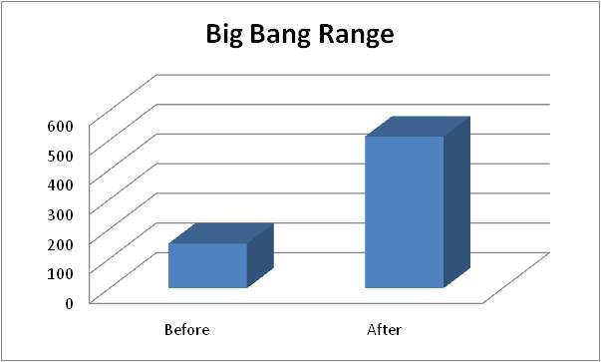
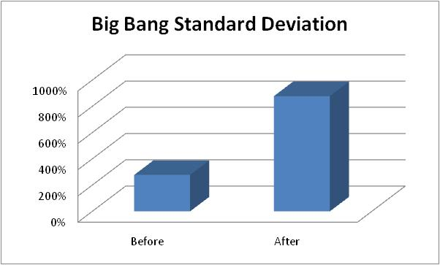
The ‘Big Bang’

Slide 39
B. The Euro (€)
Integration
European Central Bank (ECB)
Unified Monetary Policy
Macroeconomic Stability
National Inflexibility
Currency Risk
Transaction Costs

Slide 40
The Eurozone
Austria
Belgium
Cyprus
Finland
France
Germany
Greece
Greece
Ireland
Italy
Luxembourg
Malta
The Netherlands
Portugal
Slovenia
Spain

Slide 41
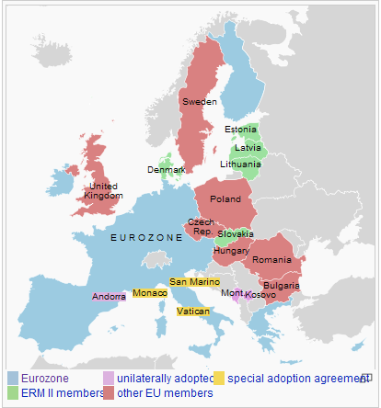
The Eurozone

Slide 42
Benefits and Costs of the Euro
Benefits
Reduce Transaction Costs
Eliminate FX Uncertainty
Costs
No National Monetary Policy
No National FX Control
Asymmetric Shocks

Slide 43
C. Liberalization and Integration
Increased Trade
Reduced Tariffs
Competitive Advantage
Organizations
General Agreements on Tariffs and Trade (GATT)
World Trade Organization (WTO)

Slide 44
Exports

Slide 45
Exports

Slide 46
Tariffs

Slide 47
D. Privatization
Description: The transfer of ownership and control of a corporation from the state to private agents.
Various Degrees of Privatization
Governmental Revenues
Foreign Ownership
Multiple Processes
Corruption

Slide 48
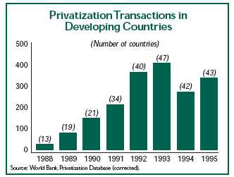
Privatization Trends

Slide 49
Privatization Trends
Dramatic rise in the number of privatizing countries, from 13 in 1988 to 43 in 1995.
Latin America 49% (Average Value $68 million)
East Asia 25% (Average Value $110 million)
Europe and Central Asia 17% (Average Value $11 million)
Other 12%
Mary M. Shirley. “Trends in Privatization.” Economic Reform Today 1 (1998): 8-10.

Slide 50
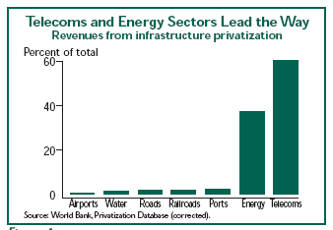
Privatization Trends

