Slide 1
FIN 440: International Finance
Topic 2–FX Market Overview
Larry Schrenk, Instructor

Slide 2
Syllabus
Questions???

Slide 3
Learning Objectives
Explain the structure and mechanisms of the FX market.
Explain the spot market.

Slide 4
Overview
FX
Transaction Types
Markets

Slide 5
1. FX

Slide 6
Motives
Tourism
Exports/Imports
Currency Demand to Buy Things
International Investment
Currency Demand to Invest

Slide 7
Abstract Theory 1: Purchasing Power
¥, £, or € have no purchasing power in U.S.
FX Market
Conversion of purchasing power from one currency into another
Market for Purchasing Power

Slide 8
Abstract Theory 2: Barter Exchange
Double Coincidence of Wants
Price Agreement
Clearing Function

Slide 9
FX Rates
Foreign Exchange (FX or Forex)
How much one currency is worth in terms of another?
Key Characteristics
Volatile
Uncertainty
Foreign Exchange Risk is
The possibility that the value of an investment, cash flow, return might change due to changes in exchange rates for currencies.

Slide 10
Mechanics
Virtual OTC Market
No Physical Market or Trading, No ‘Hub’
International, Distributed Network
24/7/365
Two Tier Market
First Tier: Ultimate Customer and Bank
Second Tier: Between Banks

Slide 11
Market Size and Volume
$5.3 trillion daily (BIS 2014)
Compare $120 billion per day in U.S. stocks
Trades of $500 million
Rates can change 20 times per minute
18,000 changes in a single day.

Slide 12
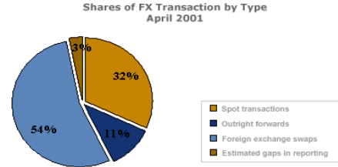
Market Breakdown Graph

Slide 13
Trading Regions
Australasia (Sydney, Tokyo, Hong Kong, Singapore)
Europe (London, Paris, Amsterdam, Frankfurt)
North America (New York, Montreal, Toronto, San Francisco, Chicago, Los Angeles)

Slide 14
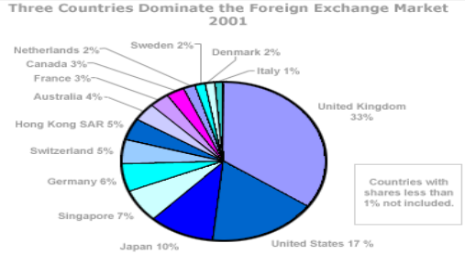
Geographic Trading Volume

Slide 15
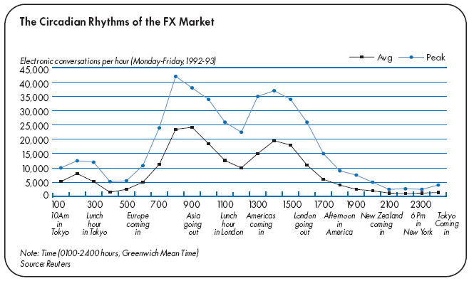
24 Hour Cycle

Slide 16
Participants
Banks and Other Financial Institutions
Two-thirds of all FX transactions involve banks dealing directly with each other (2nd Tier).
Customers
Brokers
Central Banks

Slide 17
2. Transaction Types

Slide 18
Transaction Types: Spot
Spot Transaction: Immediate Delivery (2 days)
A trader calls another trader and asks for a price of a currency.
The second trader provides the first trader with prices for both buying and selling (two-way price).
When the traders agree to do business, one will send pounds and the other dollars.

Slide 19
Transaction Types: Forward
Forward Transaction: Future Delivery
A buyer and seller agree on an exchange rate for a date in the future .
The transaction occurs on that date at the agreed upon exchange rate, regardless of what the market rates are at that time.

Slide 20
Transaction Types: Derivative, e.g., Swap
Swap Transaction
U.S. company needs 15 million Japanese yen for a three-month investment in Japan.
It may agree to a rate of 150 yen to a dollar and swap $100,000 with a company willing to swap 15 million yen for three months.
After three months, the U.S. company returns the 15 million yen to the other company and gets back $100,000, with adjustments made for interest rate differentials.

Slide 21
3. Markets

Slide 22
Currencies
Iraqi Dinar
Swiss Franc
Romanian Lei
Thai Bhat

Slide 23
Major Currencies
Euro EUR €
US Dollar USD $
Canada Dollar CAD C$
Australian Dollar AUD A$/AU$
British Pound (Sterling) GBP £
Japanese Yen JPY ¥
Swiss Franc CHF CHF

Slide 24
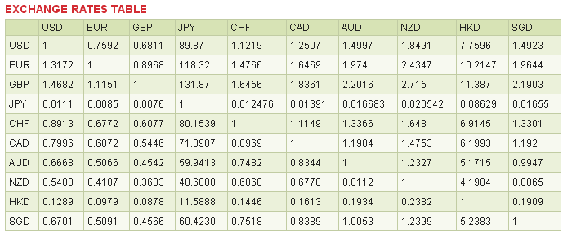
The Spot Market

Slide 25
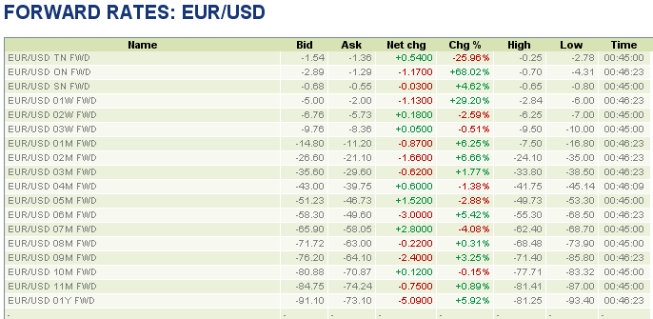
The Forward Market

Slide 26
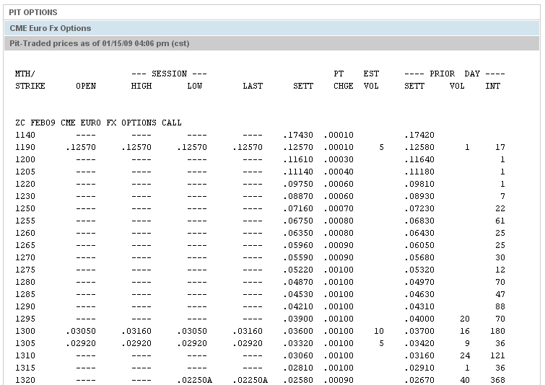
Option Markets

Slide 27
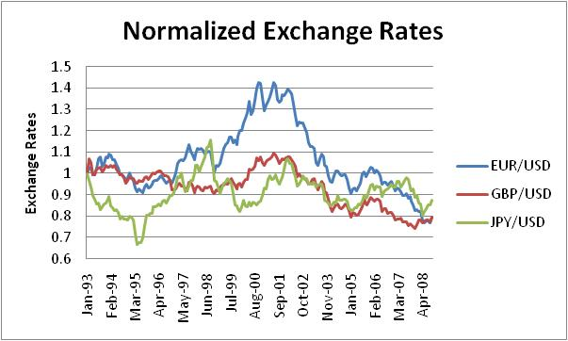
Volatility

Slide 28
Determination of Foreign Exchange Rates
Business Cycles
Political Developments
Stock Market News
Inflationary Expectations
International Investment Patterns
Government and Central Bank Policies
NOTE: Connect to Exports/Imports and Investments

