Slide 1
FIN 440: International Finance
Topic 17–International Banking and Money Markets
Larry Schrenk, Instructor

Slide 2
Learning Objectives
Describe the Motives for International Banking
Delineate the Types of Services Provided by International Banks
Explain International Money Markets and its Major Instruments
Designate Recent International Financial Crises

Slide 3
Overview
Overview of Banking
Reasons for International Banking
Types of International Banking Offices
Capital Adequacy Standards
International Money Market
Financial Crises
International Debt Crisis
Japanese Banking Crisis
The Asian Crisis
Global Financial Crisis

Slide 4
1. Overview of Banking

Slide 5
Banking in the Economy
Financial System
Financial Intermediaries
Risk Sharing
Liquidity
Information
Asset Transformation/Pooling

Slide 6
Banking History
First Bank of the US (1789)
Second Bank of the US (1816)
Free Banking (1837-1866)
National Banking Act (1863)
National Currency
Federal Reserve System (1913)

Slide 7
Federal Reserve
Supervise and regulate member banks and to help banks serve the public efficiently
Clearinghouse
All national banks are required to join
United States divided into 12 districts with a central Federal Reserve Bank in each district.

Slide 8
Types of Financial Services
Savings services
Payment services
Lending services
Electronic banking
Storage of valuables
Investment advice
Management of trusts

Slide 9
Bank Risks
Interest Rate Risk
Credit Risk

Slide 10
Balance Sheet
Bank Assets = Bank Liabilities + Bank Capital
Bank Capital = Bank Net Worth
High Leverage
Federal Deposit Insurance

Slide 11
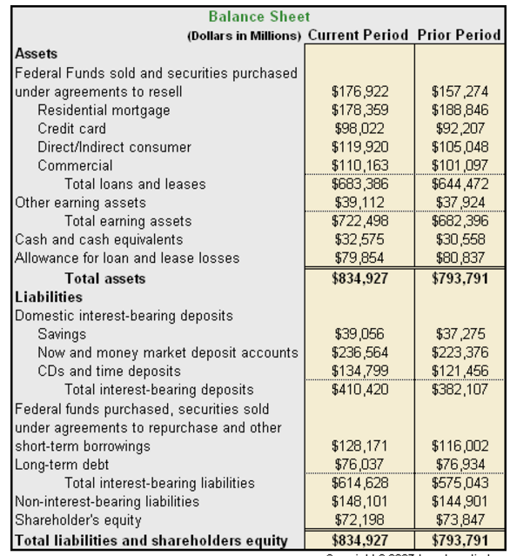
Balance Sheet

Slide 12
2. Reasons for International Banking

Slide 13
International Banking Services
International banks do everything domestic banks do and:
Arrange trade financing.
Arrange foreign exchange.
Offer hedging services for foreign currency receivables and payables through forward and option contracts.
Offer investment banking services (where allowed).

Slide 14
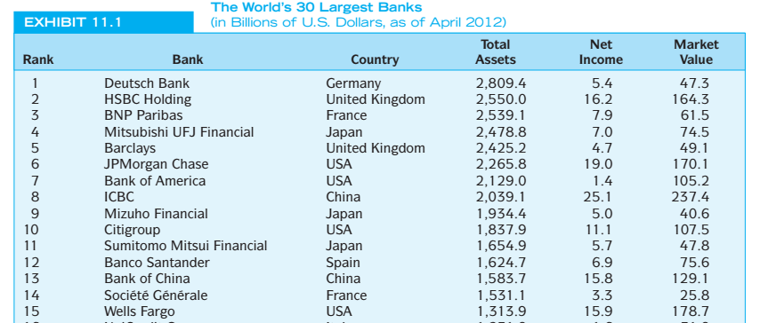
The World’s 15 Largest Banks (2012)

Slide 15
Reasons for International Banking
Low marginal costs
Managerial and marketing knowledge developed at home can be used abroad with low marginal costs.
Knowledge advantage
The foreign bank subsidiary can draw on the parent bank’s knowledge of personal contacts and credit investigations for use in that foreign market.
Home nation information services
Local firms in a foreign market may be able to obtain more complete information on trade and financial markets in the multinational bank’s home nation than is obtainable from foreign domestic banks.
Prestige
Very large multinational banks have high perceived prestige, which can be attractive to new clients.
Regulatory advantage
Multinational banks are often not subject to the same regulations as domestic banks.

Slide 16
Reasons for International Banking
Wholesale defensive strategy
Banks follow their multinational customers abroad to avoid losing their business at home and abroad.
Retail defensive strategy
Multinational banks also compete for retail services such as travelers checks and the tourist and foreign business market.
Transactions costs
Multinational banks may be able to circumvent government currency controls.
Growth
Foreign markets may offer opportunities for growth not found domestically.
Risk reduction
Greater stability of earnings with diversification.

Slide 17
3. Types of International Banking Offices

Slide 18
Types of International Banking Offices
Correspondent bank
Representative offices
Foreign branches
Subsidiary and affiliate banks
Edge Act banks
Offshore banking centers
“Shell” branches
International banking facilities

Slide 19
Correspondent Bank
A correspondent banking relationship exists when two banks maintain deposits with each other.
Correspondent banking allows a bank’s MNC client to conduct business worldwide through his local bank or its correspondents.
Notes:
Recall the examples from Chapter 5.

Slide 20
Representative Offices
A representative office is a small service facility staffed by parent bank personnel that is designed to assist MNC clients of the parent bank in dealings with the bank’s correspondents.
Representative offices also assist with information about local business customs and credit evaluation of the MNC’s local customers.

Slide 21
Foreign Branches
A foreign branch bank operates like a local bank, but is legally part of the parent.
Subject to both the banking regulations of home country and foreign country.
Can provide a much fuller range of services than a representative office.
Branch banks are the most popular way for U.S. banks to expand overseas.

Slide 22
Subsidiary and Affiliate Banks
A subsidiary bank is a locally incorporated bank wholly or partly owned by a foreign parent.
An affiliate bank is one that is partly owned but not controlled by the parent.
U.S. parent banks like foreign subsidiaries because they allow U.S. banks to underwrite securities.

Slide 23
Edge Act Banks
Edge Act banks are federally chartered subsidiaries of U.S. banks that are physically located in the U.S. and are allowed to engage in a full range of international banking activities.
The Edge Act was a 1919 amendment to Section 25 of the 1914 Federal Reserve Act.

Slide 24
Offshore Banking Centers
An offshore banking center is a country whose banking system is organized to permit external accounts beyond the normal scope of local economic activity.
The host country usually grants complete freedom from host-country governmental banking regulations.
The IMF recognizes the following as major offshore banking centers:
The Bahamas, Bahrain, the Cayman Islands, Hong Kong, the Netherlands Antilles, Panama, and Singapore.

Slide 25
“Shell” Branches
Shell branches need to be nothing more than a post office box.
The actual business is done by the parent bank at the parent bank.
The purpose was to allow U.S. banks to compete internationally without the expense of setting up operations “for real.”

Slide 26
International Banking Facilities
An international banking facility is a separate set of accounts that are segregated on the parents books.
An international banking facility is not a unique physical or legal identity.
Any U.S. bank can have one.
International banking facilities have captured a lot of the Eurodollar business that was previously handled offshore.

Slide 27
4. Capital Adequacy Standards

Slide 28
Capital Adequacy Standards
Bank capital adequacy refers to the amount of equity capital and other securities a bank holds as reserves.
Basel Accords
Three pillars of capital adequacy:
Minimum capital requirements
Supervisory review process
Effective use of market discipline
While traditional bank capital standards protect depositors from traditional credit risk, they may not be sufficient protection from derivative risk.
Barings Bank, which collapsed in 1995 from derivative losses, looked good on paper relative to the capital adequacy standards of the day.

Slide 29
Capital Adequacy Standards
The Basel II Accord has been endorsed by central bank governors and bank supervisors in the G10 countries.
Sets out the details for adopting a more risk sensitive minimum capital requirements.
The key variables the bank must estimate are the probability of default and the loss given default for each asset on their books.

Slide 30
Basel III
Original agreement 2010/11
Original Implementation 2013 to 2015
Current Implementation Target 2019???

Slide 31
Basel III: Capital Requirements
Capital Adequacy
4.5% of common equity (up from 2% in Basel II) of risk-weighted assets
Notes:
Tier 1 Capital ≈ common shares and retained earnings
Risk-Weighted Assets = assets and non-balance sheet items weighted by risk
Treasuries 0%
Mortgages 50%
Corporate Loans 100%

Slide 32
Basel III: Leverage Ratio
Minimum “Leverage Ratio“
6% for 8 Systemically important financial institution (SIFI) banks
Note:
Total Exposure = sum of the exposures of all assets and non-balance sheet items

Slide 33
Basel III: Liquidity Requirements
Liquidity Coverage Ratio
Total net cash outflows over 30 days

Slide 34
5. International Money Market

Slide 35
International Money Market
Eurocurrency is a time deposit in an international bank located in a country different than the country that issued the currency.
For example, Eurodollars are U.S. dollar-denominated time deposits in banks located abroad.
Euroyen are yen-denominated time deposits in banks located outside of Japan.
The foreign bank doesn’t have to be located in Europe.

Slide 36
Eurocurrency Market
Most Eurocurrency transactions are interbank transactions in the amount of $1,000,000 and up.
Common reference rates include:
LIBOR (London Interbank Offered Rate)
PIBOR (Paris Interbank Offered Rate)
SIBOR (Singapore Interbank Offered Rate)
A new reference rate for the new euro currency:
EURIBOR (the rate at which interbank time deposits of € are offered by one prime bank to another)
LIBOR Scandal

Slide 37
Eurocredits
Eurocredits are short- to medium-term loans of Eurocurrency.
The loans are denominated in currencies other than the home currency of the Eurobank.
Often the loans are too large for one bank to underwrite; a number of banks form a syndicate to share the risk of the loan.
Eurocredits feature an adjustable rate.
On Eurocredits originating in London the base rate is LIBOR.

Slide 38
Forward Rate Agreements
Hedges interest rate risk in mismatched deposits and credits
An interbank contract that involves two parties, a buyer and a seller.
The buyer agrees to pay the seller the increased interest cost on a notational amount if interest rates fall below an agreed rate.
The seller agrees to pay the buyer the increased interest cost if interest rates increase above the agreed rate.
Notes:
A forward rate agreement is basically a forward contract on a loan.

Slide 39
Forward Rate Agreements: Uses
Forward rate agreements can be used to:
Hedge assets that a bank currently owns against interest rate risk.
For example, a bank that has made a three-month Eurodollar loan against an offsetting six-month Eurodollar deposit could protect itself by selling a “three against six” FRA.
Speculate on the future course of interest rates.

Slide 40
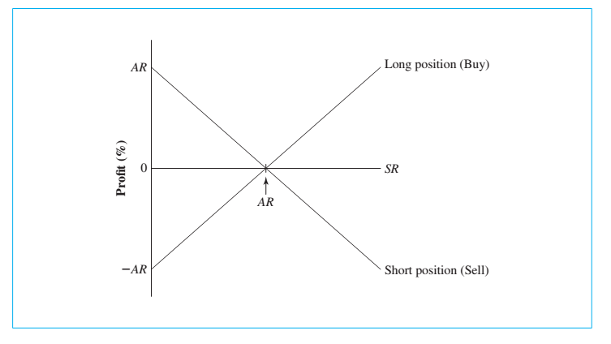
Forward Rate Agreements

Slide 41
Forward Rate Agreements: Example
A three against nine FRA is a 3-month forward contract on a six-month interest rate for a six-month period beginning three months from now.
0
1
2
3
4
5
6
7
8
9
Agreement period
FRA period (6 months)
(3 months)
Cash Settlement of FRA

Slide 42
Settling a Forward Rate Agreement
At the end of the agreement period, the loser pays the winner an amount equal to the present value of the difference between the settlement rate (SR) and the agreement rate (AR), sized according to the length of the agreement period and the notational amount.
days
Notational Amount × (SR – AR) ×
360
days
1 + SR ×
360

Slide 43
Settling a FRA
A €5,000,000, 4%, 3 against 9 FRA entered into January 1, 2014 has the following terms:
1/1/14
1
2
4
5
6
7
8
3/1/14
9/1/14
On 3/1/14 if the actual rate is 4% there is no payment.
184 days
Payment
184
€5,000,000 × (SR – 0.04) ×
360
If on 3/1/14 the SR = 5%
the seller pays the buyer €24,918.74.
184
1 + SR ×
360
If on 3/1/14 the SR = 3% the buyer pays the seller €25,169.62.
Notes:
€24,918.74 =[ €5,000,000 × (.05 – 0.04) × 184/360] / (1 + (.05 × 184/360))
A common mistake (for my American students at least) is
€47,619.05 =[ €5,000,000 × (.05 – 0.04) × 184/360] / ((1 + .05) × 184/360)
Or
€24,926.15 =[ €5,000,000 × (.05 – 0.04) × 184/360] / ((1 + .05) ^ (184/360)

Slide 44
Forward Rate Agreements
FRAs are designed so the buyer will have the same future value of interest expense (i.e., a perfect hedge at the agreed-up rate) for any value of LIBOR at maturity of the FRA.
Calculate the FV of interest expense
If LIBOR at expiration is 3 percent:
If LIBOR at expiration is 5 percent:
184
184
€5,025,169.62 x (1 + .03 x ) = €5m x ( 1 + .04 x )
360
360
€5,102,222.22 = €5,102,222.22
184
184
(€5m - €24,918.74)x(1 + .05 x ) = €5m x ( 1 + .04 x )
360
360
€5,102,222.22 = €5,102,222.22

Slide 45
Euronotes
Euronotes are short-term notes underwritten by a group of international investment banks or international commercial banks.
They are sold at a discount from face value and pay back the full face value at maturity.
Maturity is typically three to six months.

Slide 46
Eurocommercial Paper
Unsecured short-term promissory notes issued by corporations and banks.
Placed directly with the public through a dealer.
Maturities typically range from one month to six months.
Eurocommercial paper, while typically U.S. dollar denominated, is often of lower quality than U.S. commercial paper—as a result yields are higher.

Slide 47
Eurodollar Interest Rate Futures Contract
Widely used futures contract for hedging short-term U.S. dollar interest rate risk.
The underlying asset is a hypothetical $1,000,000 90-day Eurodollar deposit–the contract is cash settled.
Traded on the CME and the Singapore International Monetary Exchange.
The contract trades in the March, June, September, and December cycle.

Slide 48
Reading Eurodollar Futures Quotes
OPEN INT
OPEN
HIGH
LOW
SETTLE
CHG
YLD
CHG
Eurodollar (CME)—1,000,000; pts of 100%
Jun
96.56
96.58
96.55
96.56
-
3.44
1,398,959
-
Eurodollar futures prices are stated as an index number of three-month LIBOR calculated as F = 100 – LIBOR.
The closing price for the June contract is 96.56, thus the implied yield is 3.44 percent = 100 – 96.56.
Since it is a 3-month contract one basis point corresponds to a $25 price change: .01 percent of $1 million represents $100 on an annual basis.

Slide 49
6. Financial Crises

Slide 50
Five Principles
Avoid an undue concentration of loans to single activities, individuals, or groups
Expand cautiously into unfamiliar activities
Know your counterparty
Control mismatches between assets and liabilities
Beware that your collateral is not vulnerable to the same shocks that weaken the borrower

Slide 51
International Debt Crisis (1980s)
Some of the largest banks in the world were endangered when loans were made to sovereign governments of some less-developed countries.
19 less developed countries had debt out- standing equivalent to 53.6 percent of their GNP (1989)
At the height of the crisis, Third World countries owed $1.2 trillion.
Like many calamities, it is easy to see in retrospect that, it’s a bad idea to put too many eggs in one basket, especially if you don’t know much about that basket.

Slide 52
Debt Crisis and Oil
OPEC deposited nearly$100 billion in Eurodollar deposits by 1976
‘Petrodollar recycling’
OPEC raised oil prices in the late 1970s
Recession
Higher Interest Rates
Lower Commodity Prices
Deebt in Dollars

Slide 53
Debt-for-Equity Swaps
As part of debt rescheduling agreements among the bank lending syndicates and the debtor nations, creditor banks would sell their loans for U.S. dollars at discounts from face value to MNCs desiring to make equity investment in subsidiaries or local firms in the LDCs.
The LDC central bank would buy the bank debt from a MNC at a smaller discount than the MNC paid, but in local currency.
The MNC would use the local currency to make pre-approved new investment in the LDC that was economically or socially beneficial to the LDC.

Slide 54
Debt-for-Equity Swap Illustration
International Bank
Sell $100m LDC debt at 60% of face
$80m in local currency
$60m
LDC firm or MNC subsidiary
Equity Investor or MNC
Redeem LDC debt at 80% of face in local currency
$80m in local currency
LDC Central Bank

Slide 55
Japanese Banking Crisis
The history of the Japanese banking crisis is a result of a complex combination of events and the structure of the Japanese financial system.
Japanese commercial banks have historically served as the financing arm and center of a collaborative group know as keiretsu.
Keiretsu members have cross-holdings of one another’s equity and ties of trade and credit.

Slide 56
Japanese Banking Crisis
The collapse of the Japanese stock market set in motion a downward spiral for the entire Japanese economy and in particular Japanese banks.
This put massive amounts of bank loans to corporations in jeopardy.
It is unlikely that the Japanese banking crisis will be rectified anytime soon.
The Japanese financial system does not have a legal infrastructure that allows for restructuring of bad bank loans.
Japanese bank managers have little incentive to change because of the Keiretsu structure.

Slide 57
The Asian Crisis
This crisis followed a period of economic expansion in the region financed by record private capital inflows.
Bankers from the G-10 countries actively sought to finance the growth opportunities in Asia by providing businesses with a full range of products and services.
This led to domestic price bubbles in East Asia, particularly in real estate.
Additionally, the close interrelationships common among commercial firms and financial institutions in Asia resulted in poor investment decision making.
The Asian crisis is only the latest example of banks making a multitude of poor loans—spurred on by competition from other banks to make loans in the “hot” region.
Notes:
It is doubtful if the international debt crisis or the Asian crisis has taught banks a lasting lesson.

Slide 58
Global Financial Crisis
Officially began in the United States in December of 2007.
The origin of the credit crunch can be traced back to the low interest rate environment created by the Federal Reserve Bank in the early part of this century.
The fed funds target rate fell from 6.5 percent set on May 16, 2000, to 1.0 percent on June 25, 2003, and stayed below 3.0 percent until May 3, 2005.
Many banks and mortgage lenders lowered their credit standards to attract new home buyers who could afford to make mortgage payments at the current low interest rates, or “teaser” rates that were temporarily set at a low level during the early years of an adjustable-rate mortgage, but would likely reset to a higher rate later on.
Many of these home buyers would not have qualified for mortgage financing under more stringent credit standards, nor could they afford the loan at the eventual higher rates of interest.

Slide 59
Global Financial Crisis
These so-called subprime mortgages were typically not held by the originating bank making the loan, but instead were resold for packaging into mortgage-backed securities (MBSs).
Between 2001 and 2006, the value of subprime mortgages increased from $190 billion to $600 billion.
Conceptually, mortgage-backed securities make sense. Each MBS represents a portfolio of mortgages, thus diversifying the credit risk that the investor holds.
Structured Investment Vehicles (SIVs) have been one large investor in MBS. An SIV is a virtual bank, frequently operated by a commercial bank or an investment bank, but which operates off the balance sheet.

Slide 60
Global Financial Crisis
Typically, an SIV raises short-term funds in the commercial paper market to finance longer-term investment in MBSs and other asset-backed securities.
SIVs are frequently highly levered, with ratios of 10 to 15 times the amount of equity raised.
Since yield curves are typically upward sloping, the SIV might earn .25 percent by doing this. Obviously, SIVs are subject to the interest rate risk of the yield curve inverting (that is, short-term rates rising above long-term rates), thus necessitating the SIV to refinance the MBS investment at short-term rates in excess of the rate being earned on the MBS.
SIVs must contend with default risk. If the underlying mortgage borrowers default on their home loans, the SIV will lose investment value.

Slide 61
Global Financial Crisis
Collateralized Debt Obligations (CDOs) have been another big investor in MBS.
A CDO is a corporate entity constructed to hold a portfolio of fixed-income assets as collateral. The portfolio of fixed-income assets is divided into different tranches, each representing a different risk class: AAA, AA-BB, or unrated.
CDOs serve as an important funding source for fixed-income securities. An investor in a CDO is taking a position in the cash flows of a particular tranche, not in the fixed-income securities directly.
The investment is dependent on the metrics used to define the risk and reward of the tranche. Investors include insurance companies, mutual funds, hedge funds, other CDOs, and even SIVs. MBSs and other asset-backed securities have served as collateral for many CDOs.
Notes:
Tranche is the French word for “slice.”

Slide 62
Global Financial Crisis
To cool the growth of the economy, the Fed steadily increased the fed funds target rate at meetings of the Federal Open Market Committee, from a low of 1.00 percent on June 25, 2003, to 5.25 percent on June 29, 2006.
In turn, mortgage rates increased. Many subprime borrowers found it difficult, if not impossible, to make mortgage payments in a cooling economy, especially when their adjustable-rate mortgages were reset at higher rates.

Slide 63
Global Financial Crisis
When subprime debtors began defaulting on their mortgages, commercial paper investors were unwilling to finance SIVs. Liquidity worldwide essentially dried up.
The spread between the three-month Eurodollar rate and three-month U.S. Treasury-bills (the TED spread), frequently used as a measure of credit risk, increased from about 30 basis points in March 2007 to 200 basis points in November 2007, as investors became fearful of placing funds in even the strongest international banks.
Additionally, many CDOs found themselves stuck with the highest risk tranches of MBS debt, which they had not yet placed or were unable to place as subprime foreclosure rates around the country escalated.
Commercial and investment banks have been forced to write down over $170 billion of subprime debt to date, with as much as $285 billion expected.

Slide 64
Global Financial Crisis
Many lessons should be learned from the global financial crisis:
Credit rating agencies need to refine their models for evaluating esoteric credit risk created in MBSs and CDOs.
Borrowers must be more wary of putting complete faith in credit ratings.
Bankers seem to scrutinize credit risk less closely when they serve only as mortgage originators rather than the paper holders themselves.
As things have turned out, when the subprime mortgage crisis hit, commercial and investment banks found themselves exposed, in one fashion or another, to more mortgage debt than they realized they held.

