Slide 1
FIN 440: International Finance
Topic 18-Capital Structure
Larry Schrenk, Instructor

Slide 2
Learning Objectives
Understand the weighted average cost of capital (WACC).
Explain the three theories of Capital structure: Miller and Modigliani (no taxes), Miller and Modigliani (taxes), and financial distress.
Explain why costs of capital differs internationally and how to use this in financial decisions.

Slide 3
Overview
Capital Structure/Cost of Capital Review
International Issues
Cross-Border Listings

Slide 4
1. Capital Structure/Cost of Capital Review

Slide 5
Goal of the Firm
Maximize Firm Value
Minimize WACC
Lowering Risk
Increasing CFs
Maximize Operating Profits
Growth Business
Reduce Taxes

Slide 6
Business Risk versus Financial Risk
Business risk:
Uncertainty in future EBIT, NOPAT, and ROIC.
Depends on business factors such as competition, operating leverage, etc.
Financial risk:
Additional business risk concentrated on common stockholders when financial leverage is used.
Depends on the amount of debt and preferred stock financing.

Slide 7
Effects of Financial Leverage
Business risk:
The variability of future net cash flows attributed to the nature of the company’s operations (the risk faced by shareholders if the company is financed only by equity).
Financial risk:
The risk involved in using debt as a source of finance.
Effects of financial leverage:
Expected rate of return on equity is increased.
Variability of returns to shareholders increases.
Increasing leverage involves a trade-off between risk and return.
Notes:
5
5
5
5
5
5
5
5
5
5
5
5

Slide 8
Effects of Financial Leverage
Measures of financial leverage:
Debt to equity, debt to total assets, and interest coverage.
Leverage varies significantly between companies
Differences in leverage can be related to industry membership and asset type. For example, Computershare, which is a service company, relies much less on debt finance than Bluescope Steel, a steel manufacturer, and Amcor, a packaging manufacturer.
Since expected return and risk increase due to financial leverage, question arises as to whether the expected return is enough for the increase in risk — so that company value remains unchanged by leverage.
Notes:
6
6
6
6
6
6
6
6
6
6
6
6
6

Slide 9
Factors Affecting Capital Structure
Business Risk
Debt’s tax deductibility
Ability to raise capital under adverse terms
Managerial decisions:
Conservative vs. Aggressive
Minimize WACC

Slide 10
Capital Structure Effects
The impact of capital structure on value depends upon the effect of debt on:
WACC
FCF

Slide 11
Effect of Additional Debt on WACC
Debtholders have a prior claim on cash flows relative to stockholders.
Debtholders’ “fixed” claim increases risk of stockholders’ “residual” claim.
Cost of stock, r_{s}, goes up.
Firm’s can deduct interest expenses.
Reduces the taxes paid
Frees up more cash for payments to investors
Reduces after-tax cost of debt

Slide 12
The Effect on WACC (Continued)
Debt increases risk of bankruptcy
Causes pre-tax cost of debt, r_{d}, to increase
Adding debt increase percent of firm financed with low-cost debt (w_{d}) and decreases percent financed with high-cost equity (w_{s})
Net effect on WACC = uncertain.

Slide 13
Effect of Additional Debt on FCF
Additional debt increases the probability of bankruptcy.
Direct costs: Legal fees, “fire” sales, etc.
Indirect costs: Lost customers, reduction in productivity of managers and line workers, reduction in credit (i.e., accounts payable) offered by suppliers

Slide 14
Impact of Indirect Costs
NOPAT goes down due to lost customers and drop in productivity
Investment in capital goes up due to increase in net operating working capital (accounts payable goes down as suppliers tighten credit).

Slide 15
Debt and Managers
Additional debt can affect the behavior of managers.
Reductions in agency costs: debt “pre-commits,” or “bonds,” free cash flow for use in making interest payments. Thus, managers are less likely to waste FCF on perquisites or non-value adding acquisitions.
Increases in agency costs: debt can make managers too risk-averse, causing “underinvestment” in risky but positive NPV projects.

Slide 16
Weighted Average Cost of Capital
Average Cost for the Firm to Raise Capital

Slide 17
WACC: Inputs
Weights
Market versus Book
Historical versus Future
Cost of Debt
Similar Bonds
Cost of Equity
CAPM
Tax Rate
Implied from Financial Statements

Slide 18
Searching for the Appropriate Capital Structure
Cost of Capital
Debt Ratio
Interest payments on debt are tax deductible…
However, the tradeoff is that the probability of bankruptcy will rise as interest expenses increases.

Slide 19
Theories of Capital Structure and Cost of Capital
Miller and Modigliani (No Taxes)
Miller and Modigliani (Taxes)
Financial Distress

Slide 20
Miller and Modigliani (No Taxes)
Value of the Firm
Firm Value does not Change
Cost of Capital
Leverage increases the risk and return to stockholders
Implication
Capital Structure does not matter to Cost of Capital

Slide 21
MM Proposition II (No Taxes)
Cost of capital: R (%)
R₀
R_{B}
R_{B}
Debt-to-equity Ratio

Slide 22
Miller and Modigliani (Taxes)
Value of the Firm
Firm value increases with leverage
Cost of Capital
Some of the increase in equity risk and return is offset by the interest tax shield
Implication
Capital Structure does matter to the Cost of Capital → Maximum Debt

Slide 23
Miller and Modigliani (Taxes)
Cost of capital: R (%)
R₀
R_{B}
Debt-to-equity ratio (B/S)

Slide 24
Financial Distress
Value of the Firm
Firm value is concave leverage
Cost of Capital
Trade-off between debt and financial distress
Implication
Capital Structure does matter to the Cost of Capital → Optimal Debt Varies

Slide 25
Tax Effects and Financial Distress
Present value of tax shield on debt
Value of firm under MM with corporate taxes and debt
Value of firm (V)
Maximum firm value
Present value of financial distress costs
V = Actual value of firm
V_{U} = Value of firm with no debt
0
Debt (B)
B*
Optimal amount of debt

Slide 26
Other Theories
Signaling Theory
Pecking Order
Debt as Managerial Constraint
Windows of Opportunity

Slide 27
Implications
Take advantage of tax benefits by issuing debt, especially if the firm has:
High tax rate
Stable sales
Low operating leverage

Slide 28
Implications (Cont’d)
Avoid financial distress costs by maintaining excess borrowing capacity, especially if the firm has:
Volatile sales
High operating leverage
Many potential investment opportunities
Special purpose assets (instead of general purpose assets that make good collateral)

Slide 29
Implications (Cont’d)
If manager has asymmetric information regarding firm’s future prospects, then avoid issuing equity if actual prospects are better than the market perceives.
Always consider the impact of capital structure choices on lenders’ and rating agencies’ attitudes

Slide 30
2. International Issues

Slide 31
International Factors and MNCs
Preferential treatment from creditors & smaller per unit flotation costs
Larger size
Greater access to international capital markets
Possible access to low-cost foreign financing
Cost of capital
International diversification
Exposure to exchange rate risk
Probability of bankruptcy
Exposure to country risk

Slide 32
International WACC
cost of capital (%)
WACC _{local}
WACC _{global}
I_{global}
Investment ($)
I_{local}

Slide 33
Cost of Capital in Segmented vs. Integrated Markets
If capital markets are segmented, then investors can only invest domestically. This means that the market portfolio (M) in the CAPM formula would be the domestic portfolio instead of the world portfolio.
R_{i} = R_{f} + β_{i} (R_{U.S.} – R_{f})
^{U.S.}
versus
R_{i} = R_{f} + β_{i} (R_{W} – R_{f})
^{W}
Clearly integration or segmentation of international financial markets has major implications for determining the cost of capital.

Slide 34
International Cost of Capital Differences
Differences in different countries.
Markets are imperfect, so international financing can lower the firm’s cost of capital.
Internationalize the firm’s ownership structure.

Slide 35
Cost of Capital Across Countries
The cost of capital can vary across countries, such that:
MNCs based in some countries have a competitive advantage over others;
MNCs may be able to adjust their international operations and sources of funds to capitalize on the differences; and
MNCs based in some countries tend to use a debt-intensive capital structure.

Slide 36
Segmented Financial Markets
Capital markets become segmented because of such factors as
excessive regulatory control,
perceived political risk,
anticipated FOREX risk,
lack of transparency,
insider trading and other market imperfections.
Higher cost of capital for these markets!
Firms in segmented capital markets must devise a strategy to escape dependence on that market for their long-term debt and equity needs.

Slide 37
Local versus Global Market Access
Local Market Access
Firm-Specific Characteristics
Global Market Access
Firm’s securities appeal only
to domestic investors
Firm’s securities appeal to
international portfolio investors
Market Liquidity or Size on Financing Costs
Illiquid domestic securities market
or small domestic market
Higher financing costs
Highly liquid and large markets
with wide international participation
Lower financing costs
Market Segmentation on Firm’s Securities and Cost of Capital
Segmented domestic securities
market that prices shares
according to domestic standards
Access to global securities market
that prices shares according to
international standards

Slide 38
Country Differences in the Cost of Debt
A firm’s cost of debt is determined by:
The prevailing risk-free interest rate of the borrowed currency, and
The risk premium required by creditors.
The risk-free rate is determined by the interaction of the supply of and demand for funds. It is thus influenced by tax laws, demographics, monetary policies, economic conditions, etc.

Slide 39
International Debt
MNC can use more debt due to diversification
Borrowing in local currency helps to reduce exchange rate risk
Borrowing in local currency can reduce cost of debt
Allow subsidiary to exceed parent capitalization norm if local market has lower costs
Possibility of government subsidized debt

Slide 40
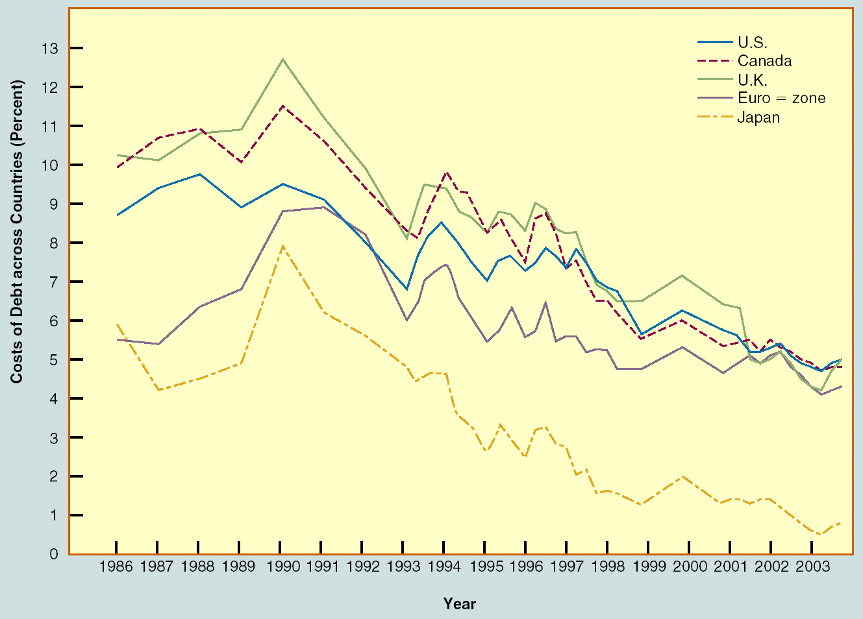
Cost of Debt Across Countries

Slide 41
Political Risk
Should there be a country risk premium?
Estimates
Historical Premium
Modified Historical Risk Premiums
Measuring Country Risk Premiums

Slide 42
Historical Premium
Historical stock/bond spread
Problems
Noise/Standard Error
Not Stable over Time
Limited Data
Emerging Markets

Slide 43
Modified Historical Premium
Equity Risk Premium
= Base Premium for Mature Equity Market
+ Country Equity Risk
Base Premium
US for Base Premium
Stock/Bond Spread
Country Risk
Country Debt Rating as Proxy
Numerical Country Risk Scores

Slide 44
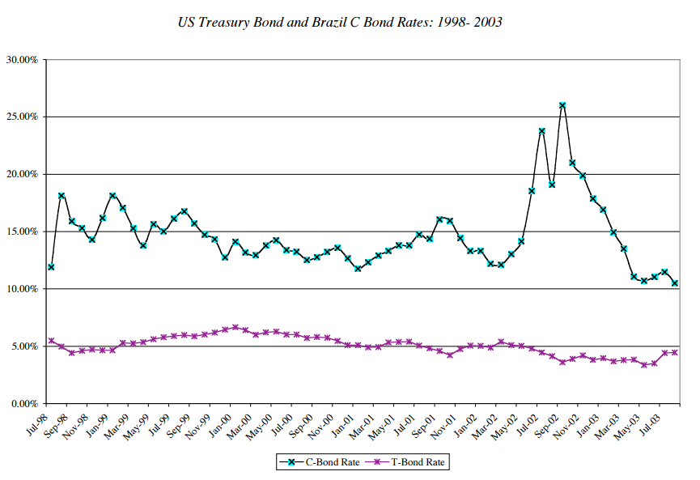
Country Risk Premiums
Spread between Dollar Denominated Bonds and Risk-Free Rate

Slide 45
3. Cross-Border Listings

Slide 46
Benefits of Cross-Border Listings of Stocks
The company can expand its potential investor base, which will lead to a higher stock price and lower cost of capital.
Cross-listing creates a secondary market for the company’s shares, which facilitates raising new capital in foreign markets.
Cross-listing can enhance the liquidity of the company’s stock.
Cross-listing enhances the visibility of the company’s name and its products in foreign marketplaces.

Slide 47
Costs of Cross-Border Listings of Stocks
Disclosure and listing requirements imposed by the foreign exchange and regulatory authorities.
Volatility spillover from these markets.
Foreigners might acquire a controlling interest and challenge the domestic control of the company.

Slide 48
The Effect of Foreign Equity Ownership Restrictions
Possible legal restrictions on the percentage of a firm that foreigners can own.
Means of ensuring domestic control of local firms.
Foreign and domestic investors many face different market share prices.
This dual pricing is the pricing-to-market phenomenon.

Slide 49
Asset Pricing under Foreign Ownership Restrictions
An interesting outcome is that the firm’s cost of capital depends on which investors, domestic or foreign, supply capital.
The implication is that a firm can reduce its cost of capital by internationalizing its ownership structure.

Slide 50
Nestlé’s Foreign Ownership Restrictions
12,000
10,000
Bearer share
8,000
SF
6,000
4,000
Registered share
2,000
0
11
20
31
9
18
24
Source: Financial Times, November 26, 1988 p.1. Adapted with permission.

Slide 51
An Example of Foreign Ownership Restrictions: Nestlé
Following this, the price spread between the two types of shares narrowed dramatically.
Major transfer of wealth from foreign to Swiss shareholders.
The price of bearer shares declined about 25 percent.
The price of registered shares rose by about 35 percent.
Because registered shares represented about two-thirds of the market capitalization, the total value of Nestlé increased substantially when it internationalized its ownership structure.
Nestlé’s cost of capital therefore declined.

Slide 52
Financial Structure of Subsidiaries: Three Approaches
Conform to the parent company's norm.
Conform to the local norm of the country where the subsidiary operates.
Vary judiciously to capitalize on opportunities to lower taxes, reduce financing costs and risk, and take advantage of various market imperfections.
In addition to taxes, political risk important

Slide 53
Local versus Global Target Capital Structure
An MNC may deviate from its “local” target capital structure when local conditions and project characteristics are taken into consideration.
If the proportions of debt and equity financing in the parent or some other subsidiaries can be adjusted accordingly, the MNC may still achieve its “global” target capital structure.

Slide 54
Local versus Global Target Capital Structure
For example, a high degree of financial leverage when the host country is in political turmoil, while a low degree when the project will not generate net cash flows for some time.
A capital structure revision may result in a higher cost of capital. So, an unusually high or low degree of financial leverage should be adopted only if the benefits outweigh the overall costs.

Slide 55
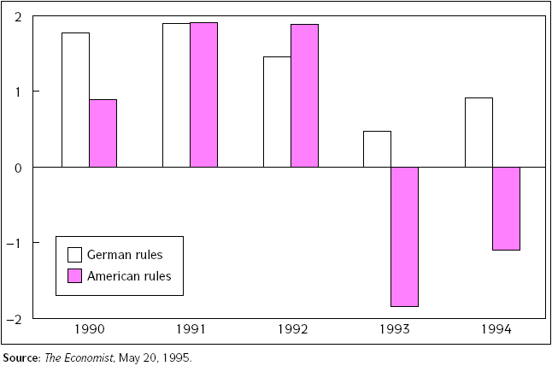
Cross-Border Listings of Shares
Cross-border listings of stocks do carry costs.
Daimler Benz’s net profit/loss (DM bn) German vs American Accounting rules

