Slide 1
Video 9 (Topic 2.3): Loan Amortization
FIN 614: Financial Management
Larry Schrenk, Instructor

Slide 2
Topics
What is an Amortized Loan?
The Amortization Schedule

Slide 3
What is an Amortized Loan?
Features
Regular Payments of Principal and Interest
The Principal is ‘amortized’
Constant Payments
Tax Implications for Mortgages
Alternatives
Interest Only Loans
Balloon Payments

Slide 4
Amortization Schedule
Describes
Payments
Opening and Closing Balances
Interest vs. Principle Payments
Payment Decomposition
Payments Constant
Ratio of Interest to Principal Payments Changes.
Beginning of Loan: Primarily Interest Payment
End of Loan: Primarily Principal Payment

Slide 5
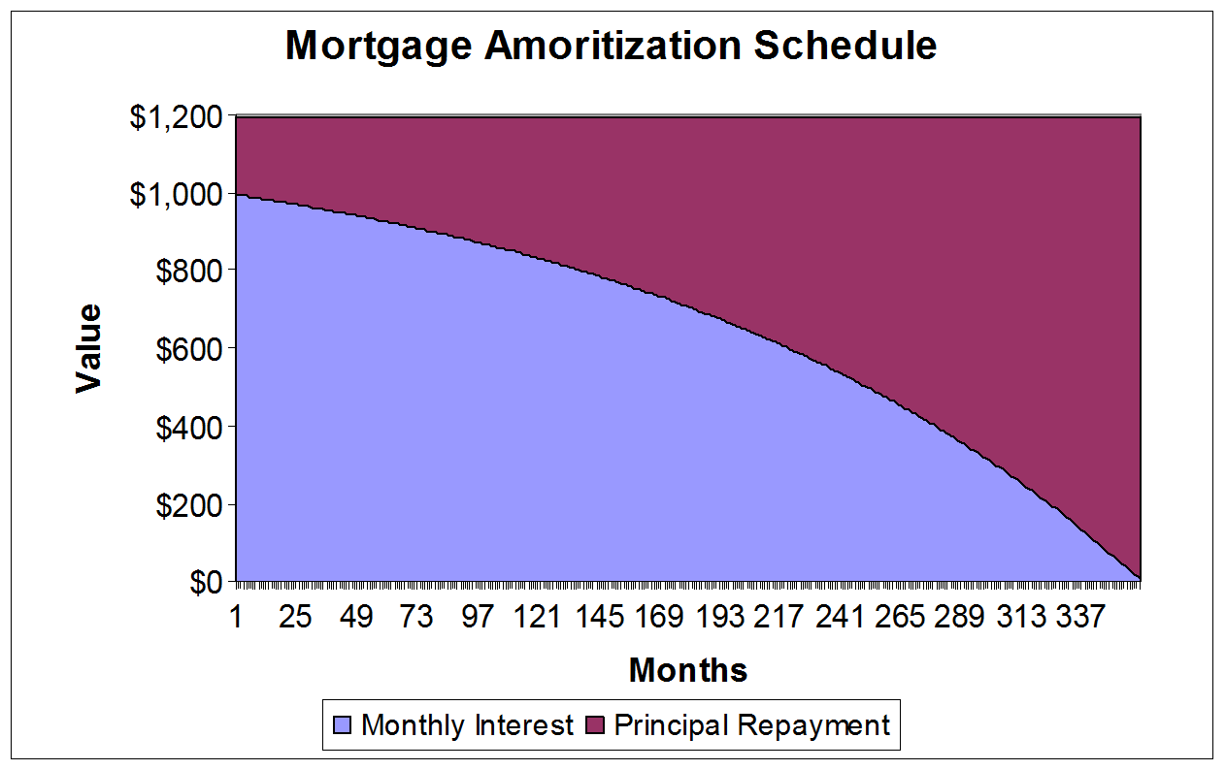
Example: Amortization Schedule

Slide 6
Amortization Calculation
Find Interest due on Balance.
Subtract Interest from Payment to get Principle.
Subtract Principle from Balance to get New Balance.

Slide 7
Amortization Example I
You borrowed $1,000 for 3 years at 8% with annual payments.
What is your payment each year?
PV Annuity Problem.
N = 3; I/Y = 8; PV = -1,000; PMT = $388.03; FV = 0

Slide 8
Amortization Example II
Interest
80.00
55.36
28.74
Principal
308.03
332.68
359.29
End Bal.
691.97
359.29
0
Year
1
2
3
Begin Bal.
1,000
691.97
359.29
Payment
388.03
388.03
388.03
Interest
80.00
55.36
28.74
Principal
308.03
332.68
359.29
End Bal.
691.97
359.29
0
Interest = Rate x Balance
1,000(0.08) = 80
691.97(0.08) = 55.36
359.29(0.08) = 28.74
Principal = Payment – Interest
388.03 – 80 = 308.03
388.03 – 55.36 = 332.68
388.03 – 28.74 = 359.29
Balance = Balance – Principal
1,000 – 308.03 = 691.97
691.97 – 332.68 = 359.29
359.29 – 359.29 = 0

Slide 9
Video 9 (Topic 2.3): Loan Amortization
FIN 614: Financial Management
Larry Schrenk, Instructor

